Slide 1
Towards Image Based Modelling of Composite Li-ion Electrodes
James Le Houx, Denis Kramer, Richard Wills

Slide 2
Contents
Research challenge
Why use an image-based model?
Imaging methods (μVis Laboratory)
Modelling Technique
Initial scaling results
Conclusion

Slide 3
Research Challenge
To develop an image based, multi-physics computational framework capable of modelling lithium ion batteries
Understand how thermal fields propagate through microstructure
Imaging of Li-ion electrode microstructure
Solution of multi-physics partial differential equations
Generate report to characterise battery performance

Slide 4
Bruggeman Correlation

Slide 5
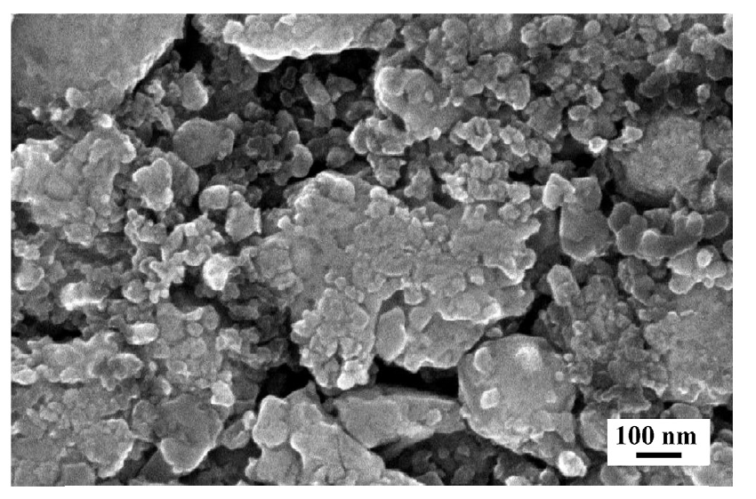
Bruggeman Correlation
Current Li-ion modelling assumes electrodes are homogenous structures through the use of the Bruggeman correlation
This correlation has been shown to be invalid for heterogeneous structures [2]
Figure 1: SEM image of a commercial lithium iron phosphate electrode [1]
[1]: Kashkooli, A. (2016) Multiscale Modeling of lithium-ion battery electrodes based on nano-scale X-ray computed tomography, Journal of Power Sources 307 496-509
[2]: Tjaden, B., Cooper, S. J., Brett, D. J., Kramer, D., & Shearing, P. R. (2016). On the origin and application of the Bruggeman correlation for analysing transport phenomena in electrochemical systems. Current opinion in chemical engineering, 12, 44-51.

Slide 6
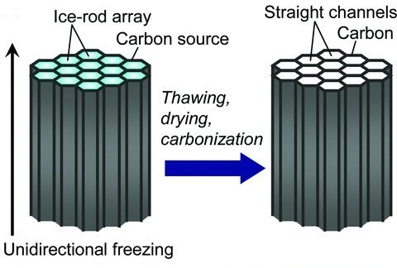
Structured Electrodes
Figure 1: Scheme of the ice-templating method [1]
[1]: Nishihara, H., & Kyotani, T. (2012). Templated nanocarbons for energy storage. Advanced Materials, 24(33), 4473-4498.
[2]: Lee, S. W., Yabuuchi, N., Gallant, B. M., Chen, S., Kim, B. S., Hammond, P. T., & Shao-Horn, Y. (2010). High-power lithium batteries from functionalized carbon-nanotube electrodes. Nature nanotechnology, 5(7), 531.

Slide 7
Imaging Methods
SEM has all been used in electrode analysis however they all miss 3D volumetric properties that are of interest to us. ~10nm
Focused Ion Beam (FIB) allows 3d volumetric properties in the nano-scale, but is a destructive method. ~5nm
X-ray tomography allows for the multiple length scales required whilst being a non-destructive imaging method. ~50nm

Slide 8
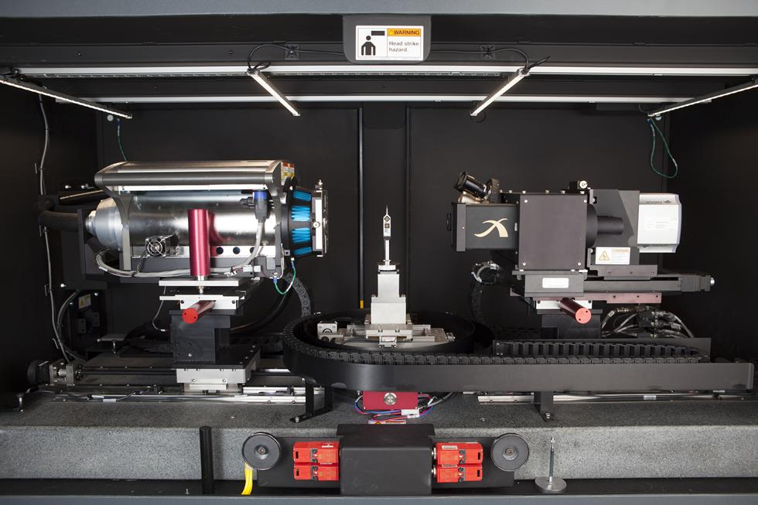
μVis Laboratory
Voxel Size: 70nm
Pixel Detector : 2048 x 2048
Figure 1: Photograph of the University of Southampton’s Zeiss 160 kVp Versa 510 [1]
[1] Zeiss 160 kVp Versa 510, μVis, https://www.southampton.ac.uk/muvis/about/equipment/versa.page Date Accessed: 10/06/18

Slide 9
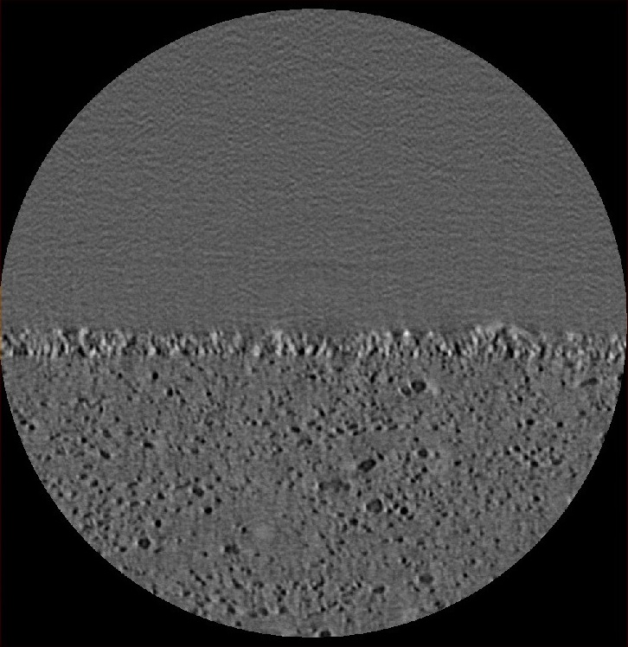
CT Imaging of Electrodes
Obtain tomography of electrode structure
Air
TiO₂
Carbon Polymer
50μm
Figure 1: Individual tomographic slice of a TiO₂ layer on a carbon polymer substrate, voxel size of 481nm

Slide 10
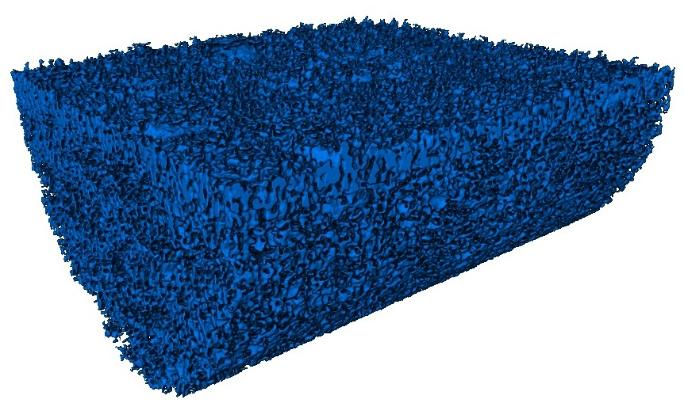
CT Imaging of Electrodes
Obtain tomography of electrode structure
Threshold the data into regions of interest through post-processing
50μm
Figure 1: Volumetric rendering of a thresholded TiO₂ layer on a carbon polymer substrate, ~10⁸ voxels, size of 481nm

Slide 11
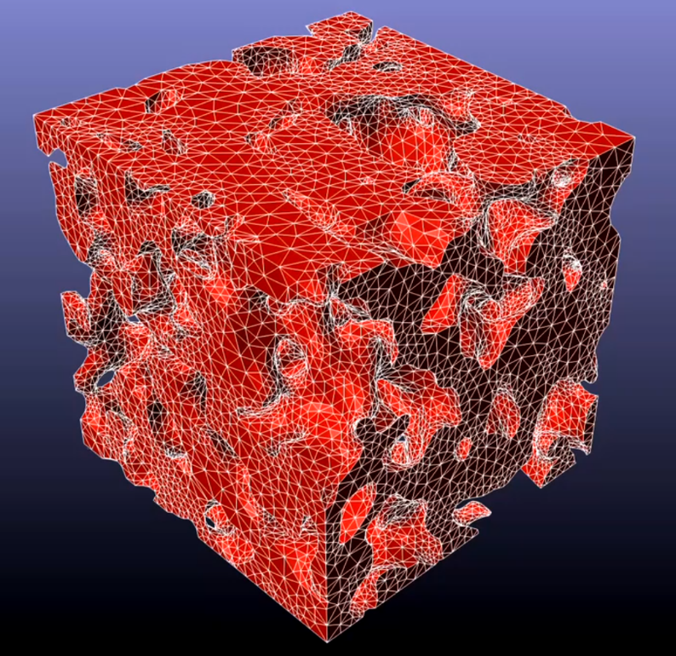
Similar Research
Sample Size: 750nm x 750nm x 750nm
Figure 1: Finite element mesh from Kashkooli’s simulation [1]
[1]: Kashkooli, A. (2016) Multiscale Modeling of lithium-ion battery electrodes based on nano-scale X-ray computed tomography, Journal of Power Sources 307 496-509
[2]: Cooper, S. J., Bertei, A., Shearing, P. R., Kilner, J. A., & Brandon, N. P. (2016). TauFactor: An open-source application for calculating tortuosity factors from tomographic data. SoftwareX, 5, 203-210.

Slide 12
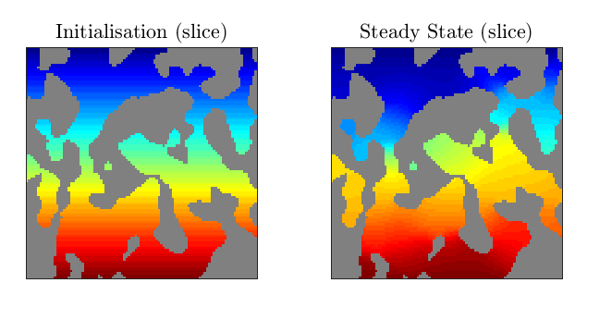
Similar Research
Figure 1: Tortuosity calculation from Taufactor [2]
[1]: Kashkooli, A. (2016) Multiscale Modeling of lithium-ion battery electrodes based on nano-scale X-ray computed tomography, Journal of Power Sources 307 496-509
[2]: Cooper, S. J., Bertei, A., Shearing, P. R., Kilner, J. A., & Brandon, N. P. (2016). TauFactor: An open-source application for calculating tortuosity factors from tomographic data. SoftwareX, 5, 203-210.

Slide 13
Finite Differences vs Finite Element
[1] Lecture 24 – Introduction to Variational Methods, CEM, https://www.youtube.com/watch?v=BddajYoBHiI Date Accessed: 19/03/18

Slide 14
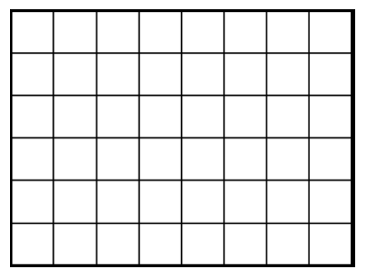
Types of Structured Mesh
Mesh Distortion (Biasing)
[1]: Guarrasi, M. (2015) An introduction to Adaptive Mesh Refinement (AMR): Numerical Methods and Tools, Supercomputing Applications and Innovation

Slide 15
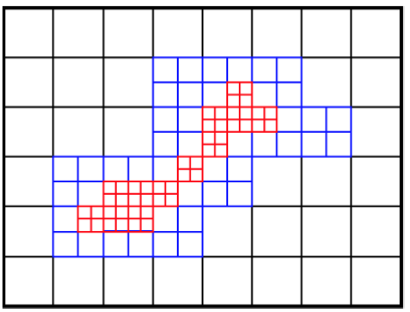
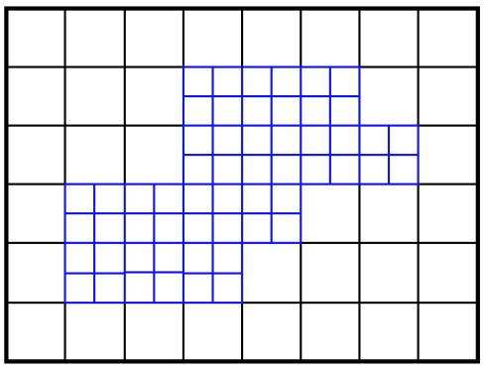
Types of Structured Mesh
Mesh Distortion (biasing)
Point-wise (tree based)
[1]: Guarrasi, M. (2015) An introduction to Adaptive Mesh Refinement (AMR): Numerical Methods and Tools, Supercomputing Applications and Innovation

Slide 16
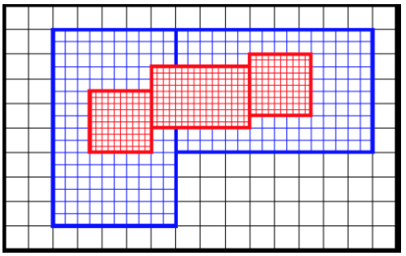
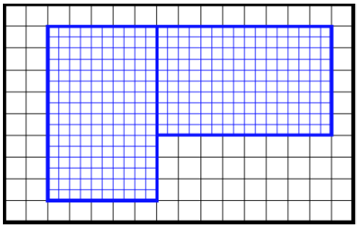
Types of Structured Mesh
Mesh Distortion (biasing)
Point-wise (tree based)
Block-structured
In block-structured AMR the solution is defined on a hierarchy of levels of resolution – a union of rectangular grids which can change dynamically.
[1]: Guarrasi, M. (2015) An introduction to Adaptive Mesh Refinement (AMR): Numerical Methods and Tools, Supercomputing Applications and Innovation

Slide 17
Block Structured Adaptive Mesh
Figure 1: A depiction of the Kelvin-Helmholtz instability using a 3 levelled adaptive mesh [1]
[1] Why Block Structured AMR?, AMReX, https://amrex-codes.github.io/overview.html Date Accessed: 19/03/18

Slide 18
How does AMReX work?
Fortran PDE Thermal Kernel
Fortran PDE Electrical Kernel
Fortran PDE Electrochem Kernel
Fortran PDE Diffusion Kernel
C++ Wrapper used to call Fortran subroutines and AMReX library
MPI used to distribute to multinode HPC

Slide 19
Partial Differential Equations
To model a li-ion electrode a number of physical fields need to be considered:
Diffusion
Thermal (Heat equation)
Electrochemical (Butler-Volmer equation)
Electrical (Ohm’s aw)
Our initial model solves for diffusion

Slide 20
Programme Workflow
Obtain tomography of electrode structure
Threshold the data into regions of interest through post-processing
Calculation of tortuosity factor
$D^{eff}=D \frac{ε}{τ}$ (1)
Eq 1 [1]: where $D^{eff}$ is effective diffusivity, $D$ is intrinsic diffusivity and $ε$ is the volume fraction of the conducting phase
[1] Grathwohl, P. (2012). Diffusion in natural porous media: contaminant transport, sorption/desorption and dissolution kinetics (Vol. 1). Springer Science & Business Media.

Slide 21
Programme Workflow
Obtain tomography of electrode structure
Threshold the data into regions of interest through post-processing
Calculation of tortuosity factor
$F_{p}=−A_{CV}D \frac{ε}{τ}\frac{∆C}{L_{CV}}$ (2)
$F_{CV}=−A_{CV}D \frac{∆C}{L_{CV}}$ (3)
Eq 2,3 [1]: where $F_{p}$ is the flow through the pore network, $F_{CV}$ is the flow a control volume, $A_{CV}$ and $L_{CV}$ are the area and length; and $C$ is the concentration of diffusing species
[1]: Cooper, S. J., Bertei, A., Shearing, P. R., Kilner, J. A., & Brandon, N. P. (2016). TauFactor: An open-source application for calculating tortuosity factors from tomographic data. SoftwareX, 5, 203-210.

Slide 22
Future Work
Scaling analysis comparison with Taufactor
Further CT imaging of electrode structure
Figure 1: Scaling analysis for solution to heat equation problem with embedded boundary

Slide 23
Conclusions
An image based modelling framework for lithium-ion batteries has started development
Initial results show the code scales well with an increase in threads
50μm

Slide 24
Any questions?

