Slide 1
Dielectric Characterisation of Fibre-Reinforced Composite Materials with the use of μCT
Dimitrios Fakis
Dr. Mihalis Kazilas
College of Engineering, Design and Physical Sciences
Department of Mechanical and Aerospace Engineering
Notes:
Thank you for the invitation to talk to you about an innovative assessment approach we have been using at Brunel, for which we received a Collaborative Award for Teaching Excellence, sponsored by the HEA (UK).
Whilst Amanda Harvey and myself collected the award last January, this was on behalf of all the Biosciences staff, some of which you see here.
IPA is used in about half of the subject areas at Brunel, but Biosciences remains the flagship.
What is it?
Why we developed it?
What are the outcomes?
How did we do it?

Slide 2
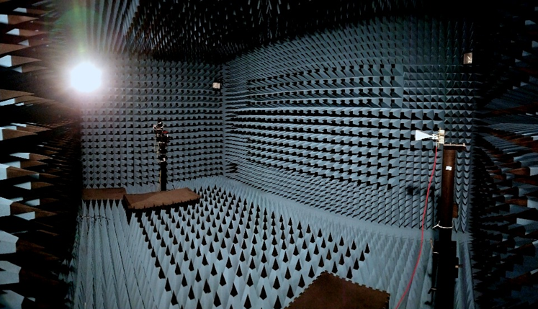
Contents
Surface Wave Propagation
Motivation-Applications
Problem Formulation
Dielectric Characterisation
Future Work
Notes:
David Boud (Australia)
Standard based assessment – where students meet or don’t meet the requirements; clear transparency of how LOs are met;
Sustainable assessment - meets needs of the present w/o compromising students ability to meet their own future learning need – fosters long-term learning

Slide 3
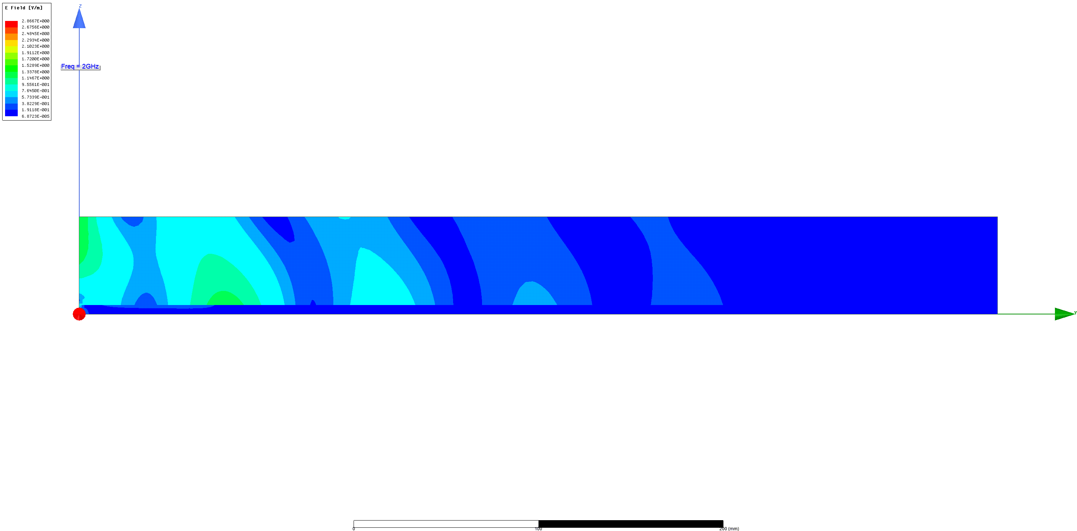
Introduction
Electromagnetic waves propagating along the interface (boundary) of two dissimilar materials
Properties:
Evanescent
Inhomogeneous
Different terms have been used historically:
Zenneck Waves
Sommerfeld-Goubeau Waves
“Creeping” Waves and “Spoof plasmons” (?)
Notes:
David Boud (Australia)
Standard based assessment – where students meet or don’t meet the requirements; clear transparency of how LOs are met;
Sustainable assessment - meets needs of the present w/o compromising students ability to meet their own future learning need – fosters long-term learning

Slide 4
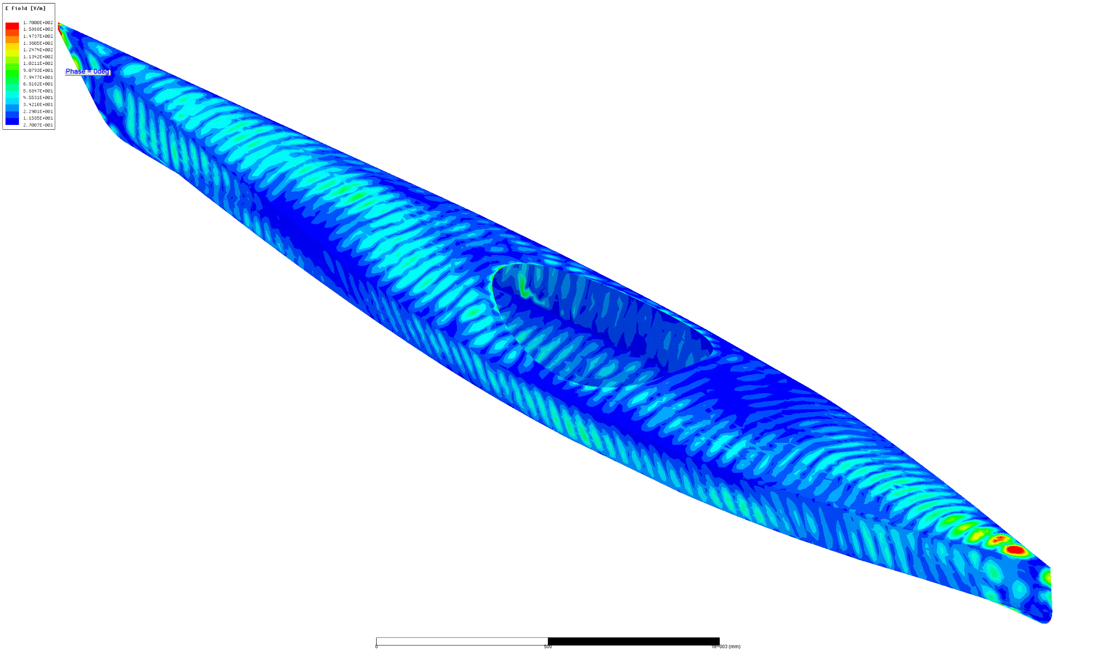
Motivation
Advantages :
Extended Range
Following the Surface Geometry
Covertness
Applications:
Communications
Non-destructive Testing/Monitoring
Radars (aerospace/automotive)
Radiation Absorbing Coatings
Range limitations due to:
Absorption Losses at the substrate
Leakage Losses in air
Notes:
David Boud (Australia)
Standard based assessment – where students meet or don’t meet the requirements; clear transparency of how LOs are met;
Sustainable assessment - meets needs of the present w/o compromising students ability to meet their own future learning need – fosters long-term learning

Slide 5
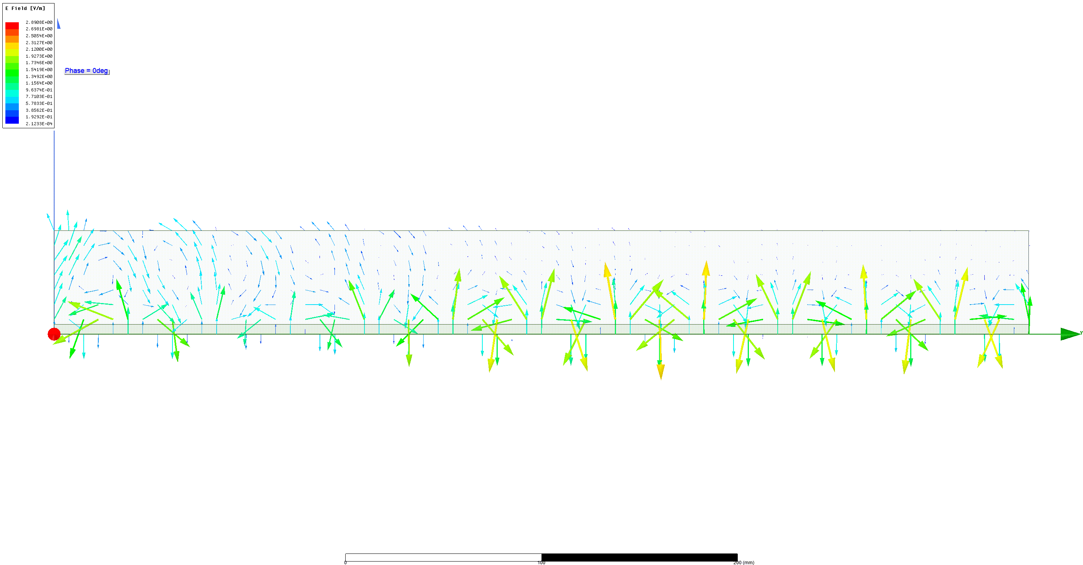
Electromagnetic Surface Waves
TM0 modes propagating along the interface between a dielectric material and air.
Such surface modes can propagate on imperfect, dielectric-clad, or corrugated conductors and on lossy dielectrics.
Suitability determined by “Complex Surface Impedance”
Notes:
David Boud (Australia)
Standard based assessment – where students meet or don’t meet the requirements; clear transparency of how LOs are met;
Sustainable assessment - meets needs of the present w/o compromising students ability to meet their own future learning need – fosters long-term learning

Slide 6
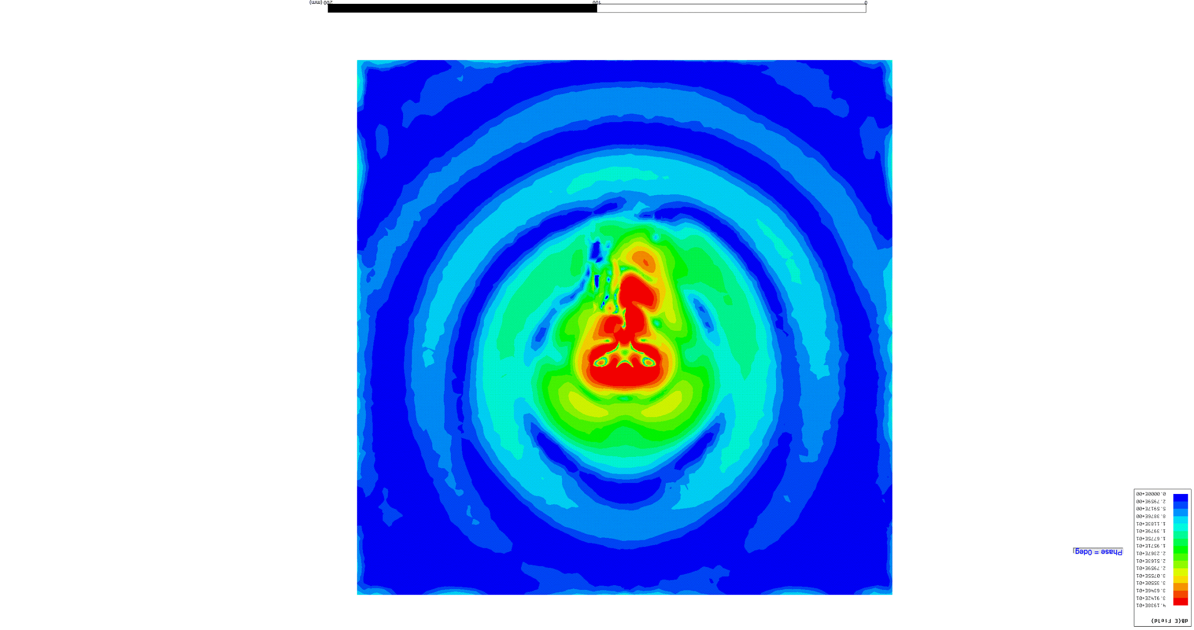
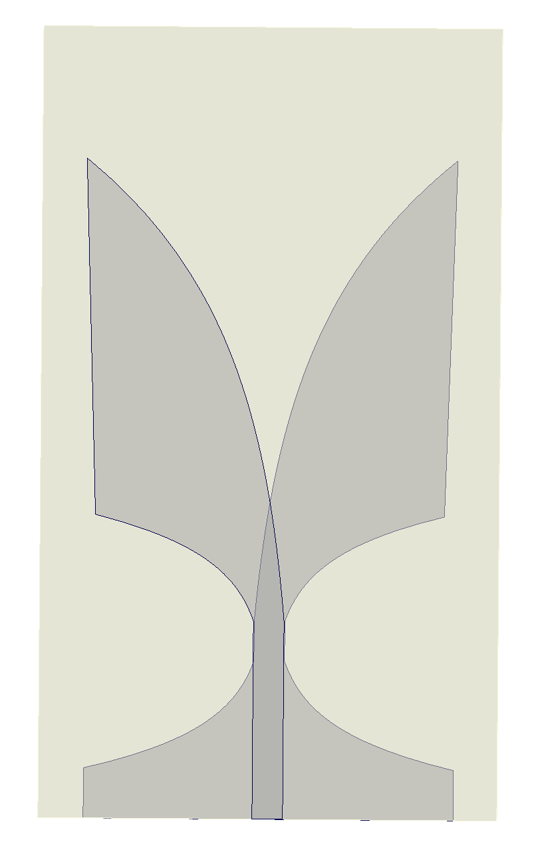
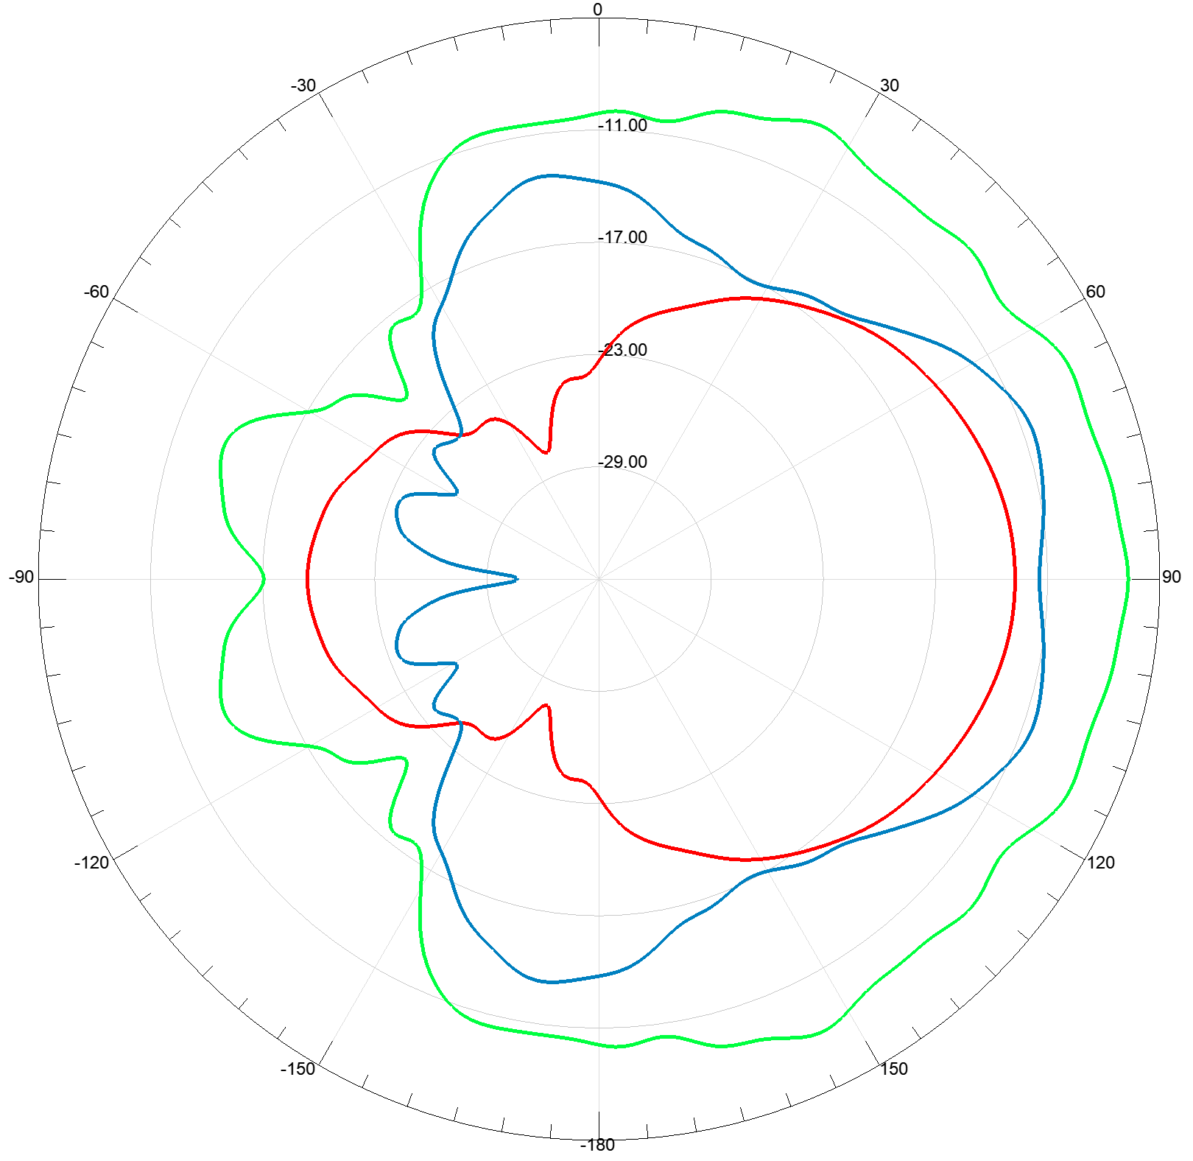
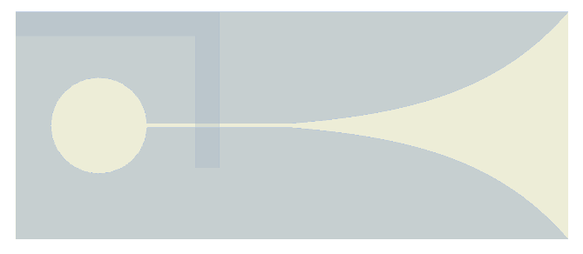
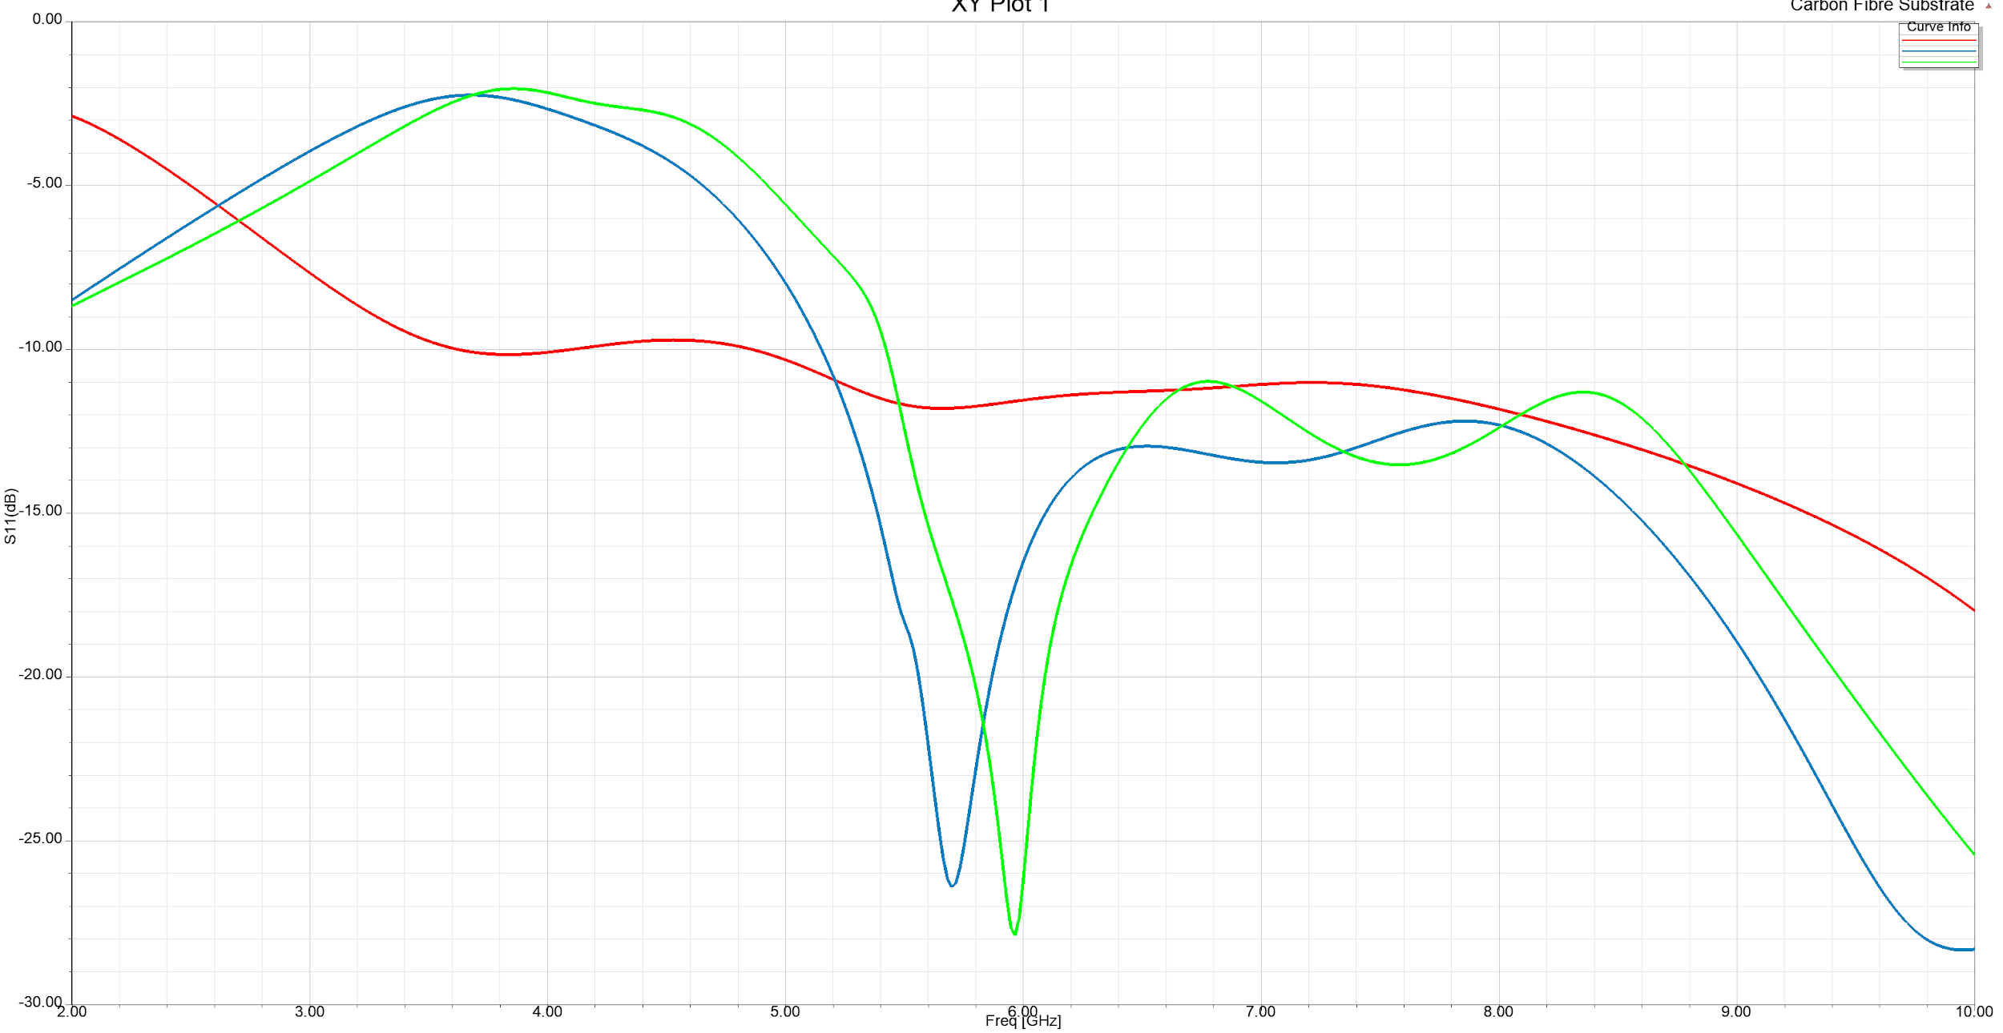
Electromagnetic Surface Wave Excitation on
a Composite Substrate
Surface Wave Antennas-Launchers:

Slide 7
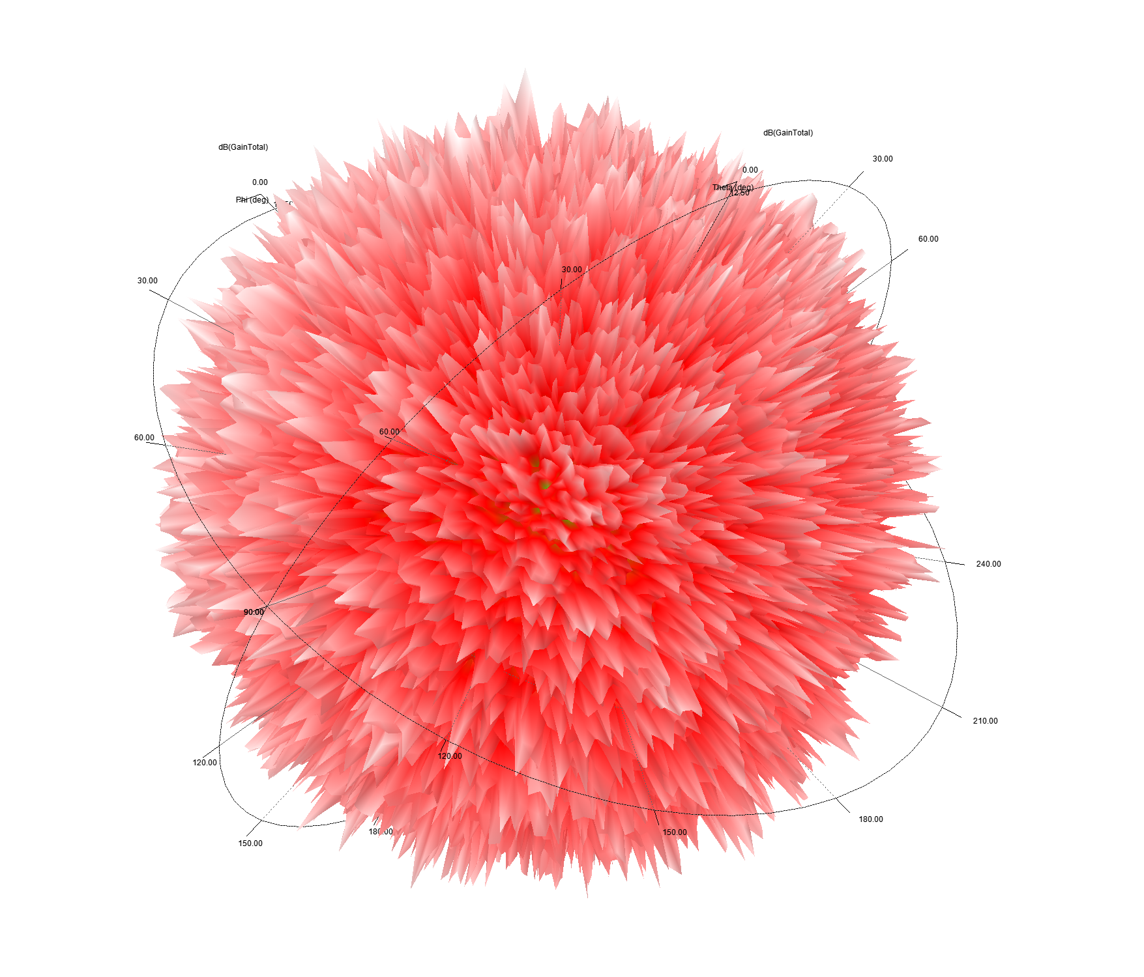
Problem Formulation
Dielectric characterisation of fibre-reinforced composites
Assessment of substrate suitability for surface wave propagation
Optimization of surface wave excitation source and substrate for the application

Slide 8
Dielectric Properties of Carbon Fibre Composites
Metamaterials: Properties not only from their composition, but also from their exactingly-designed macro structures (geometry, size, orientation, periodicity).
Effectively continuous materials:
Wavelength much Larger than Periodic Features
Described by Weak Spatial Dispersion Theory
Dominant Local Effects
Homogenization Approximation is Possible
Effective Permittivity/Permeability
Bi-Anisotropic Properties (Chirality)

Slide 9
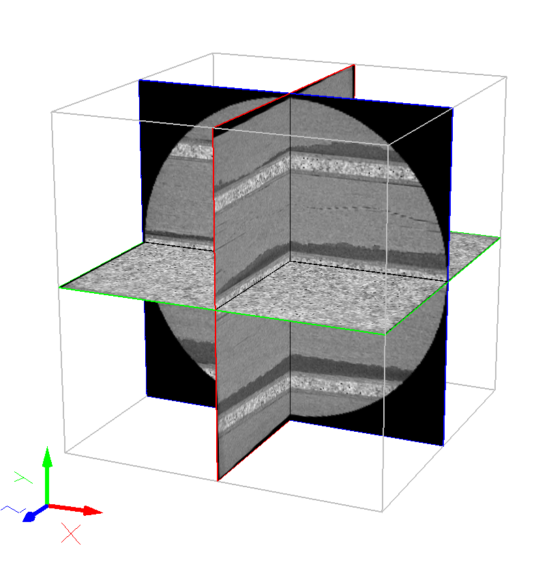
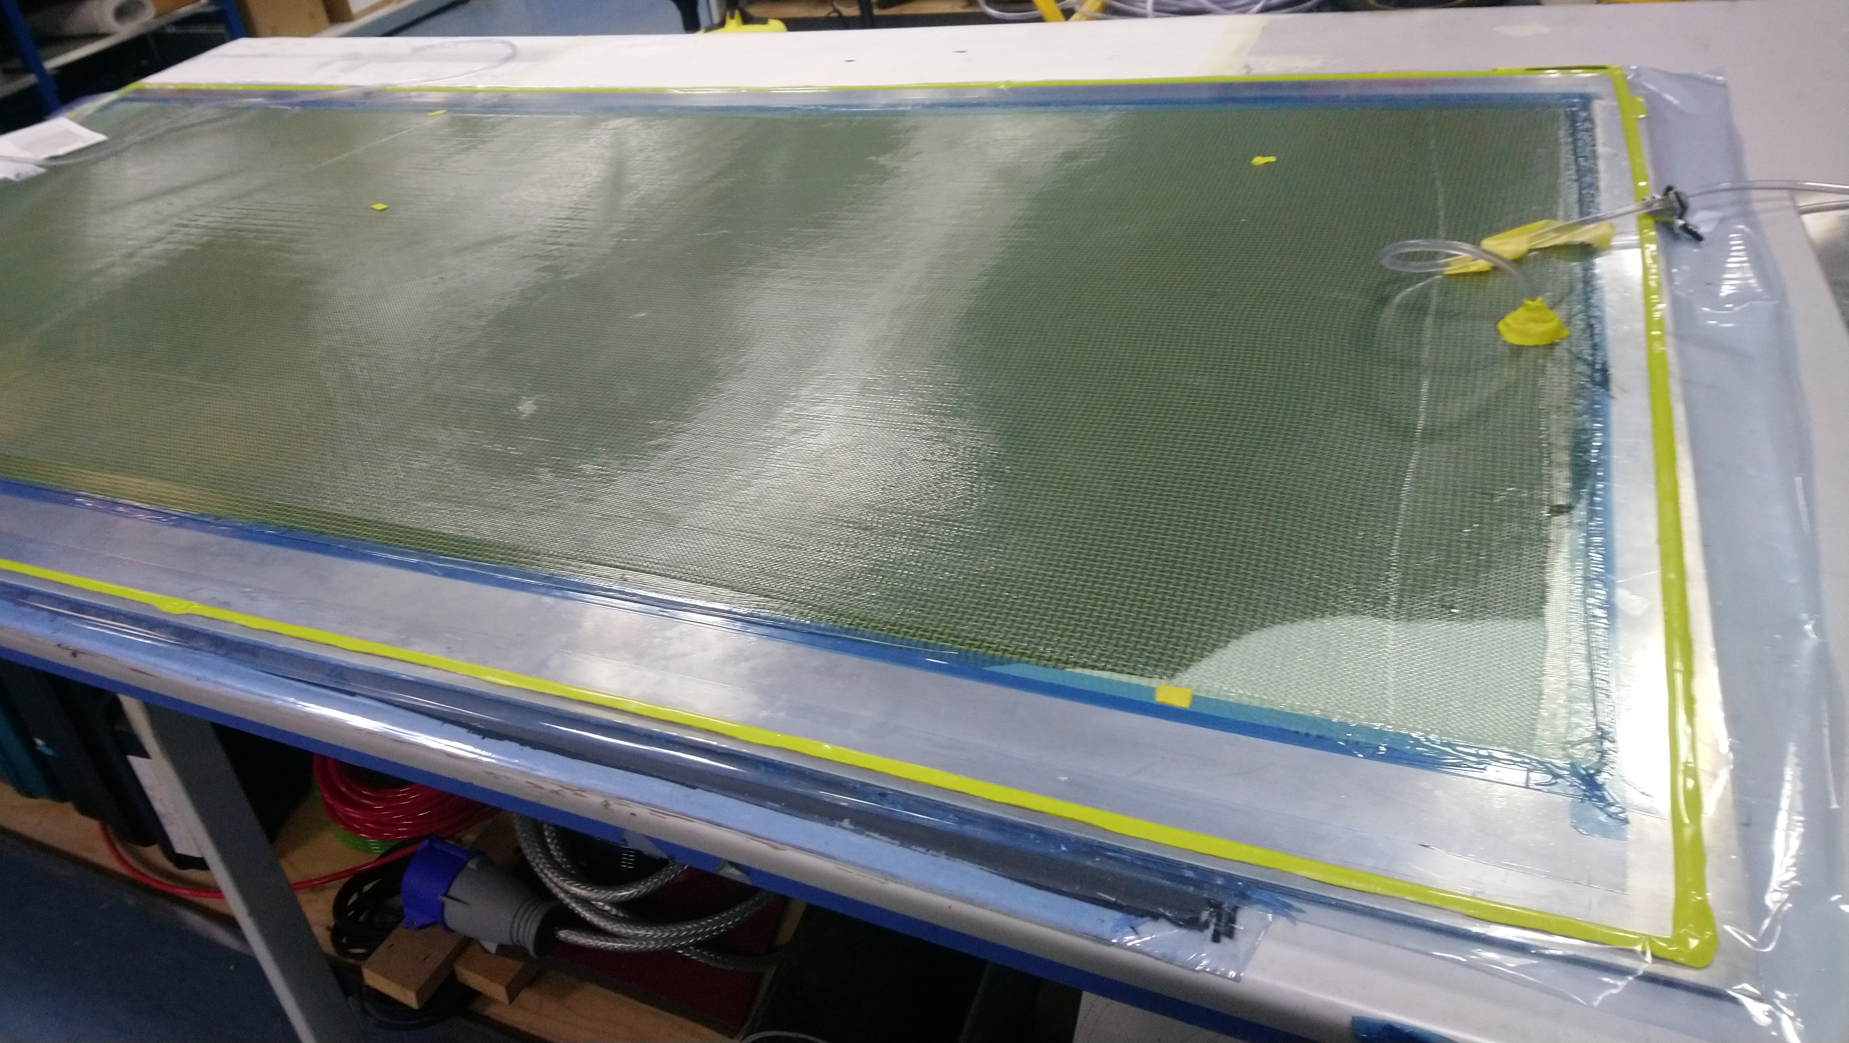
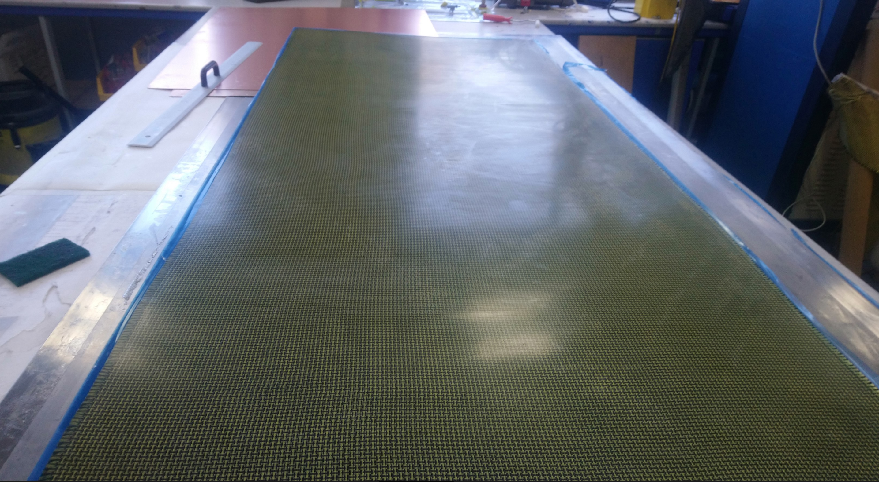
Carbon Fibre Composite – μCT Scan Setup
Plain Weave-1k Tow Carbon Fiber
5-Layer Stackup, ~1mm Thickness
Resin Infusion in Vacuum,
~40% Resin per Weight
3x3x3mm Sample, 5μm Resolution

Slide 10
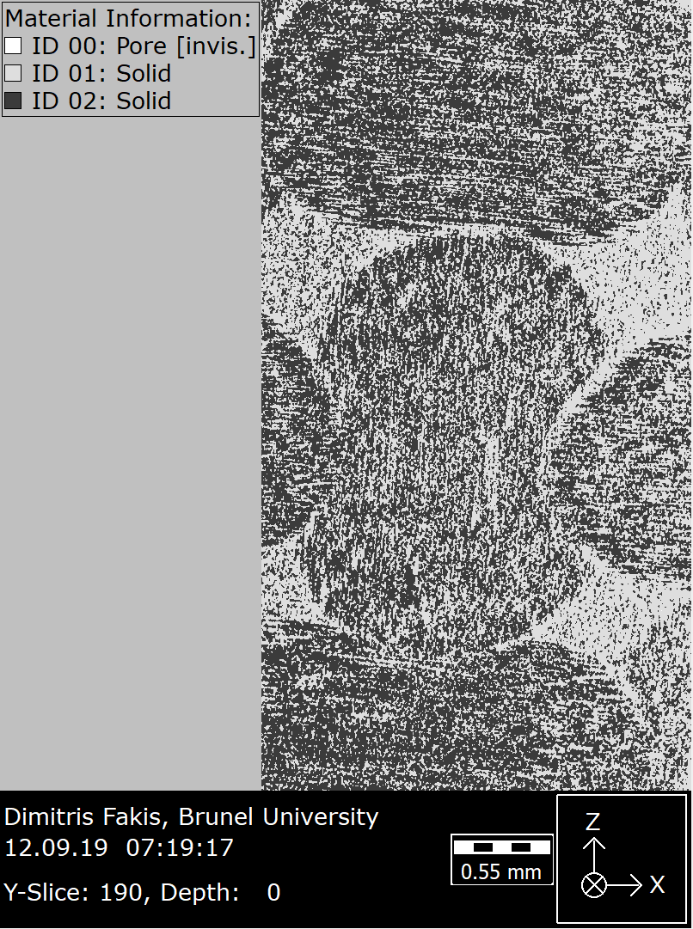
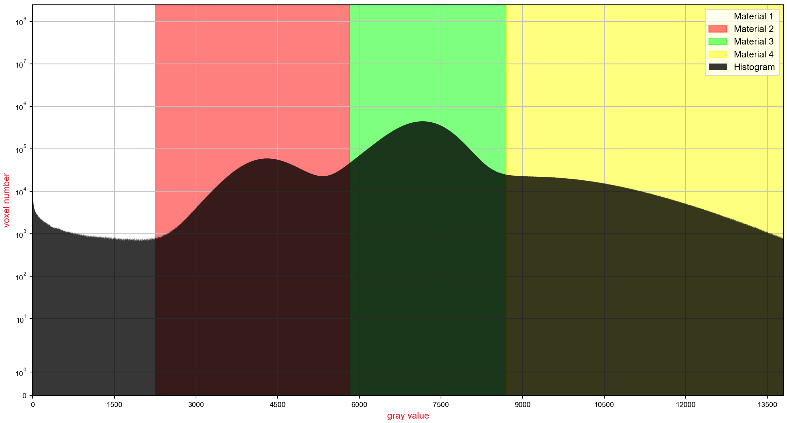
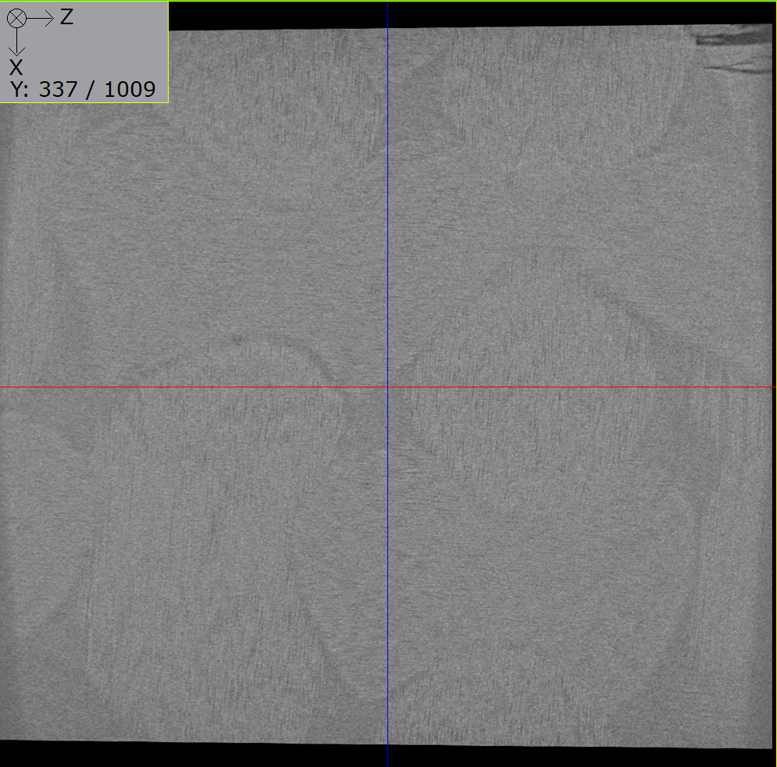
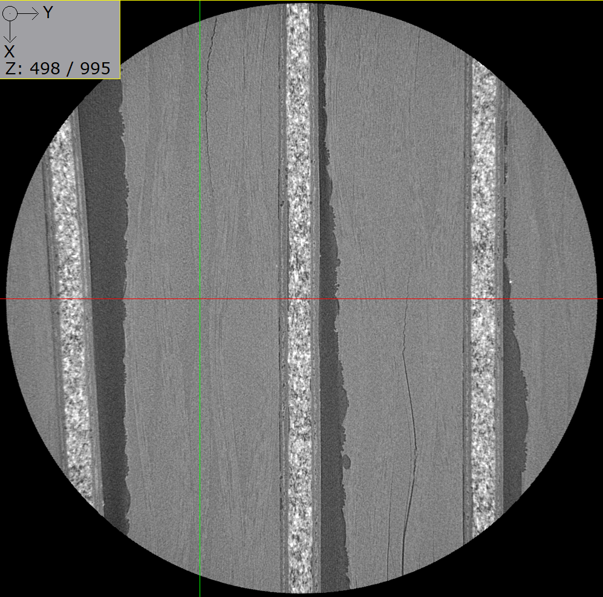
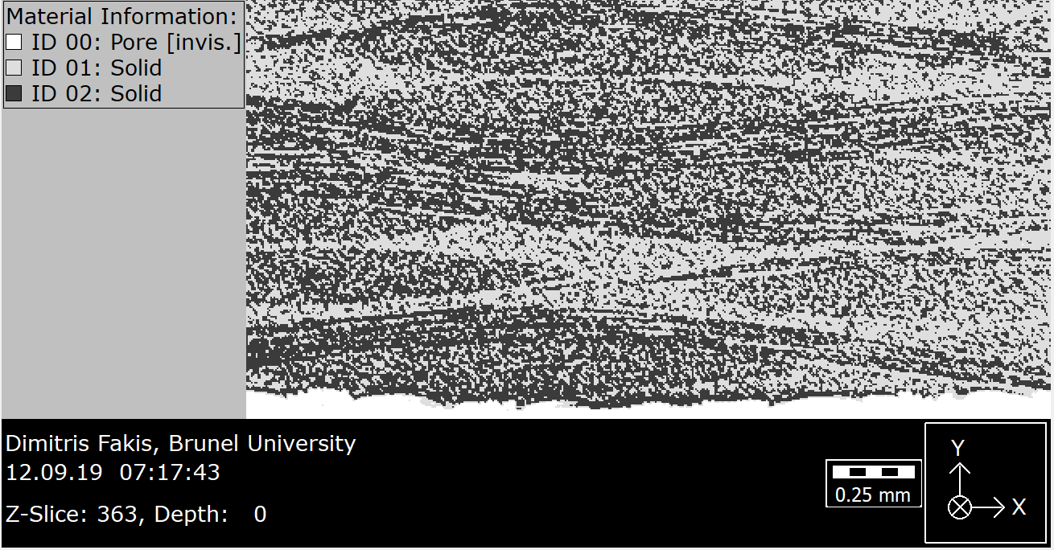
Carbon Fibre Composite – μCT Scan Results

Slide 11
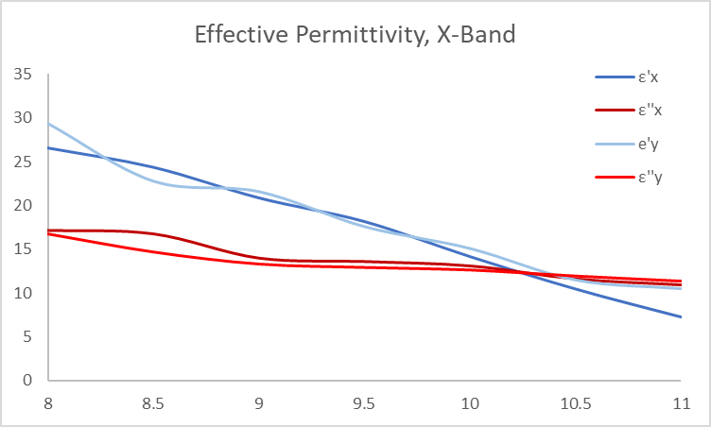
Dielectric Characterisation - Analytical
Effective Complex Permittivity of Dielectric with Ellipsoidal Scatterers/Absorbers:
${\overline{ε}}_{eff}={\overline{ε′}}_{r}$+ ${j\overline{ε^{′′}}}_{r}$
Models require the calculation of a Polarization Factor that is calculated using Image Data from uCT Scan.
Decent Results, but very unsatisfactory approximation: L>>D

Slide 12
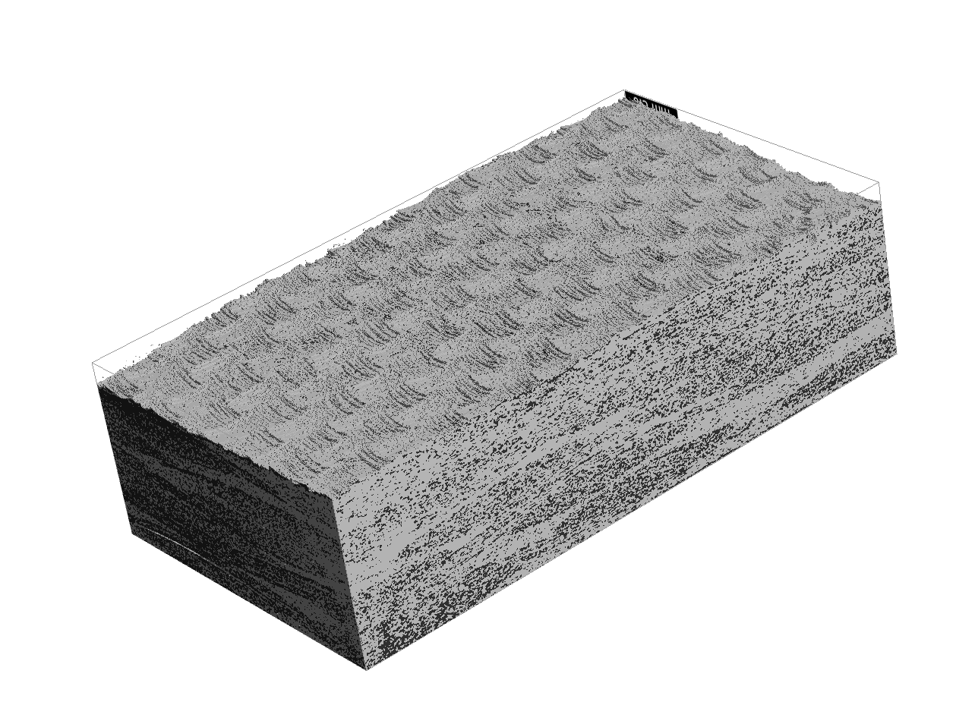
Dielectric Characterisation - Numerical
CAD Import from CT Data
Full Wave Electromagnetic Simulation in Material Volume
Post Processing Calculation of:
Electric Energy Density (W_{e}) ${\overline{ε′}}_{r}$
Electromagnetic Power Loss (Q_{e}) ${\overline{ε′′}}_{r}$

Slide 13
Challenges and Future Work
Issues with commercial simulation software (Implementation of Volume Integral/Finite Difference Method?)
Unit Cell Dimensions and Boundary Conditions
Fiber Conductivity Measurement
Micro-CT Data for more FRC samples
Comparison of effective medium results from uCT scan with macroscopic microwave measurements.

Slide 14
Acknowledgement
This publication was made possible by the sponsorship and support of BP. The work was enabled through, and undertaken at, the National Structural Integrity ResearchCentre (NSIRC), a postgraduate engineering facility for industry-led research into structural integrity established and managed by TWI through a network of both national and international Universities.
I would like to thank the RadioFrequency: Circuits, Antennas & Systems research group of Universidad Autonoma de Madrid fortheir continuous collaboration and for granting me access to their research facilities.

