Slide 1
Skeleton Based Human Action Recognition Using Doubly Linked List
Muhammad Sajid Khan

Slide 2
Abstract
Human Action Recognition is a significant focus for research because of its many applications in robotics and automation.
This talk demonstrates how doubly linked list can be used to sequence the 3D actions recorded as video clips in the NTU RGBD 60 dataset.
The nodes and edges in the list represents the joint and bone structure in the human skeleton.
Each node holds information about the joints position within the skeleton and pointers to its parent and child nodes.
The doubly Linked list is constructed by utilizing the nodes representing the torso joints and then adding the nodes for the limb's joints.
The chosen sequence of nodes preserves the structural shape of the skeleton.
The linked list for many known activities are used as the training set for a classifier capable of identifying subsequent human actions.

Slide 3
Introduction
Human action recognition (HAR), a complex machine vision problem, has various human-computers interactions (HCI), automation, and computer vision applications.
The development of HAR is to enable a computer to perceive the world and the human activity within it.
HAR includes several common steps, including detecting human movement using raw data sensor and extracting these movement characteristics to classify the performed actions.
This talk present an algorithm that makes use of a series of linked list.
Each linked list in the series holds static and dynamic information about human’s position at a point during the performance of a given action.
Each linked sequence is fed into a neural network that learns and identifies the human action performed

Slide 4
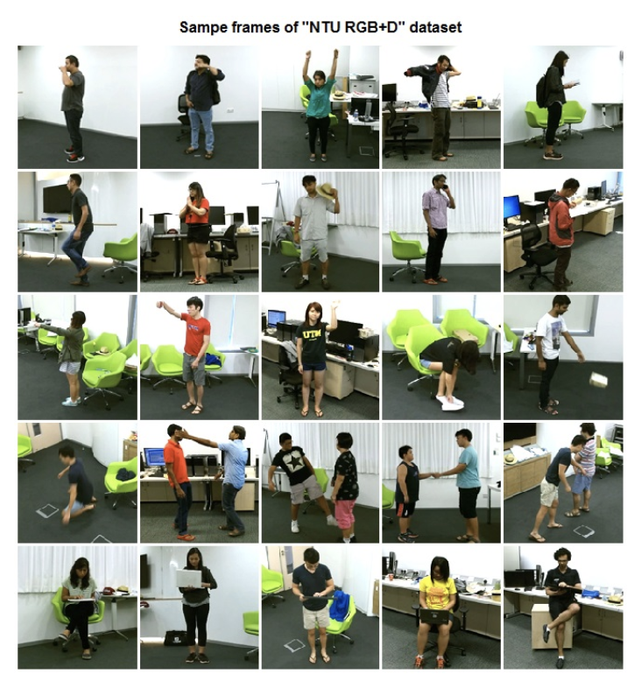
Sample Frames from “NTU RGBD Dataset”

Slide 5
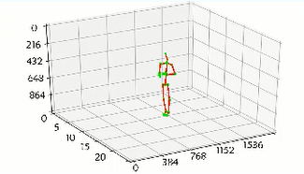
Dataset Video Clip and Skeleton Detection

Slide 6
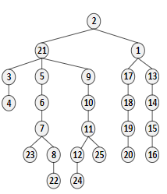
Previous Work
Directed Acyclic Graph Structure Tree

Slide 7
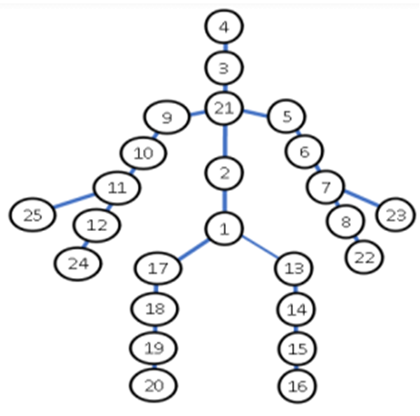
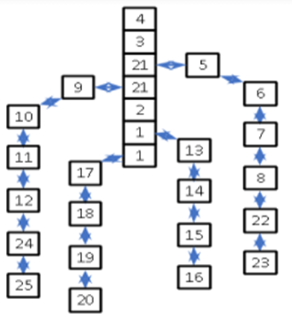
Proposed Method
Tree Structure Doubly linked list

Slide 8
This paper proposes a sequence-based method that uses a Doubly Linked List to represent the skeleton. Initially, a hash table representing each element of the doubly linked list is constructed.
The table comprises the central joints or skeleton, i.e.., head, nose, neck, back and spine joints (note that the neck and spine joints appear twice).
The linked list elements representing the arms are attached to the neck element. Similarly, the linked list elements representing the legs are connected to the spine joint element.
The joints of the backbone are also interconnected. The node of the linked list represents the joint of the arms and legs. Each node (whether in the linked list or hash table) holds information about its position and connected nodes, as shown in figure. 1.
The node numbers and names for the skeletal structure are given in table.

Slide 9
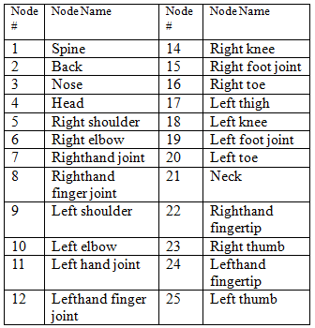
Human Skeleton Representation on Node

Slide 10
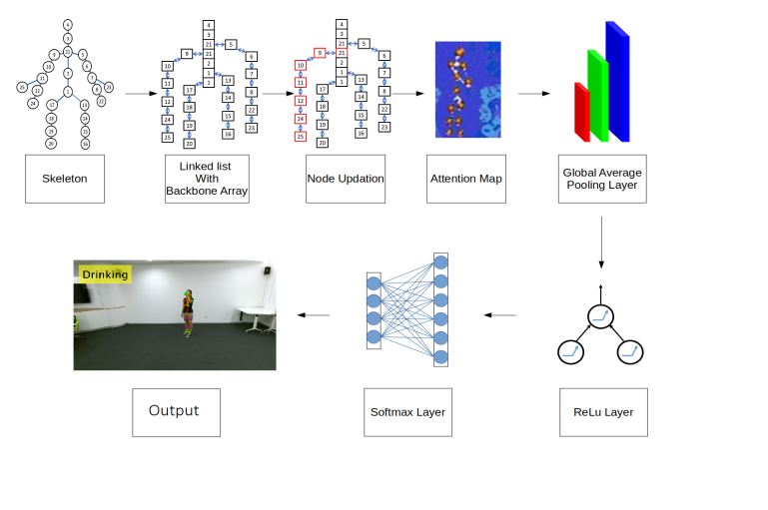
Use of doubly linked list for classification

Slide 11
Neural Network
The Neural Network employed has four layers: an input layer, upper hidden layer, lower hidden layer, and output layer.
The input and upper hidden layers start working simultaneously, with the upper hidden layer responsible for extracting the movements' features.
These layers save the values of the features for each node frame-by-frame. The lower hidden layer starts processing as soon as the upper hidden layer begins saving the feature values.
The lower layer aggregates the features and filters the nodes with redundant features.
The output layer begins processing after the lower hidden layer has finished.

Slide 12
Testing
The experiments were carried out on an i5 system with Windows 10 and 16GB of RAM, utilising almost 100GB of secondary memory.
The NTU-RGBD 60 dataset was used to train and test the system. Training took 144 hours using 70% of the dataset (almost 40,000 videos) and was tested using the remaining 16,880 videos.
The linked list methodology produced a marked improvement over previous techniques, with an overall accuracy of 97.8% and a reduced training time.

Slide 13
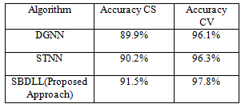
A Comparison with other Methodologies

Slide 14
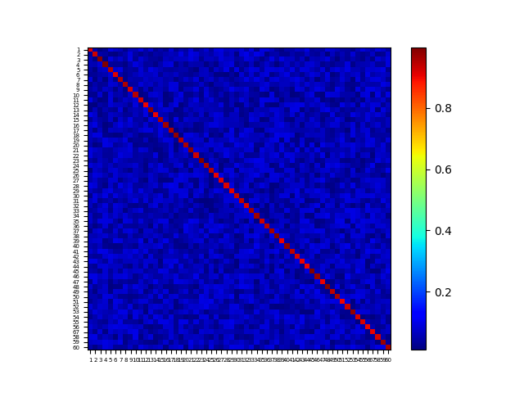
Confusion matrix of observation and prediction

Slide 15
Conclusion
This talk demonstrates how a Skeleton Based Doubly Linked List (SCDLL) can reduce the complexity and improve performance of a neural network based HAR system. The system described produces good results and reduced training time frames.

Slide 16
Send Your Questions
sajid.khan@myu.edu.pk
sajid@widi.wales

