Slide 1
Laser Plasma Accelerator X-ray Sources
and their Applications so far….
Dr. Christopher Thornton
christopher.thornton@ucl.ac.uk

Slide 2
Content
Why use lasers?
How does the technique work?
Examples
2/22

Slide 3
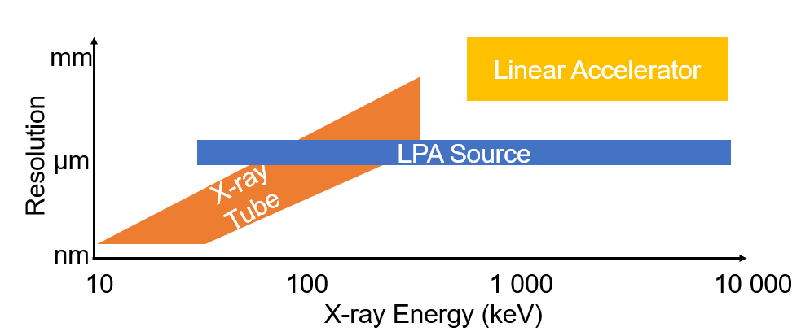
Why use Lasers to Generate X-rays?
Incredibly small source size
Phase enhanced images
High resolution at high energy
Very short pulse duration (fs)
It’s a pulsed source!
3/22

Slide 4
Laser Systems
Energy (1-10J), pulse duration (25-50fs) and multi-TW peak powers.
Systems are made up of a number of lasers.
Can be very big national systems but smaller (~1.5m x 4.2m) commercial systems for specific applications are becoming more widely available.
4/22

Slide 5
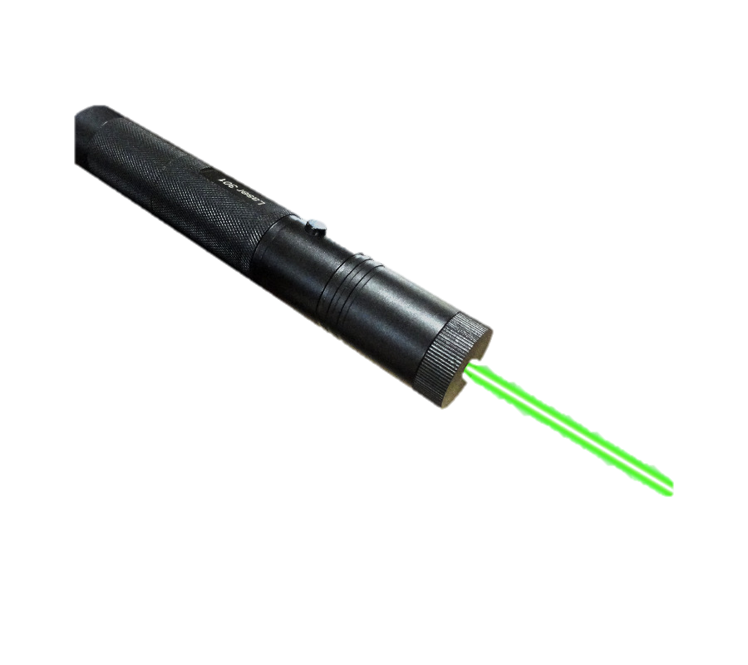
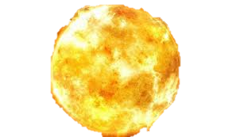
Introduction to Laser Plasma Accelerators
Particle beam
5/22

Slide 6
Introduction to Laser Plasma Accelerators
6/22

Slide 7
Introduction to Laser Plasma Accelerators
6/22

Slide 8
Types of X-ray Radiation that can be Produced?
There are many mechanisms for generating X-rays:
Wiggler radiation (Betatron)
Bremsstrahlung
Thomson scattering
Free Electron Lasers
Characteristic radiation (K-alpha etc)
7/22

Slide 9
Betatron
Albert, F. & Thomas, A. G Plasma Phys. Control. Fusion 58, 103001 (2016)
8/22

Slide 10
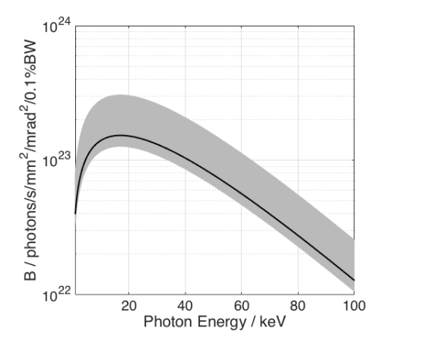
Betatron Properties
Energy: 10 – 100 keV
Spectrum: Broad
Flux: 10⁸ photons/pulse
Divergence: Parallel Beam
9/22

Slide 11
Betatron Examples
1mm
10/22
J. Cole, PNAS 10.1073/pnas.1802314115 (2018)

Slide 12
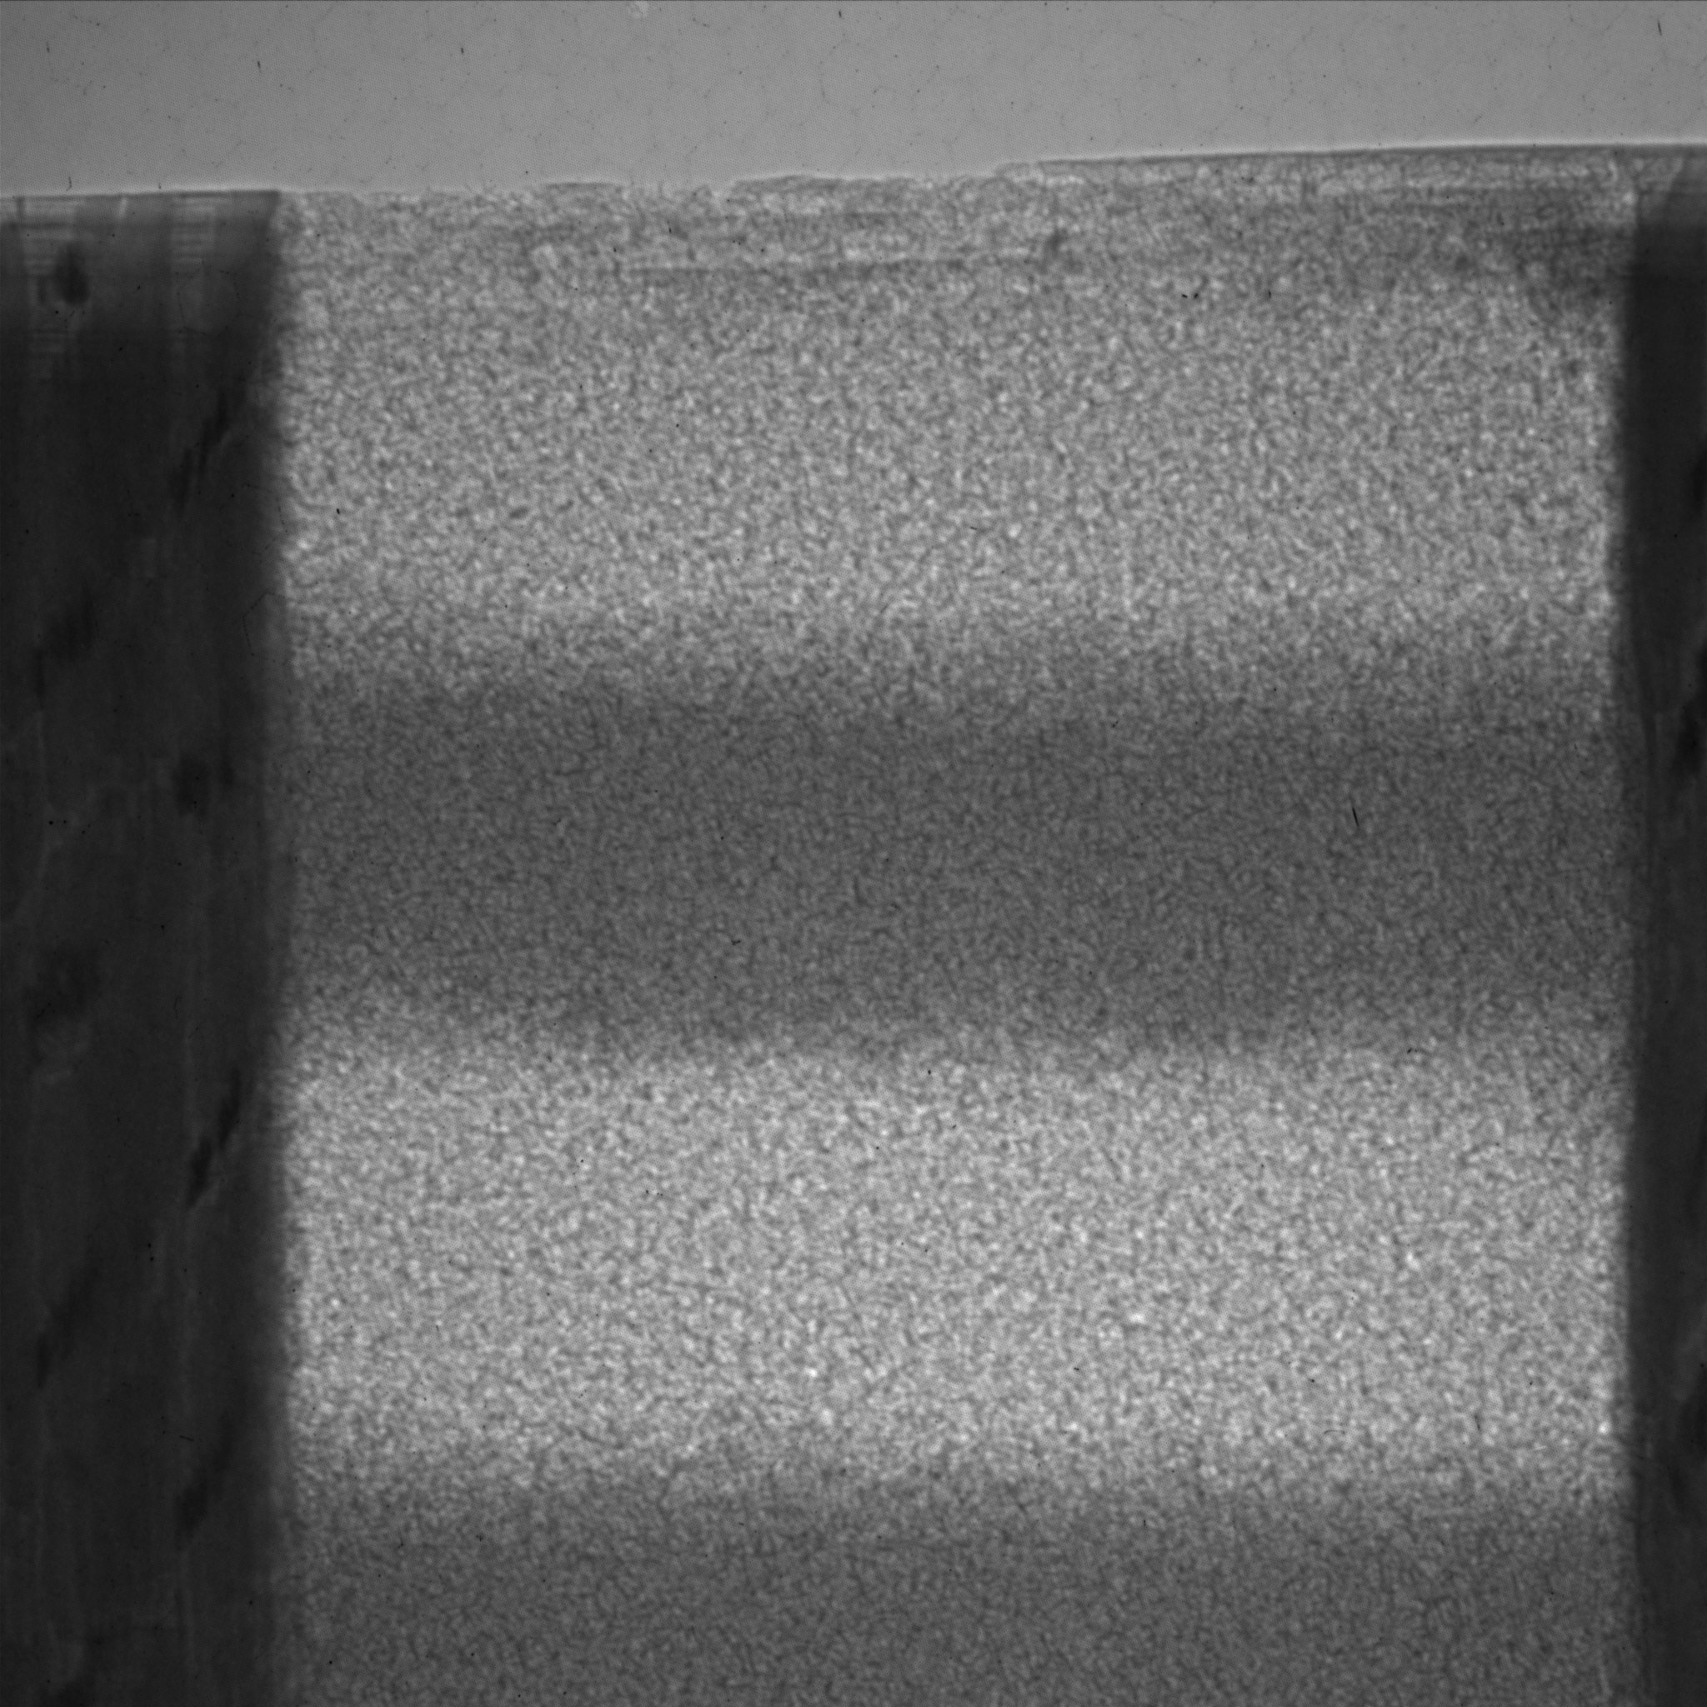
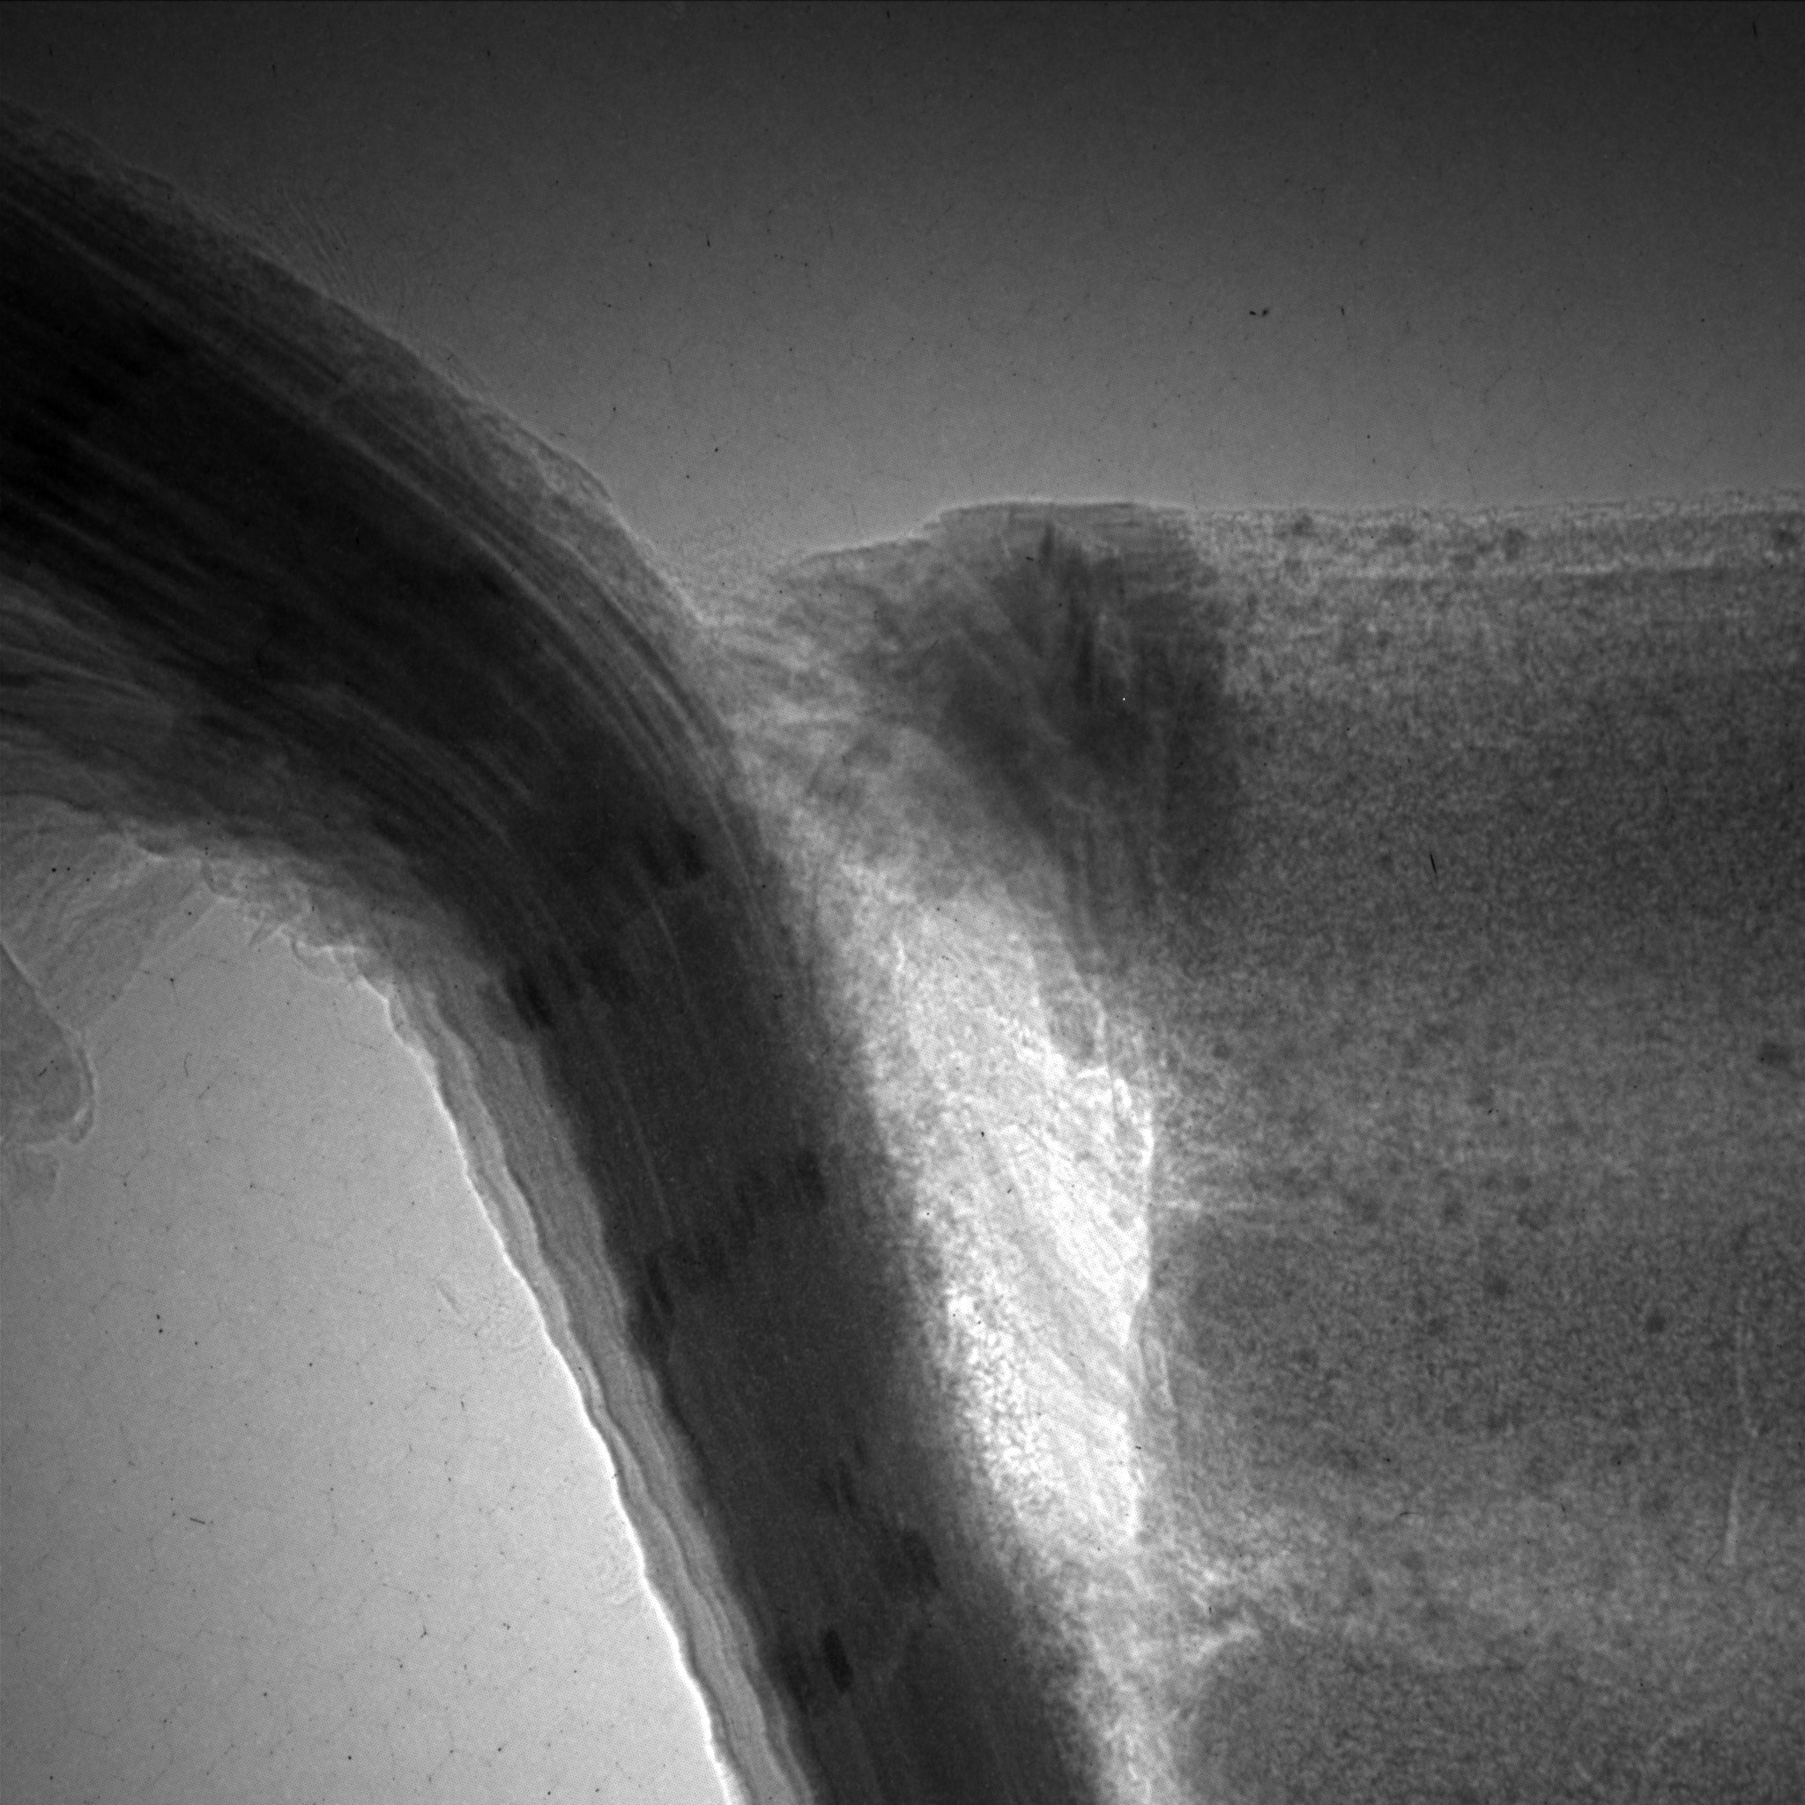
Betatron Examples
Intact tufted sandwich
Crushed tufted sandwich
11/22

Slide 13
Bremsstrahlung
Albert, F. & Thomas, A. G Plasma Phys. Control. Fusion 58, 103001 (2016)
12/22

Slide 14
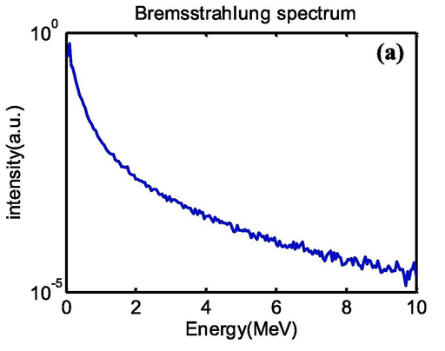
Bremsstrahlung Properties
Energy: 1 – 10’s MeV
Spectrum: Broad
Flux: 10⁹ photons/pulse
Divergence: Cone Beam
13/22

Slide 15
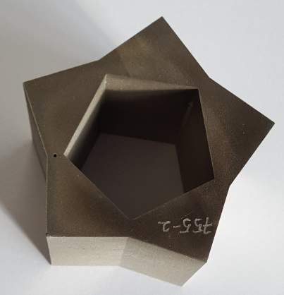
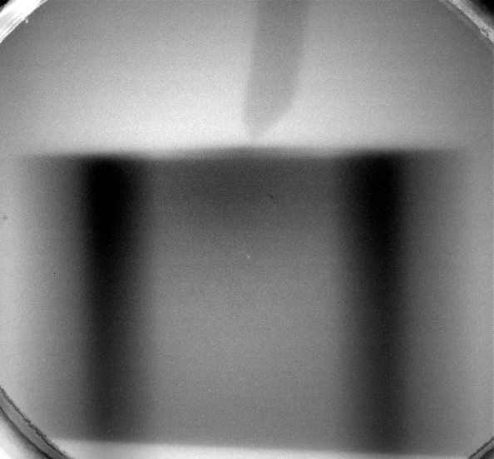
Bremsstrahlung Examples
Nickel AM test object
Preliminary angle scan
~50% transmission
To few projections to produce a reconstruction
C. I. D. Underwood et al Plasma Phys. Control. Fusion 62 124002 (2020)
14/22

Slide 16
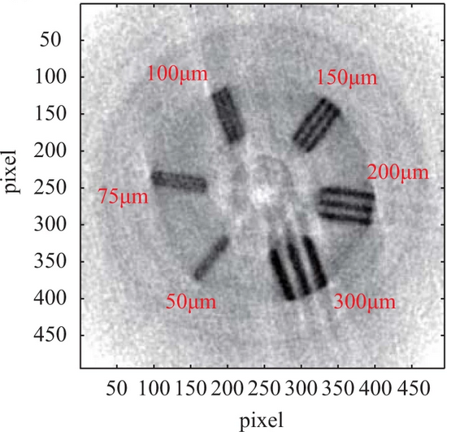
Bremsstrahlung Examples
Wu, Y.C., Zhu, B., Li, G. et al. Sci Rep 8, 15888 (2018)
15/22

Slide 17
Inverse Compton Scattering
Albert, F. & Thomas, A. G Plasma Phys. Control. Fusion 58, 103001 (2016).
16/22

Slide 18
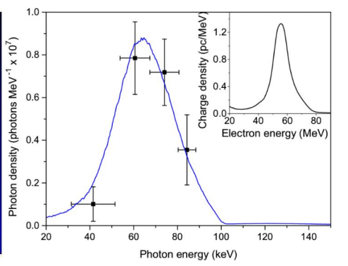
Inverse Compton Scattering Properties
Energy: 10keV – 2MeV
Spectrum: Narrow
Flux: 10⁷ photons/pulse
Divergence: Parallel Beam
17/22

Slide 19
Inverse Compton Scattering Examples
Watch test object
100 keV X-ray beam
Single image exposure
Different materials are clearly visible
A. Döpp et al Plasma Phys. Control. Fusion 58 034005 (2016)
18/22

Slide 20
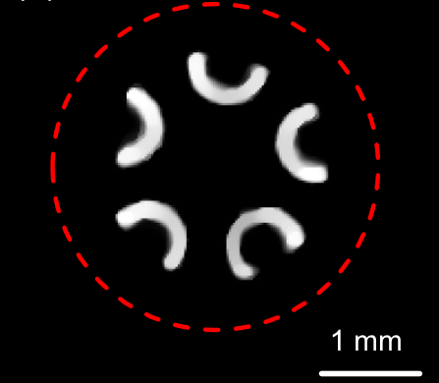
Inverse Compton Scattering Examples
Y. Ma, Matter Radiat. Extremes 5, 064401 (2020)
19/22

Slide 21
Conclusions
Many ways LPA can be used to generate X-ray sources, with each method having different advantages.
The LPA field is getting more comfortable with imaging and especially with tomography.
These unique properties look to complement the imaging techniques already available.
20/22

Slide 22
Future Directions
High energy (MeV) X-rays + small source size
High energy phase contrast imaging
Rapid tomography (short scan times)
Motion caption X-ray imaging
Others?
21/22

Slide 23
Thank You
J. Warnett
M. Williams
N. Brierley
N. Turner
C. Armstrong
D. Symes
C. Brenner
N. Bourgeois
J-N. Gruse
M. Streeter
N. Lopes
R. Shalloo
S. Mangles
Z. Najmudin
C. Underwood
C. Baird
M. Selwood
C. Murphy
P. Collier
T. Hyde
G. Hatton
22/22

