Slide 1
SuRVoS2: Software to Accelerate Annotation and Segmentation of 3D Image Data
Olly King
Diamond Light Source
19/10/22

Slide 2
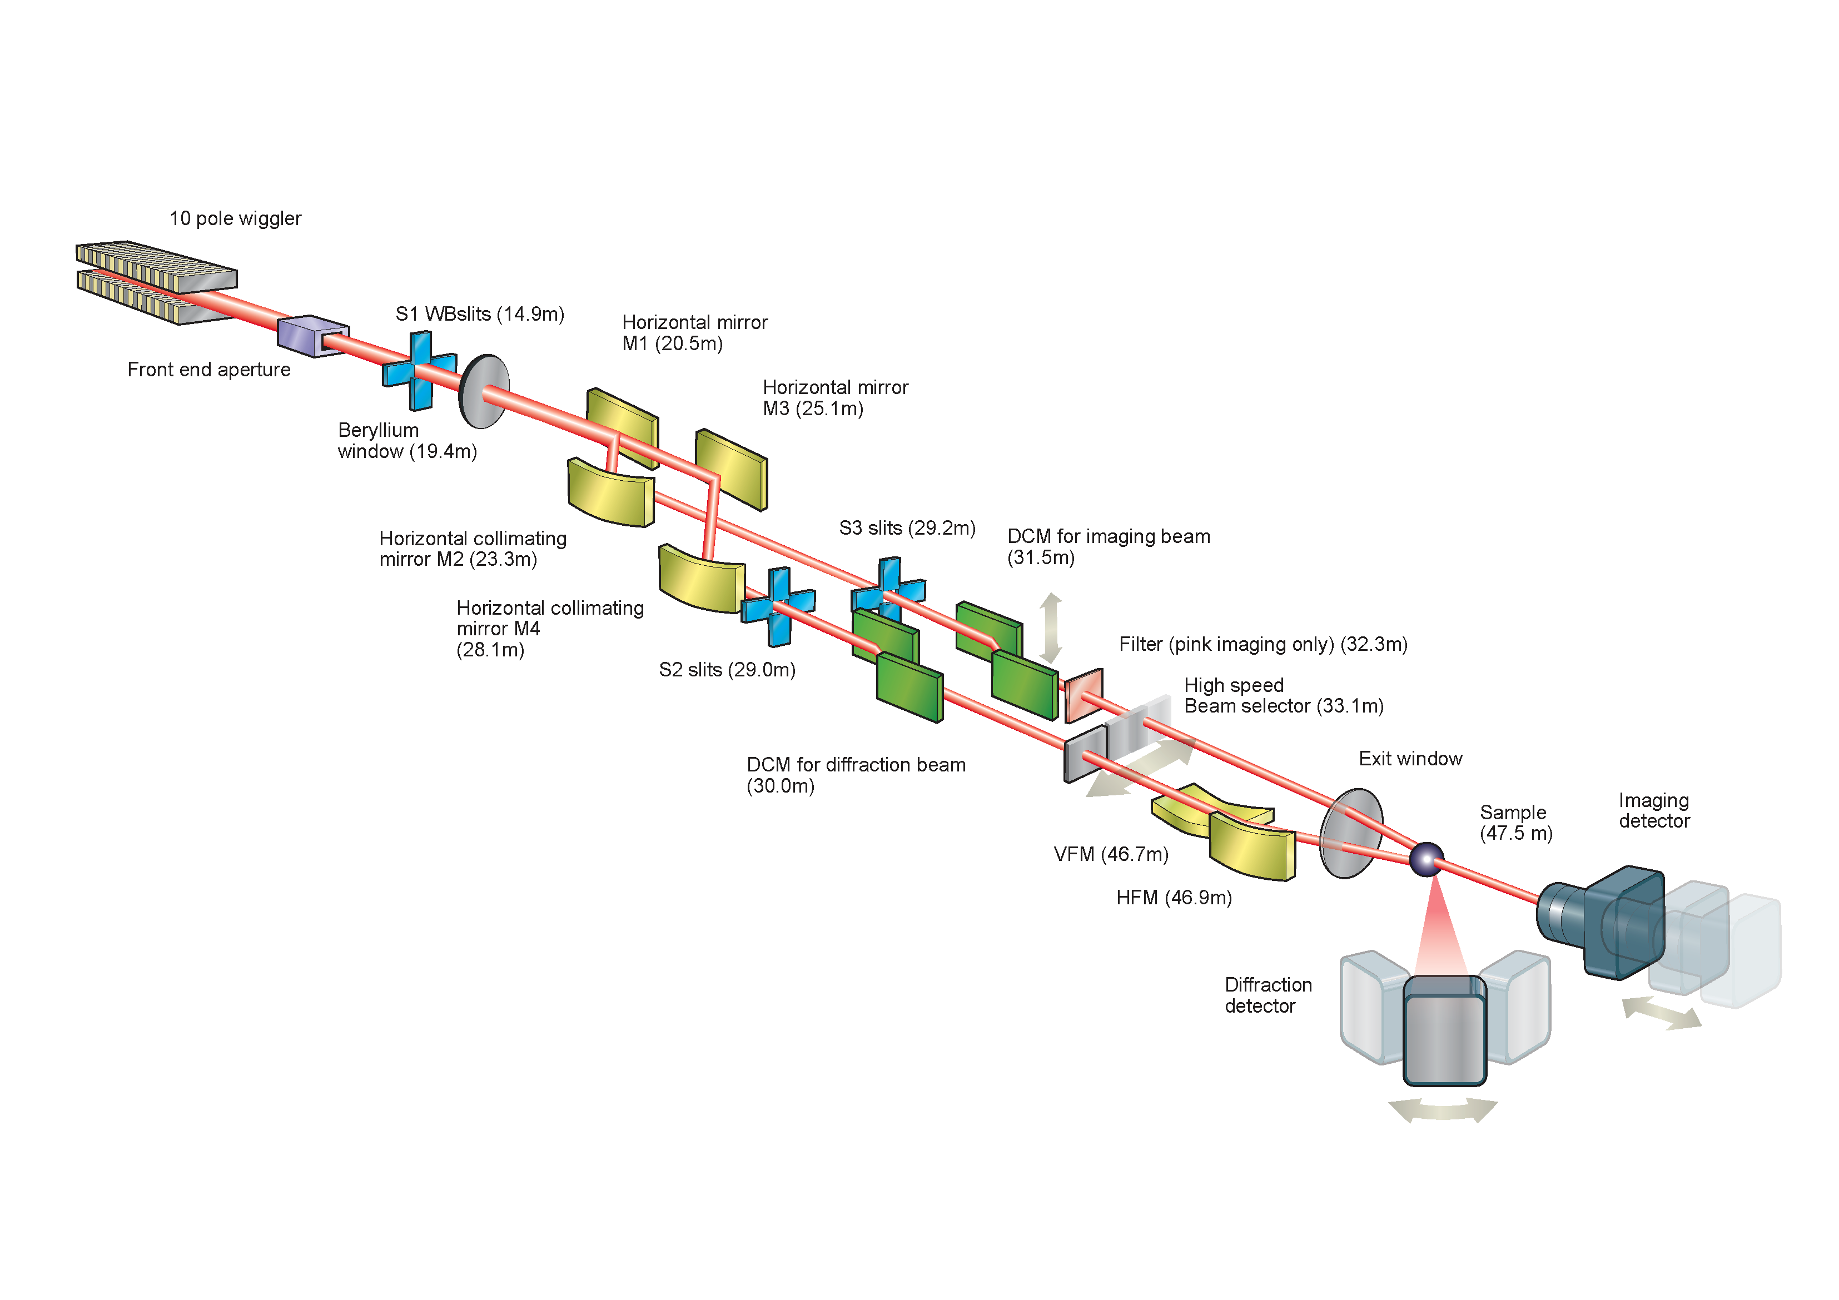
3D Imaging at Diamond
3-dimensional imaging data is generated on a number of beamlines/facilities
i12 JEEP – Joint Engineering, Environmental and Processing
i13 X-ray Imaging and Coherence (i13-2 Diamond Manchester Imaging Branchline)
DIAD - Dual Imaging And Diffraction
B24 – Cryo-SXT: Cryo Soft X-Ray Tomography
eBIC – electron Bio-Imaging Centre
ePSIC – electron Physical Science Imaging Centre
Dr. Nghia T. Vo and Dr. Robert C. Atwood. Little Foot Australopithecus Data collected on i12
DIAD schematic
Notes:
3.67-million-year-old ‘Little Foot’ Australopithecus skeleton, from South Africa

Slide 3
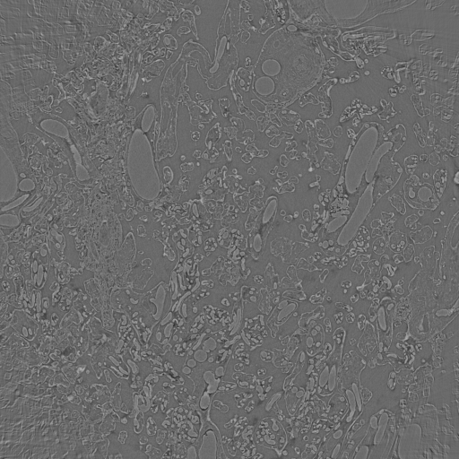
Analysis of 3D Image Data - Segmentation
Image segmentation
“to simplify and/or change the representation of an image into something that is more meaningful and easier to analyse”
The process of labelling each pixel/voxel in the image data in order to allow quantification and robust analysis
Can be simple – for simple objects with separated by high contrast
But… most systems being characterised are not simple and most data is imperfect – reconstruction artifacts, low contrast, noise, unclear boundaries
e.g. Segmentation of a dataset collected at Diamond may take weeks or months
Human placental tissue. X-ray CT data collected on i13-2.
Notes:
3-dimensional imaging data is generated on a number of beamlines/facilities
i12 JEEP – Joint Engineering, Environmental and Processing
i13 X-ray Imaging and Coherence (i13-2 Diamond Manchester Imaging Branchline)
DIAD - Dual Imaging And Diffraction
B24 – Cryo-TXM: Cryo Transmission X-ray Microscopy
eBIC – electron Bio-Imaging Centre
ePSIC – electron Physical Science Imaging Centre

Slide 4
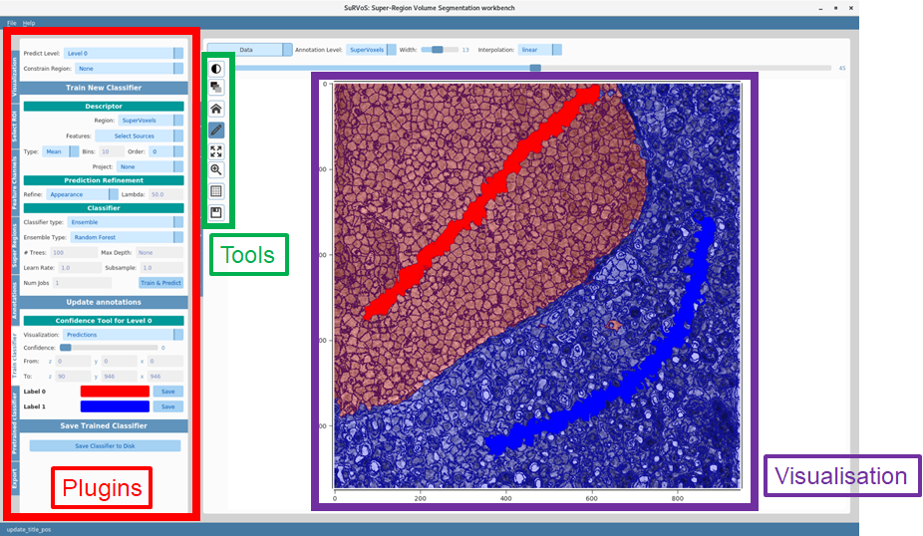
SuRVoS Workbench
Super-Region Volume Segmentation
What is it?
An application written in Python by Imanol Luengo with input from Michele Darrow, Mark Basham (Diamond) and Andrew French and Tony Pridmore (University of Nottingham)
Originally designed for staff and users on B24 to segment complex biological volumes (cell organelles)
Unsupervised clustering of voxel data into supervoxels
Manual image feature extraction
User painted annotations
"Classical" machine learning tools. e.g Random forests, SVMs
Notes:
Will explain more about Superregions in a minute
Uses shallow machine learning techniques for the time being

Slide 5
SuRVoS Workbench
Super-Region Volume Segmentation
Generate supervoxels
Extract image features
Notes:
gSLIC – Simple Linear Iterative Clustering
K-means local clustering of pixels in 5 dimension labxy space
The image is split into uniform grid then local k means is done in a window of size 2s
gslic replaces search in 2s windows with a lookup table of nearest cluster centres M=9 in 2D and M=26 in 3D

Slide 6
SuRVoS Workbench
Super-Region Volume Segmentation
Annotate data
Train a classifier
Features extracted from the data are concatenated into a matrix, X
Used to train the classifier in conjunction with the labels from annotations, Y
D
0.5 | 0 | 0.1 | …
…
0
1
…
-1
0
N: Number of supervoxels
D: Number of features
X: Descriptor matrix
Y: Supervoxel class label
X =
N
Y =
N
Notes:
Will explain more about Superregions in a minute
Uses shallow machine learning techniques for the time being

Slide 7
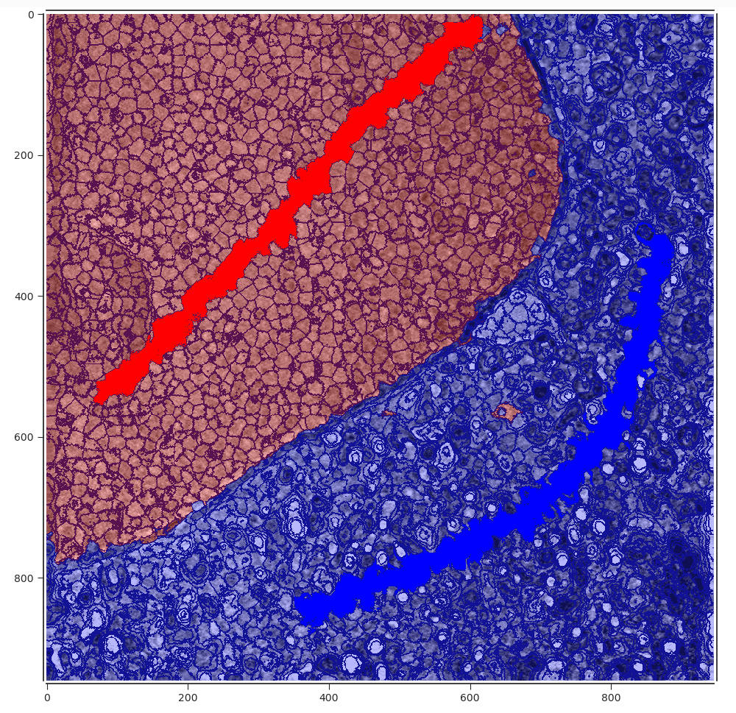
SuRVoS Workbench
Super-Region Volume Segmentation
Predict data
Refine prediction and/or adjust annotations
Prediction refinement can be used to remove “islands” by minimisation of a Markov Random Field energy function
Cycles of annotation, prediction, followed by annotation adjustment and re-prediction can be used to reach a final segmentation
Segmentations labels can be analysed, segmentation masks exported and classifiers can be saved and reutilised on new data
Notes:
Will explain more about Superregions in a minute
Uses shallow machine learning techniques for the time being

Slide 8
SuRVoS Workbench
Export data
Issues
SuRVoS is a monolithic/standalone application
Needs to be run on high performance hardware (NVIDIA GPU)
Extending the application is not straightforward
Difficult to keep up with the state of the art in segmentation
Not easy to collaborate on the same datasets

Slide 9
Rethinking SuRVoS
Desirables:
Switchable workspaces
Easier addition of new methods e.g .Deep learning techniques
Easier viewing of multiple datasets e.g. correlative imaging
Ability to run on the cloud or from less powerful machines
Client-server model
Ability to segment larger datasets
Allow import of data from citizen science projects
Run in conjunction with Jupyter notebooks for experienced users

Slide 10
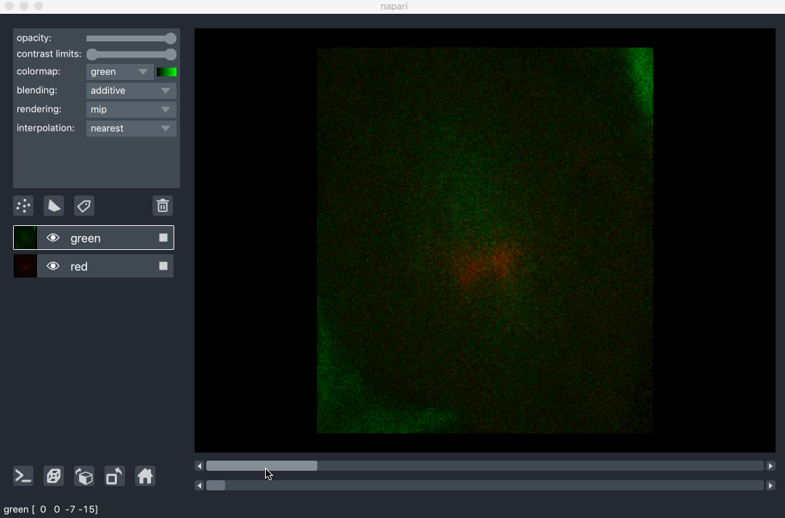
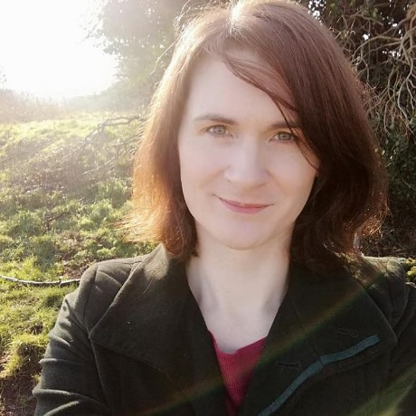
SuRVoS2: A client-server napari plugin
Client – napari
Python library “designed for browsing, annotating, and analyzing large multi-dimensional images”
Can run alongside other plugins from napari hub
Server – can run on HPC/cloud
Has access to raw and processed data
Can switch between workspaces
Avery Pennington

Slide 11
SuRVoS2

Slide 12
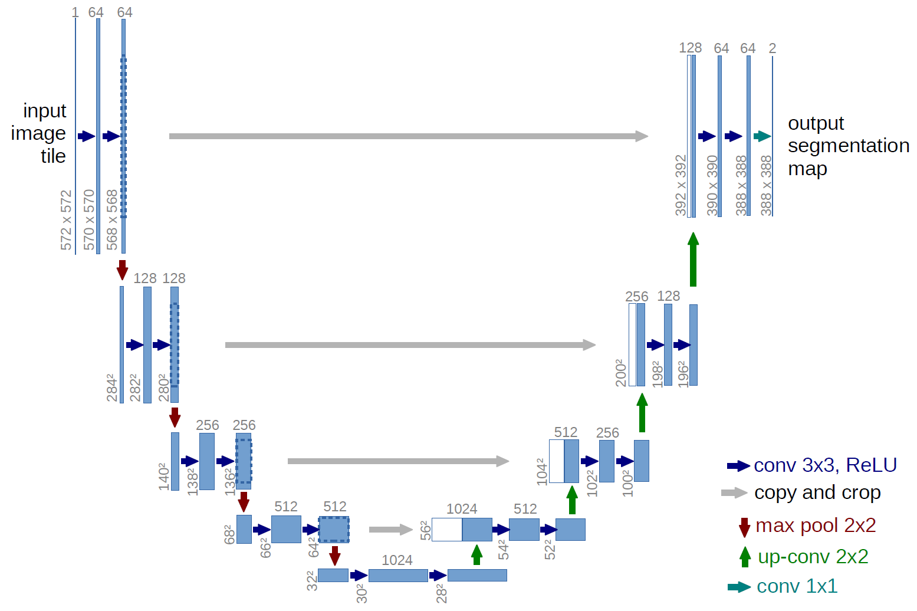
Deep Learning Segmentation
A deep learning approach?
We can reuse trained classical ML models from SuRVoS on new datasets
But large data volumes pose various challenges:
Large feature volumes generated
Speed/memory requirements of feature extraction
Generalisation to large data is problematic – easy to overfit model when training on a small number of features and small training volumes
Olaf Ronneberger, Philipp Fischer, Thomas Brox
Medical Image Computing and Computer-Assisted Intervention (MICCAI), Springer, LNCS, Vol.9351: 234--241, 2015, available at arXiv:1505.04597 [cs.CV]
Notes:
Will explain more about Superregions in a minute
Uses shallow machine learning techniques for the time being

Slide 13
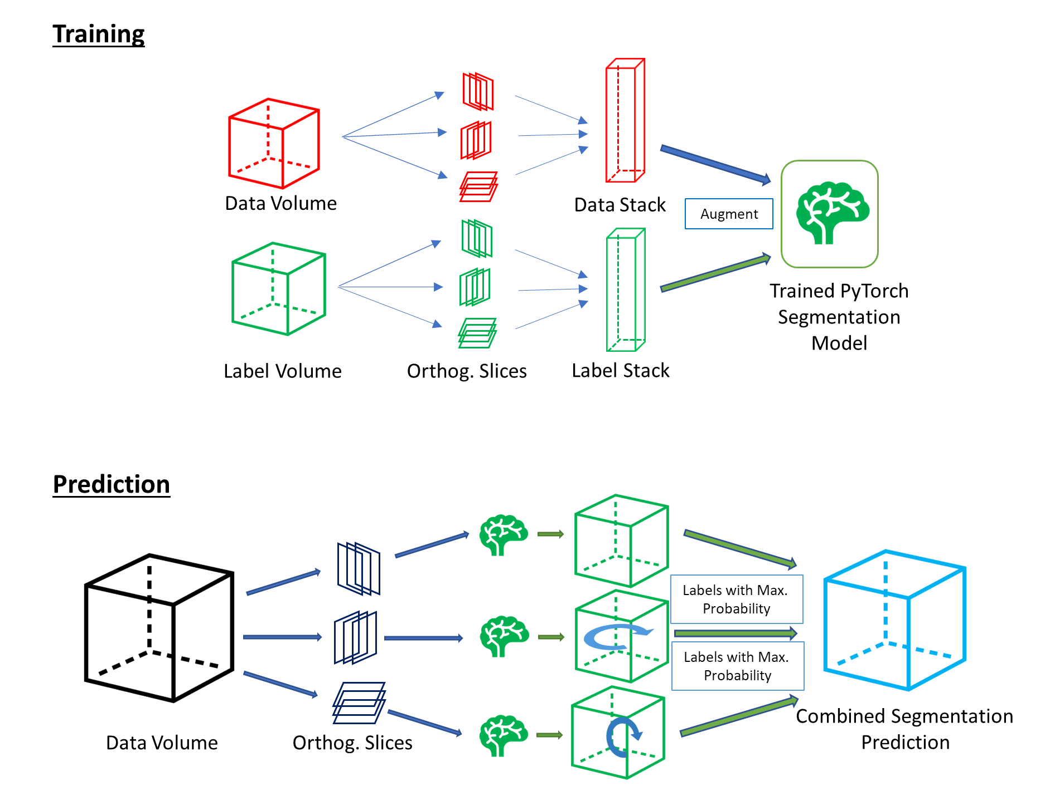
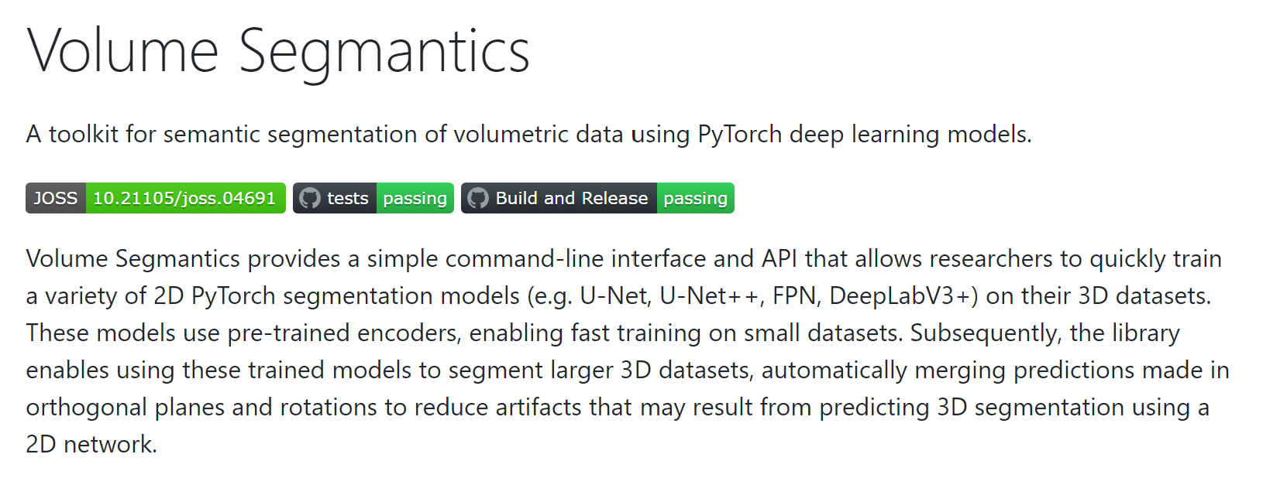
3D Segmentation using 2D deep CNNs
Flexible Deep CNN Architectures
Variety of pre-trained 2D segmentation networks available via “Volume Segmantics” package
e.g. U-Net, U-Net++, DeepLabV3+
King O.N.F, Bellos, D. and Basham, M. (2022). Journal of Open Source Software, 7(78), 4691. doi: 10.21105/joss.04691
Notes:
Will explain more about Superregions in a minute
Uses shallow machine learning techniques for the time being

Slide 14
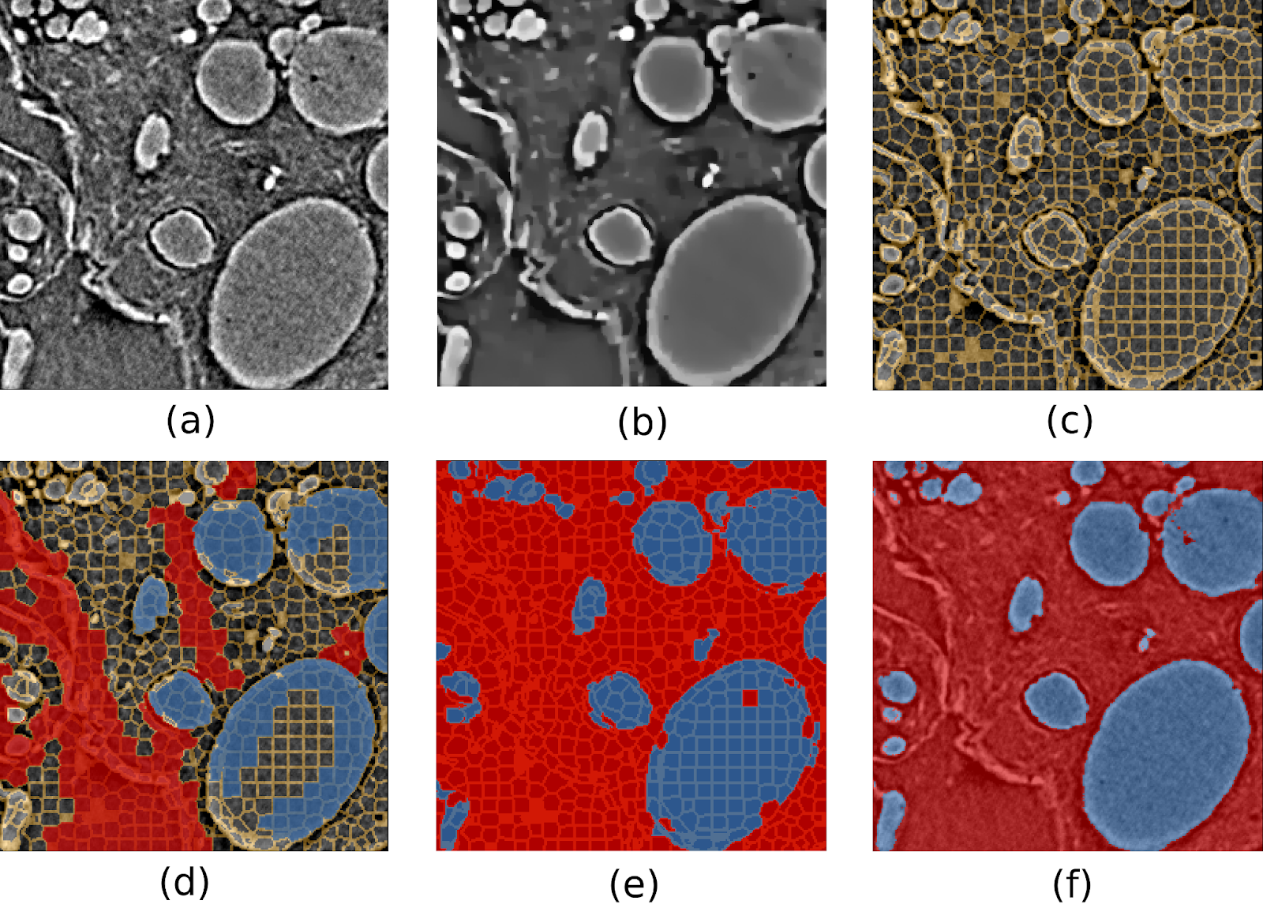
SuRVoS2 – Segmentation Example
Training data is created using super-region segmentation
256 x 256 x 256 px region of interest taken from dataset of size 2520 × 2520 × 2120 px
A 2d U-Net is trained on this initial segmentation
Training is done in the (x, y), (x, z) and (y, z) planes
Segmentation of blood vessels from X-ray microtomography dataset of human placental tissue
Pennington, A., King, O. N. F., Tun, W. M., Ho, E. M. L., Luengo, I., Darrow, M. C., & Basham, M. (2022). SuRVoS 2: Accelerating Annotation and Segmentation for Large Volumetric Bioimage Workflows Across Modalities and Scales. Frontiers in Cell and Developmental Biology, 10. https://doi.org/10.3389/fcell.2022.842342

Slide 15
SuRVoS2 – Segmentation Example
A larger dataset can then be loaded and the U-net applied
Time estimates:
Manual: 2 months
Super-region: 1 month
Super-region + U-net: 4 hours
A slice of the full data (2520 X 2520 px)
Pennington, A., King, O. N. F., Tun, W. M., Ho, E. M. L., Luengo, I., Darrow, M. C., & Basham, M. (2022). SuRVoS 2: Accelerating Annotation and Segmentation for Large Volumetric Bioimage Workflows Across Modalities and Scales. Frontiers in Cell and Developmental Biology, 10. https://doi.org/10.3389/fcell.2022.842342

Slide 16
SuRVoS2 – Segmentation Example
Pennington, A., King, O. N. F., Tun, W. M., Ho, E. M. L., Luengo, I., Darrow, M. C., & Basham, M. (2022). SuRVoS 2: Accelerating Annotation and Segmentation for Large Volumetric Bioimage Workflows Across Modalities and Scales. Frontiers in Cell and Developmental Biology, 10. https://doi.org/10.3389/fcell.2022.842342

Slide 17
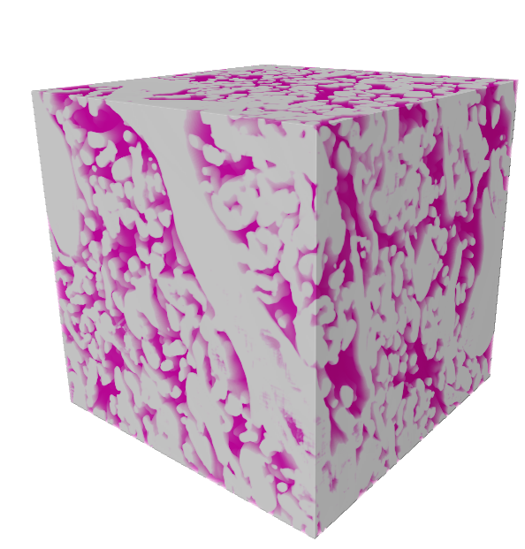
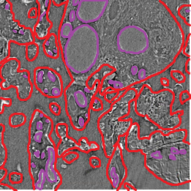
SuRVoS2 – Segmentation Example
Multiscale Characterisation of Tissues and Blood Vessels in the Human Placenta
Tissue Regions
Two separate 2D U-Nets trained on small training volumes that were segmented using SuRVoS:
[256]³ volume representing blood vessels
[384]³ volume representing maternal/fetal blood tissue regions
Tissue Regions
Blood Vessels
Win Tun
Notes:
The human placenta is an exchange organ with a large surface area of the feto-maternal interface packed in a relatively small volume, and an extensive feto-placental vascular network
We use one U-Net to segment and quantify the intervillous space (IVS)
The intervillous space is simply the space between the mother's blood vessels and the fetal chorionic villi. It is filled with a pool of maternal blood where bathe the villi. This is where all nutrient, gas and waste exchange occur.

Slide 18
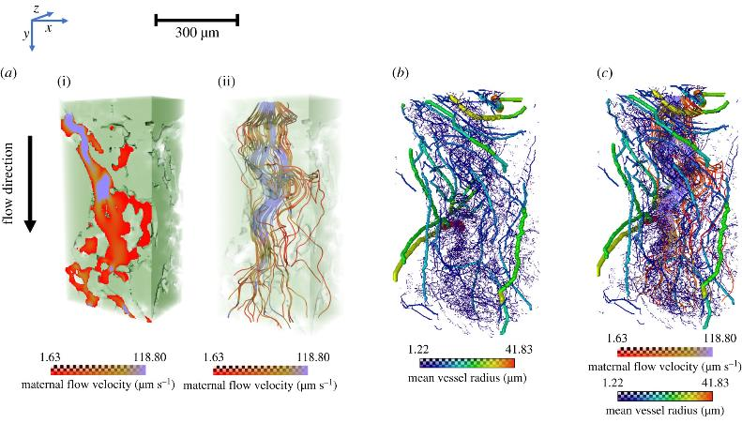
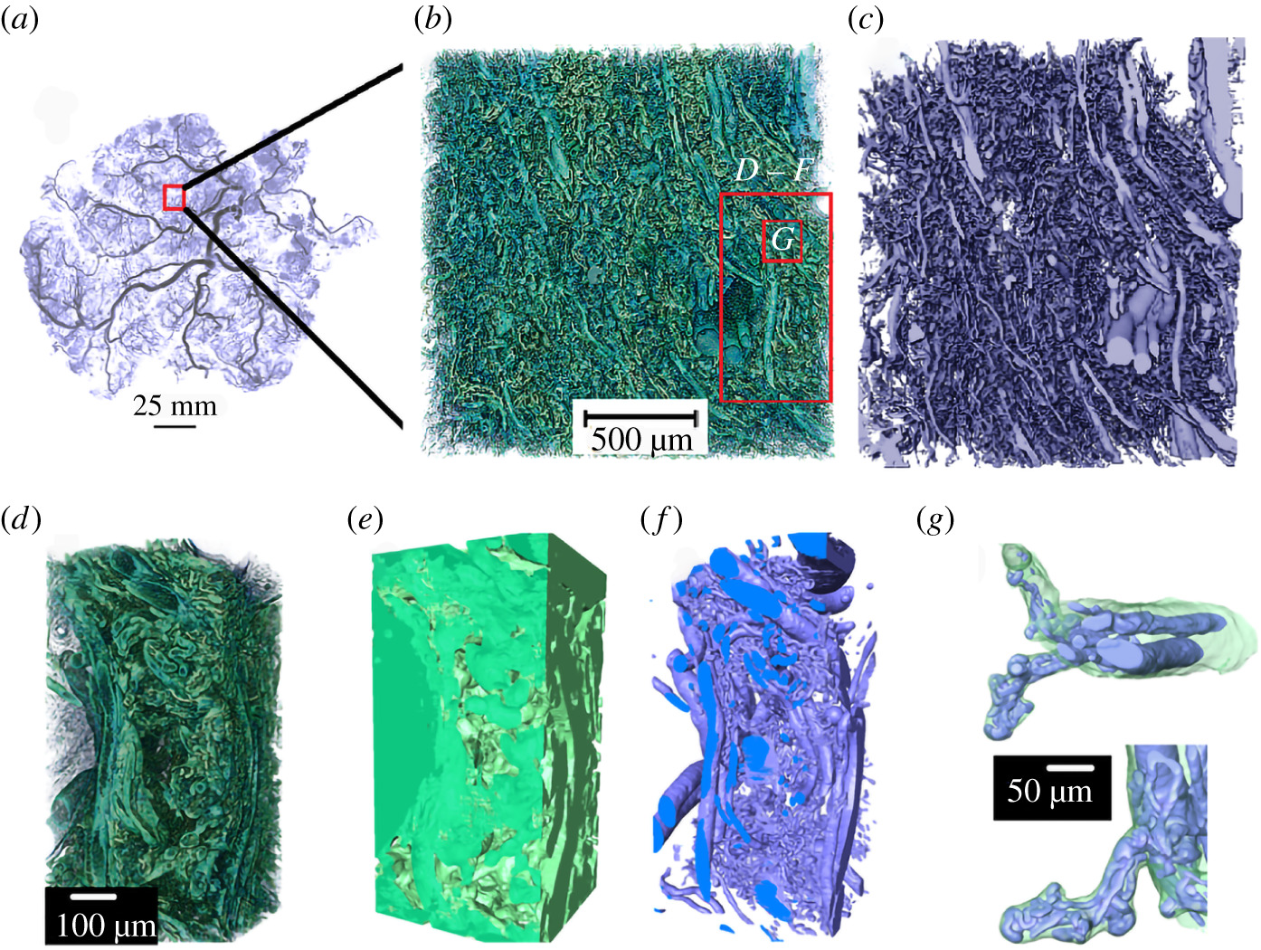
Segmentation Example - Summary
Multiscale Characterisation of Tissues and Blood Vessels in the Human Placenta
Tun W. M., Poologasundarampillai G et al. (2021). J. R. Soc. Interface. 18:20210140
Notes:
Placental cast under micro-CT (unpublished image from [5]). (b–g) Images demonstrating the complex hierarchical architecture of the human placenta (Specimen 1, normal placenta at term). (b) Three-dimensional rendering of approximately 8 mm3 human placental tissue. (c) Fetal vascular network segmented from placental tissue using a U-Net algorithm. (d–f ) A small section of the placental tissue was cropped from the original dataset (red box in b) and 3D rendered. (d ) Three-dimensional rendering of approximately 0.2 mm3 tissue showing different hierarchical features. (e) U-Net segmented fetal tissue component, ( f ) fetal vessels and (g) fetal capillary network with surrounding villous tissue overlaid
Flow simulations across maternal IVS to visualize the inter-relationship between maternal blood flow and fetal vascular flow (Specimen 1, normal placenta at term). (a) The maternal (i) flow velocity map and (ii) flow streamlines in the IVS. (b,c) The inter-relationship of maternal flow streamlines and fetal blood vascular network. (d )

Slide 19
Summary
SuRVoS has been completely rewritten as a client-server application installed as a napari plugin
SuRVoS2 features the functionality of the original software plus much more flexibility
Interaction directly with the server through API calls
Richer visualisation of data
Deep-learning pipelines
Import of crowd-sourced annotations
There is still scope for adding more features and functionality according to the needs of facility users, please contact us!
avery.pennington@diamond.ac.uk
olly.king@diamond.ac.uk
mark.basham@rfi.ac.uk
michele.darrow@rfi.ac.uk
https://github.com/DiamondLightSource/SuRVoS2
Pennington A, King ONF, Tun WM, et al. SuRVoS 2: Accelerating Annotation and Segmentation for Large Volumetric Bioimage Workflows Across Modalities and Scales. Frontiers in Cell and Developmental Biology. 2022 ;10:842342. DOI: 10.3389/fcell.2022.842342.

Slide 20
Acknowledgments
Thanks for listening!
Avery Pennington
Imanol Luengo
Win Tun
Mark Basham
Michele Darrow
Omar Elamin
Richard Parke
Sharif Ahmed

