Slide 1
PHASE SEGMENTATION OF UNCURED COMPOSITE PREPREGS VIA DEEP LEARNING
Pedro Galvez Hernandez
Dr. James Kratz
Image Based Simulation For Industry (IbSim-4i)
20.10.2022
London
pedro.galvezhernandez@bristol.ac.uk
Notes:
Reduce number animations
Timeline change: Remove?

Slide 2
Index
Introduction
Phase Segmentation: Deep Learning vs Thresholding
The effect of the Deep Learning Architecture
The effect of the Annotator Bias
Summary

Slide 3
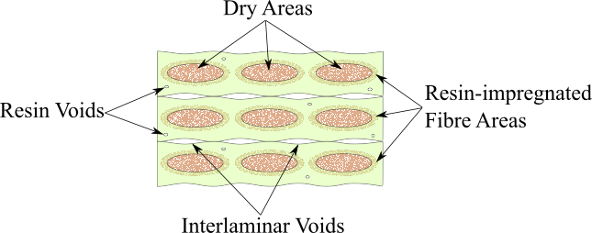
Introduction
Phase Segmentation
Deep Learning Architectures
Annotator Bias
Summary
What is a prepreg?
In theory…

Slide 4
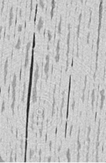
Introduction
Phase Segmentation
Deep Learning Architectures
Annotator Bias
Summary
In reality…
X-Ray CT micrography
Variability due to:
Different material suppliers
Different batches
Different classes (e.g. autoclave, out-of-autoclave, ATL grades, etc…)
Different Void Distribution and Level of Impregnation (Dry Areas)

Slide 5
Introduction
Phase Segmentation
Deep Learning Architectures
Annotator Bias
Summary
Accurate quantification of the different phases in X-Ray CT micrographs of uncured prepreg composite
Phase Segmentation

Slide 6
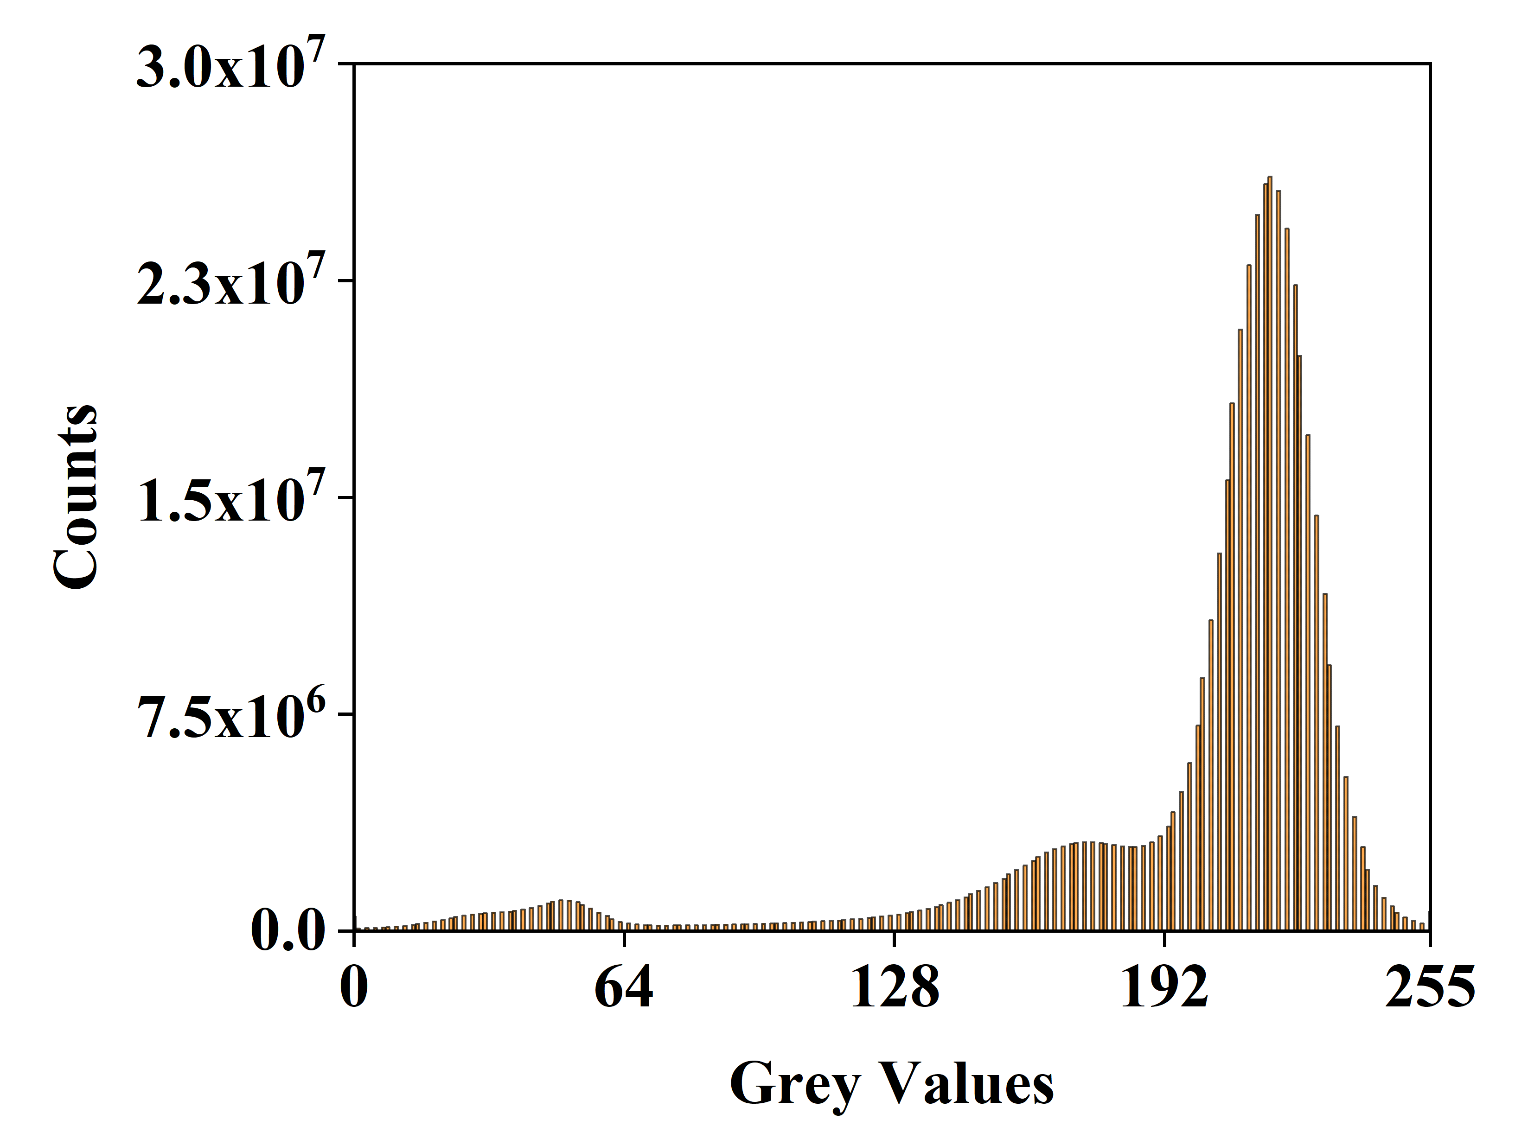
Introduction
Phase Segmentation
Deep Learning Architectures
Annotator Bias
Summary
How to effectively separate the different phases?
Thresholding
Deep Learning
Voids
Dry Areas
U-Net architecture Ronneberger et al. 2015)
Th1: Mid-grey value between peaks
Th2: Minimum grey value between peaks
Notes:
- Add year in reference

Slide 7
Introduction
Phase Segmentation
Deep Learning Architectures
Annotator Bias
Summary
How to effectively separate the different phases?
Deep Learning
Patches Selection
Manual Annotations
Training Set Size
25
DL Training and Segmentation
50
100

Slide 8
Introduction
Phase Segmentation
Deep Learning Architectures
Annotator Bias
Summary
Thresholding
Deep Learning
Mid-grey value threshold
DL Trained with 50 images
2 mm

Slide 9
Introduction
Phase Segmentation
Deep Learning Architectures
Annotator Bias
Summary
Deep Learning and Thresholding provide similar content estimations for dry areas but different distribution
Galvez-Hernandez et al. (2021)

Slide 10
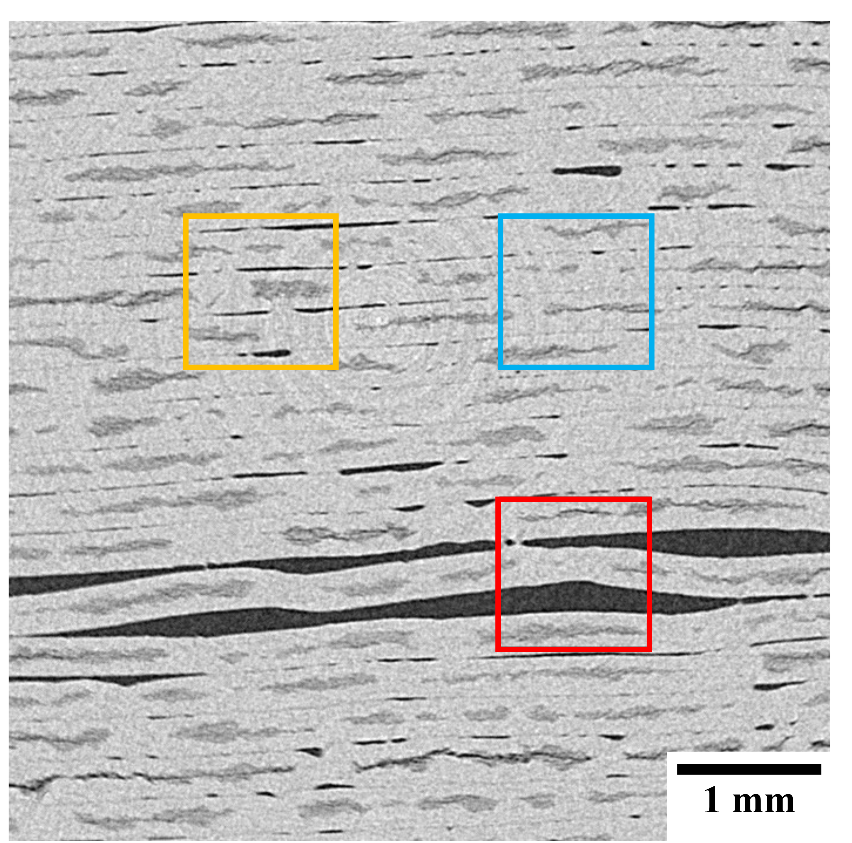
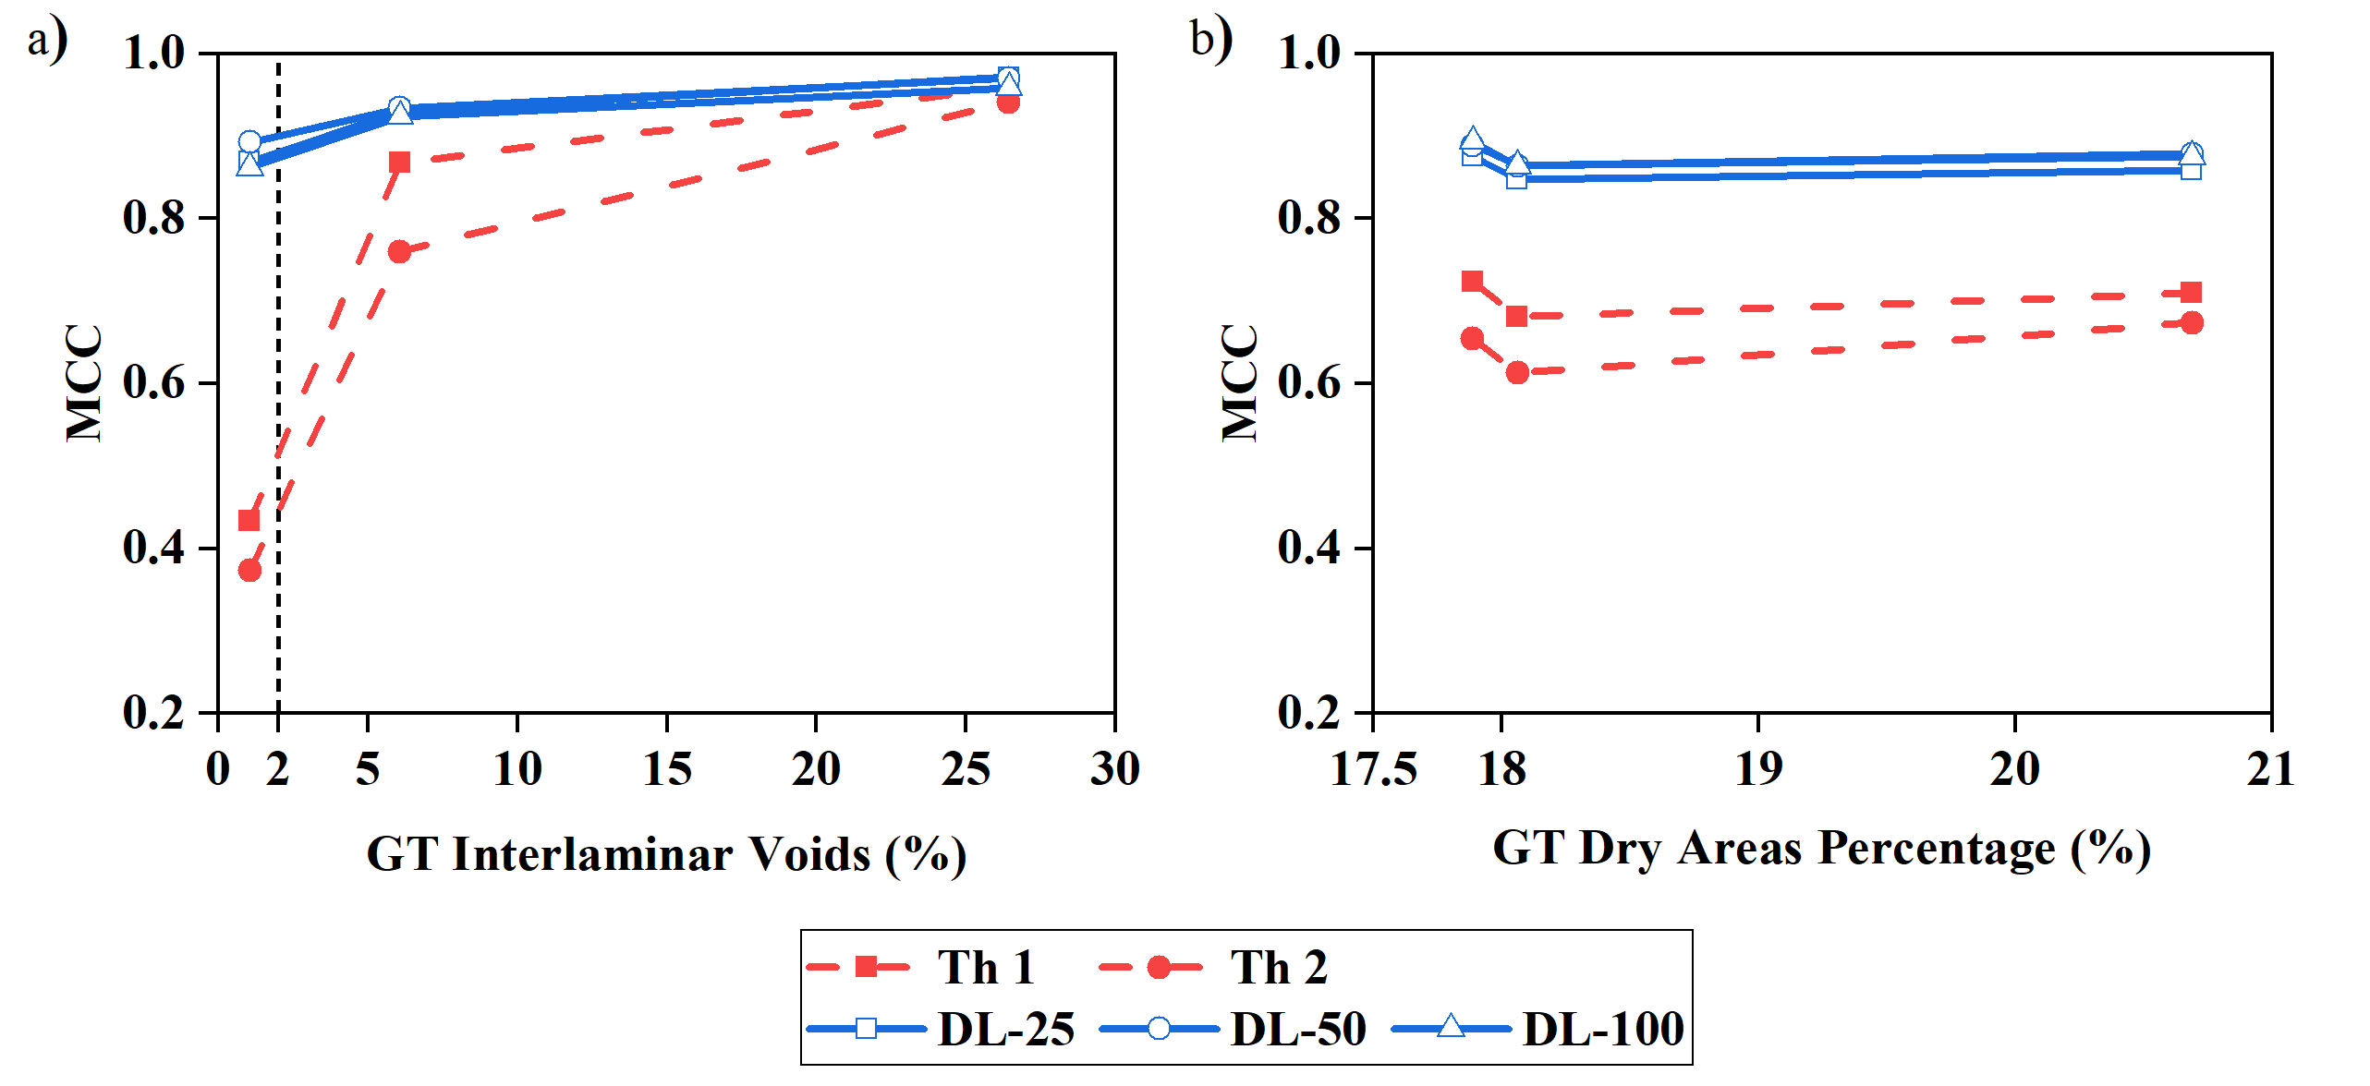
Introduction
Phase Segmentation
Deep Learning Architectures
Annotator Bias
Summary
Performance Evaluation
Three ROIs with low (1%), medium (6%) and high porosity (25%)
TP: True Positive
TN: True Negative
FP: False Positive
FN: False Negative
Notes:
MCC equation
Mention DL outperforms Thresholding at low porosity

Slide 11
Introduction
Phase Segmentation
Deep Learning Architectures
Annotator Bias
Summary
What is the effect of the Deep Learning architecture in the segmentation performance?
Architecture | Publication | Applications
FCN-8s and FCN-16s | (Long, 2014) | Composites characterization and manufacturing Medicine Remote Sensing Construction
SegNet | (Badrinarayanan, 2015)
U-Net | (Ronneberger, 2015)
FCDenseNet - Tiramisu | (Huang, 2016) (Jegou, 2016)
LinkNet | (Chaurasia, 2017)
DeepLabV3+_Xception and _ResNet18 | (Chen, 2018)

Slide 12
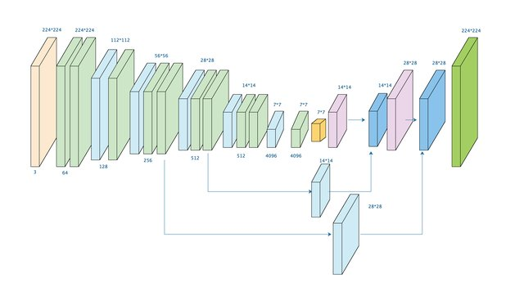
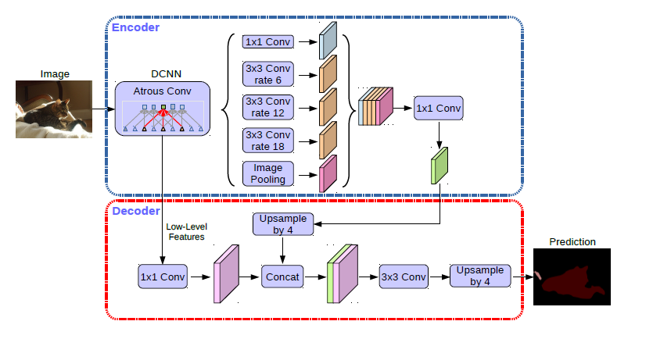
Introduction
Phase Segmentation
Deep Learning Architectures
Annotator Bias
Summary
What defines a Deep Learning architecture?
Type of layers: Convolution, Atrous Conv., Depthwise Conv., Separated Conv, Dropout…
Sequence and Connection between layers: Concatenation, Add…, Upsampling
FCN-8s
DeepLabV3+ (2018)
He et al. (2018)
Chen et al. (2018)

Slide 13
Introduction
Phase Segmentation
Deep Learning Architectures
Annotator Bias
Summary
Performance Evaluation: DL Models Comparison
Training Set Size: 25
Training Set Size: 50
Training Set Size: 100
Most DL models outperform Thresholding in low porosity volumes
U-Net and FCDenseNet best models in any volume and training set size
SegNet: Struggle in the segmentation of big voids

Slide 14
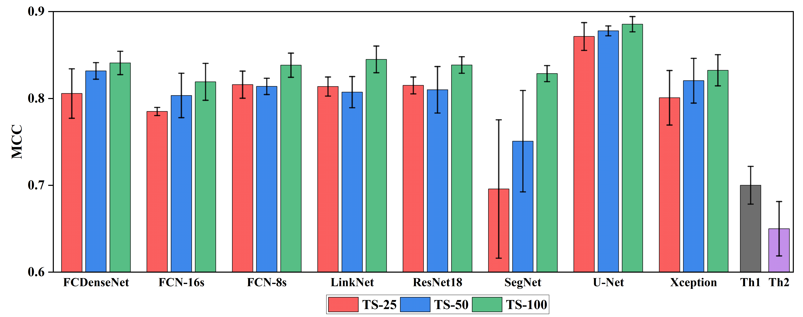
Introduction
Phase Segmentation
Deep Learning Architectures
Annotator Bias
Summary
Performance Evaluation: DL Models Comparison
DL models consistently outperform Thresholding in all volumes regardless of the Training Set Size

Slide 15
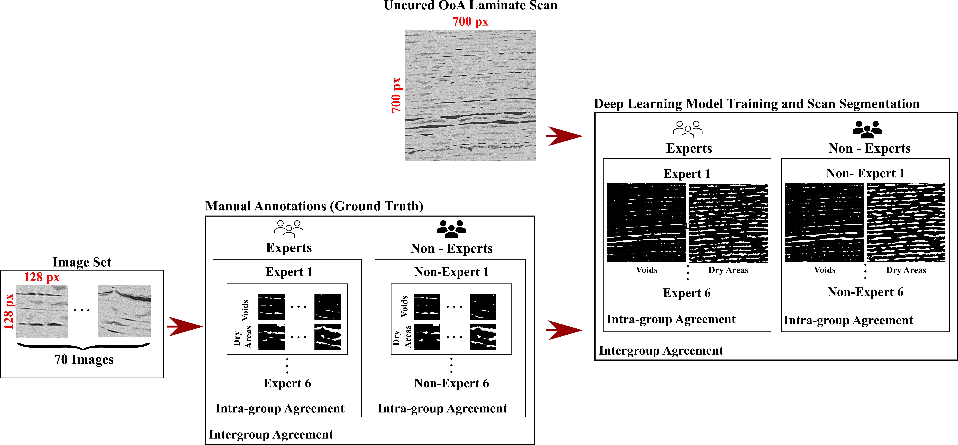
Introduction
Phase Segmentation
Deep Learning Architectures
Annotator Bias
Summary
Objectives and Experiment Design
Effect of the Annotator Bias in the Deep Learning segmentation of interlaminar voids and dry area in uncured prepreg micrographs

Slide 16
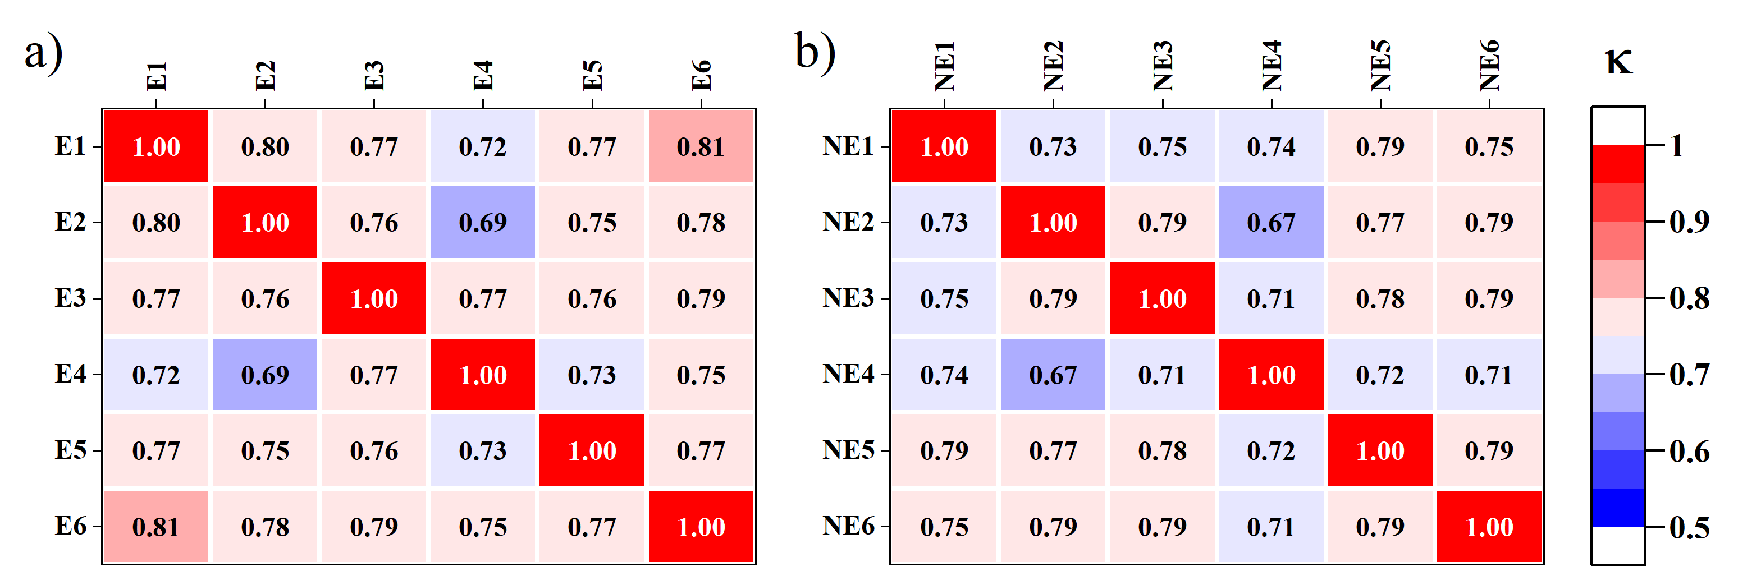
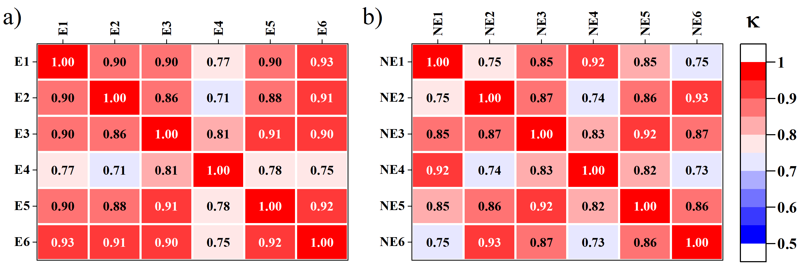
Introduction
Phase Segmentation
Deep Learning Architectures
Annotator Bias
Summary
Inter-Annotator Agreement (Cohen’s Kappa)
High level of inter-annotator and inter-model agreement
Higher degree of similarity between DL segmentation than between annotators ground truths.
Inter-group agreement (Vanbelle’s method):
Ground Truths: 0.99
Phase Segmentation: 0.99
Ground Truth (Manual Annotations)
DL Phase
Segmentation

Slide 17
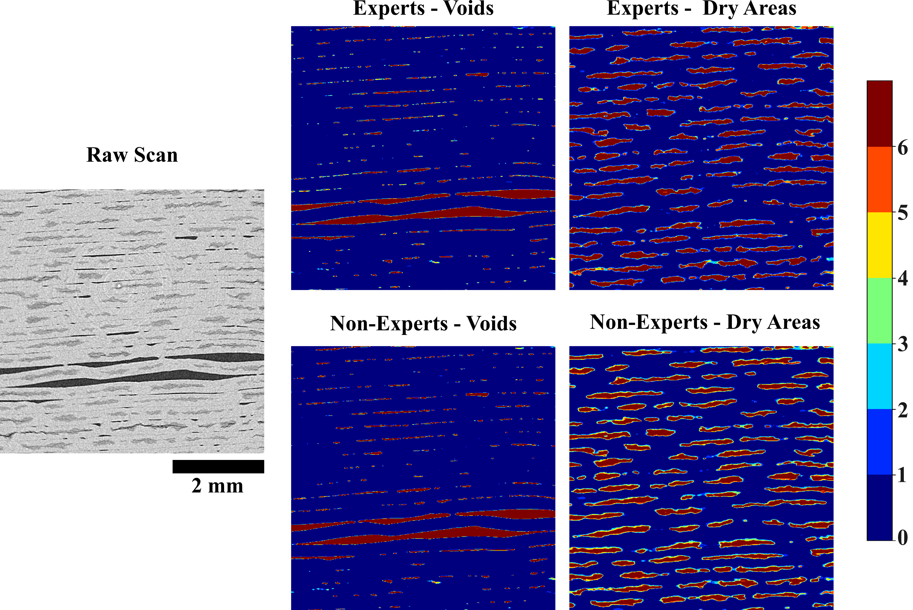
Introduction
Phase Segmentation
Deep Learning Architectures
Annotator Bias
Summary
Phase Segmentation – Models Agreement
Higher degree of disagreement in the edges of the features of interest

Slide 18
Introduction
Phase Segmentation
Deep Learning Architectures
Annotator Bias
Summary
Phase Segmentation – Qualitative Results
Both groups provide comparable quantitative segmentation results
Non-experts DL tend to overestimate the percentage of interlaminar voids and dry areas
Non-experts DL segment fewer but bigger objects

Slide 19
Introduction
Prepregs Segmentation
Results
Summary
Deep Learning consistently outperforms Thresholding
Deep Learning successfully segments volumes with low porosity
Deep Learning provides a sharper and cleaner segmentation of dry areas
U-Net showed the best performance amongst the selected DL models
Both groups provide a comparable segmentation of voids and dry areas

Slide 20
Introduction
Prepregs Segmentation
Results
Summary
Galvez-Hernandez P, Gaska K, Kratz J, Phase segmentation of uncured prepreg X-Ray CT micrographs, Composites Part A: Applied Science and Manufacturing, Volume 149, 2021

Slide 21
Acknowledgments
The authors would like to acknowledge Rolls-Royce plc for their support of this research through the Composites University Technology Centre at the University of Bristol, UK and the EPSRC grant Investigation of fine-scale flows in composites processing (EP/S016996/1)

Slide 22
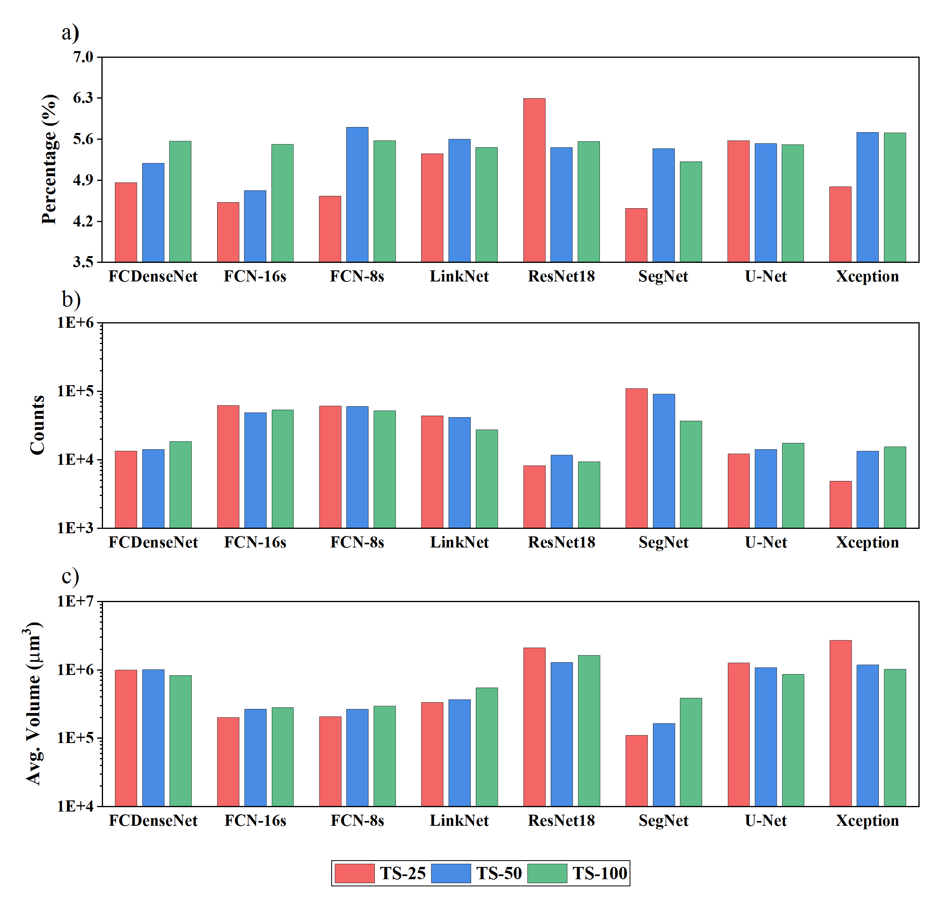
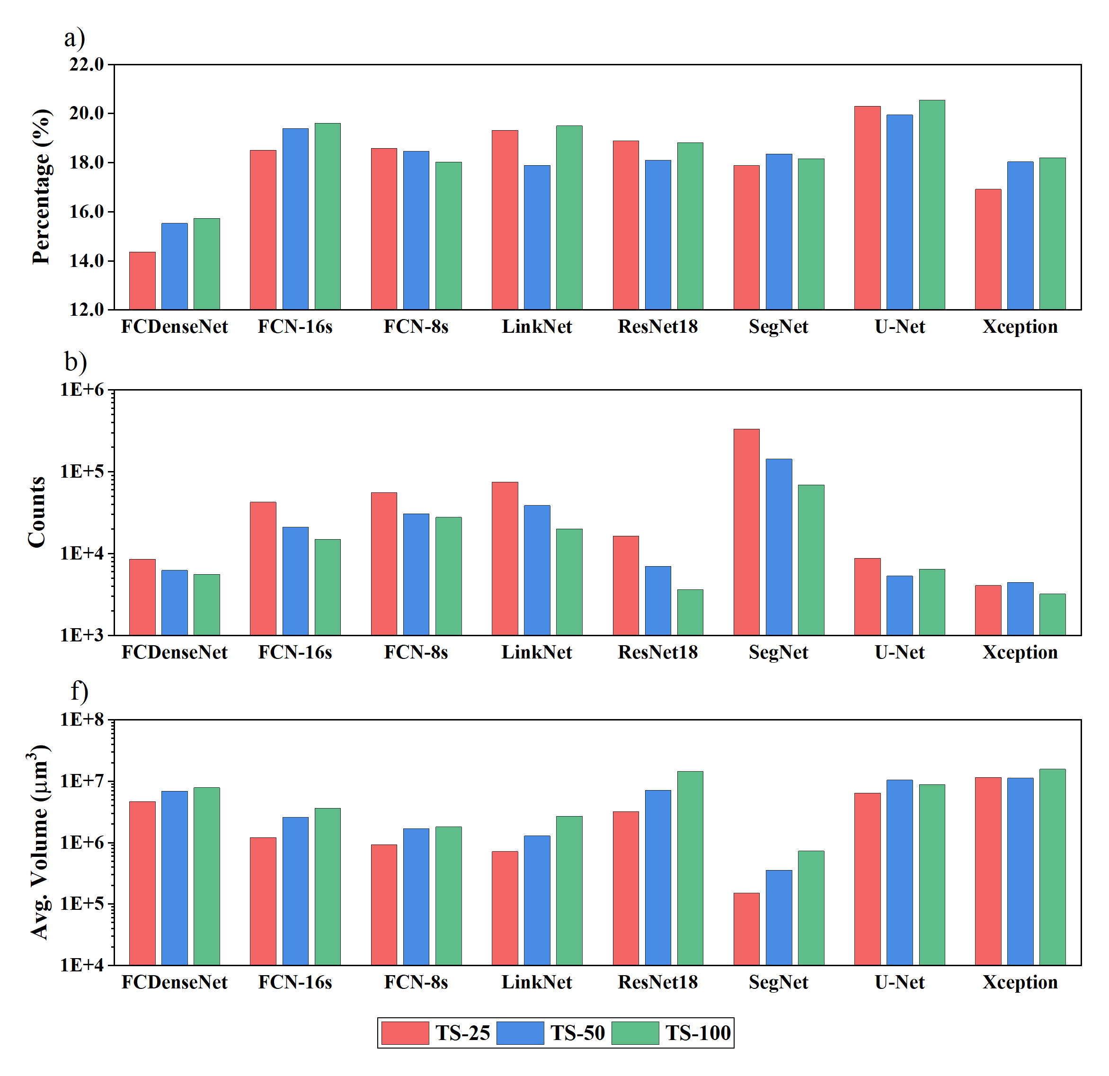
Introduction
Phase Segmentation
Deep Learning Architectures
Annotator Bias
Summary
Percentage Voids and Dry Area: DL Models Comparison

