Slide 1
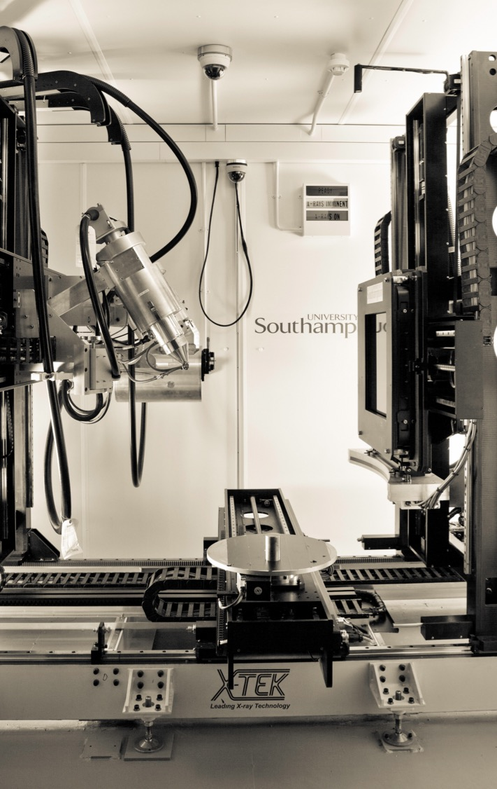
X-ray Tomographic Reconstruction using Adaptive (Mesh) Representations
20/10/2022
Thomas Blumensath, Ibrahim Harrane, Emilien Valat
µ-VIS X-ray Imaging Centre
University of Southampton,
Southampton,
SO17 1BJ
UK
muvis@soton.ac.uk
www.muvis.org
Supported by EPSRC grant: EP/R002495/1

Slide 2
Utilising CAD data in X-ray tomography reconstruction
CAD data can be used in different ways to constrain X-ray tomographic reconstruction.
We here investigate its use in conjunction with different adaptive image representations.

Slide 3
Adaptive image bases
Images are typically made up of pixels (2D) or voxels (3D).
Pixels and voxels are orthogonal, non-overlapping partitions of unity basis functions that can be used to approximate continuous 2D and 3D functions.
In theory, many other basis functions can be used to represent images.
  They do not need to be orthogonal.
  They can be overlapping.
  They do not all need to sum to a constant function.
  However, all of these properties are useful.

Slide 4
Adaptive image bases
In general, a 3D image basis is any set of functions such that
for all x, y, z in the domain of the image.
Traditional voxel basis in 3D
Notes:
\Phi_i(x,y,z)=\begin{cases} 1 & \text{if $a_i\leq x<a_{i+1}$, $b_i\leq y<b_{i+1}$, $c_i\leq z<c_{i+1}$} \\
0 & \text{otherwise} \end{cases}

Slide 5
Adaptive image bases
Whilst in theory, the functions can overlap, i.e.
we often choose a basis that is orthogonal:
and non-overlapping
Notes:
\langle \Phi_i(x,y,z) , \Phi_j(x,y,z) \rangle = 0 \ \mathrm{ for }\ i\neq j

Slide 6
Variable size bases
For tomographic image reconstruction, it can be advantageous to use a basis that has a non-uniform spatial density.
The density of the basis can depend on:
  Prior information (e.g. CAD data)
  Be adapted during reconstruction based on current image estimates

Slide 7
Different bases for volumetric images
Superpixels
Variable size voxels
Tetrahedral meshes

Slide 8
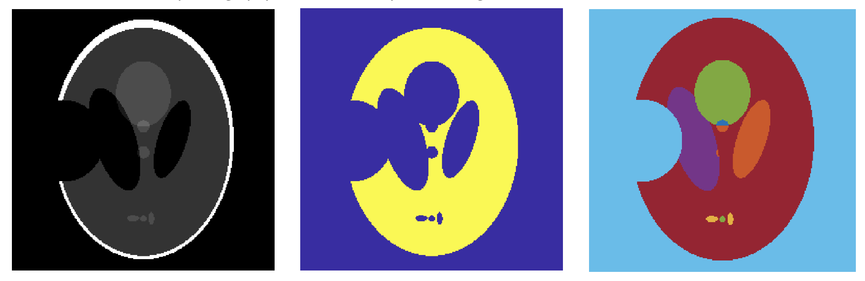
Prior information: Mask based superpixels
CAD data can be used to define different image masks, either for the entire object or for parts of an object.
This can be used in X-ray tomography reconstruction by constraining attenuation in each area to be uniform.
Phantom
Background mask
Object masks

Slide 9
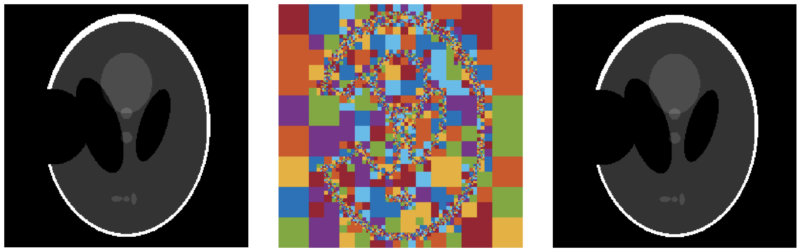
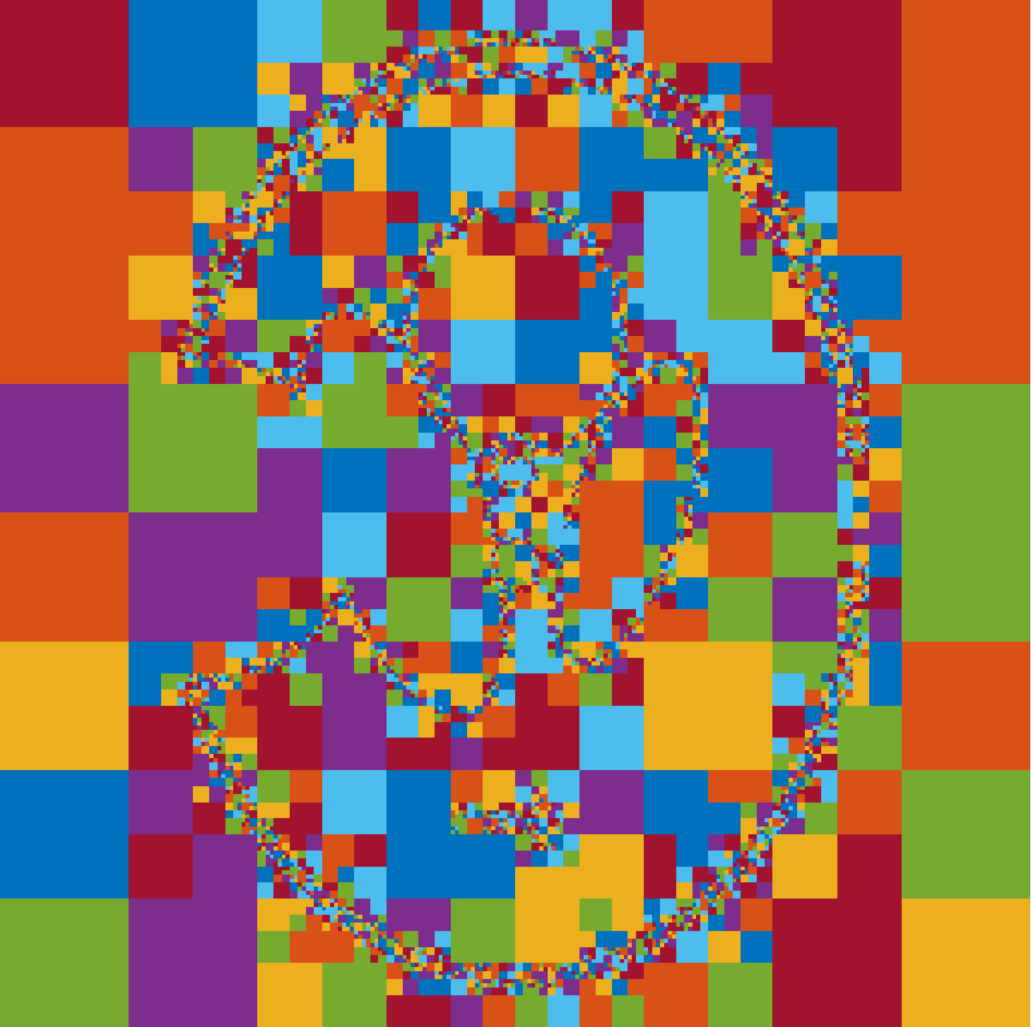
Prior information: Variable size pixels
CAD data can also be used to define a variable image basis, with higher resolution around object boundaries.
Here an optimal pixel basis with variable size pixels is shown, using a quad-tree the optimal basis can be found.
Original
Optimal Basis
Optimal approximation
Phantom
(65536 pixels)
Randomly colored variable size pixels
(Basis optimized for phantom, 5000 pixels)
Approximation of Phantom
in variable size basis with 5000 pixels

Slide 10
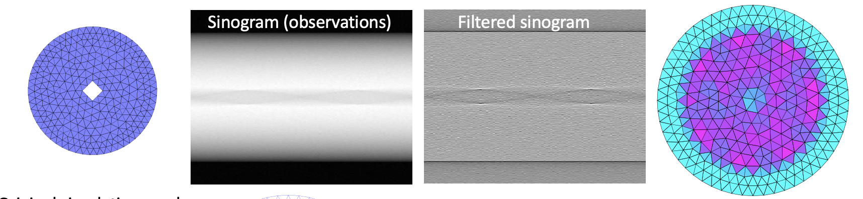
Tetrahedral mesh representations
CAD data can also be used to define Tetrahedral basis representations.
But with all of these methods, if the CAD representation is not correct, image estimation is compromised.
Sinogram (observations)
Filtered sinogram
Original simulation mesh
Filtered backpojection reconstruction
Simulation mesh (red dash-dot) is different from the
reconstruction mesh (blue)

Slide 11
Experiments using masks in reconstruction

Slide 12
Using Masks in reconstruction
If we have the correct mask, using FBP (from 18 projections):
Original
FBP reconstruction
FBP reconstruction with mask

Slide 13
Using Masks in reconstruction
Using iterative methods can lead to better results:
FBP reconstruction with mask
Iterative reconstruction with mask

Slide 14
Using Masks in reconstruction
However, if the mask is not correct, we get larger errors again
Iterative reconstruction with mask
Iterative recon. with shifted mask
Mask shifted 10 pixels downwards

Slide 15
Using Masks in reconstruction
We can however also estimate a mask from the projections, using thresholding and a convex hull reconstruction
Iterative reconstruction with mask
Mask estimated from projections
Iterative recon. with convex hull mask

Slide 16
Using Masks in reconstruction
Pros:
  If the mask fits well or if a mask can be derived form the projections, then this provides an easy to use constraint in iterative reconstruction.
Cons
  If the mask does not include parts of the object, large errors in the reconstruction occur
  If the mask is too large, the method is less effective, but errors are relatively small

Slide 17
Quad/Oct tree pixel bases
  Variable size pixel/voxel basis can be used in different ways
    Define a fixed image basis with variable size pixels/voxels based on CAD data
    Start with a low resolution basis and split voxels/pixels whenever needed
    For a given approximation, find an optimal variable resolution representation

Slide 18
Quad/Oct tree pixel bases
Iterative voxel/pixel splitting based on error metric
  Reconstruction form 18 projections using FBP into high resolution basis with averaging in low resolution basis
140 pixels
1000 pixels
4000 pixels

Slide 19
Quad/Oct tree pixel bases
Careful CAD based initialization, convex hull masking, iterative splitting and merging can increase reconstruction accuracy

Slide 20
Quad/Oct tree pixel bases
Using an iterative thresholding based optimizer (find ‘best’ basis in each iteration):
(Left) Reconstruction by iteratively projecting onto the best 4000 pixel quad-tree basis. Some evidence of over-smoothing (some small features are missing). But other features are captured well.
(Middle) Additional TV constraint offers additional smoothness constraint.
(Right) TV only regularization for comparison.

Slide 21
Tetrahedral mesh bases
In tetrahedral mesh bases, there is no useful quad/oct tree like structure.
We could split tetrahedra into smaller tetrahedra by adding a central node, but this leads to increasingly “flat” tetrahedra and is thus not advisable.
Instead, we can use one of several approaches
  Use CAD data to define the shape of the object but then keep the mesh fixed.
  Start with a course mesh and refine the mesh by splitting cells or boundaries.
  Iteratively generate a new mesh with a variable density
  Move mesh nodes

Slide 22
Tetrahedral mesh bases
Iterative mesh density refinement
Uniform
mesh
recon
1st refined
mesh
recon
2nd refined
mesh
recon
Uniform
mesh
1st refined
mesh
2nd refined
mesh

Slide 23
Tetrahedral mesh bases
By adding a TV type constraint to the mesh optimization, improved results are possible.
Resolution 1
Resolution 2
Resolution 3

Slide 24
Tetrahedral mesh bases (Mesh node location gradient)
Node placement based on local density might not allow nodes to placed exactly at boundaries, as we might not have a very good estimate of current node boundaries.
Also, when using CAD based mesh models, errors in CAD/object alignment will lead to errors around object boundaries.
One way to overcome this is to move the object boundary or mesh nodes based on the reconstruction error.

Slide 25
Tetrahedral mesh bases
Initial mesh and gray values
Bottom and right edge incorrect
Original shape shown in red
Mesh after 200 iterations
Node gradient shown in dark blue
Mesh after 400 iterations
Node gradient shown in dark blue

Slide 26
Summary
Adaptive voxel based basis (quad/oct tree) are easy to incorporate into current reconstruction framework, but computational operations run at the highest resolution.
Adaptive voxel based basis (quad/oct tree) allow us to ‘project’ onto the ‘best’ N term basis.
Tetrahedral basis reconstruction is computationally more challenging, but we can work with fewer elements.
Tetrahedral basis does not allow us to find ’optimal’ N term representation, but node locations can be adapted to fit boundaries.

Slide 27
Any questions?

