Slide 1

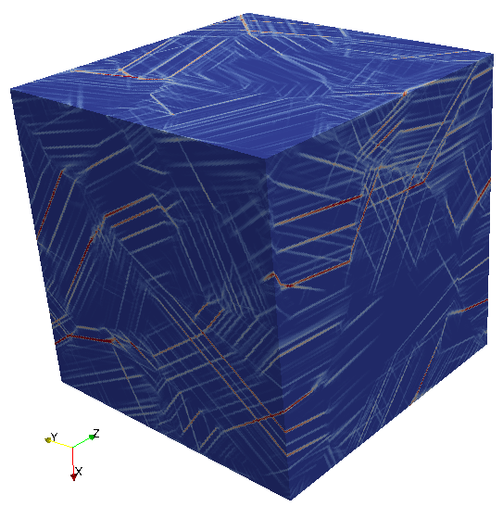
  https://amitexfftp.github.io/AMITEX/
A massively parallel FFT-based solver for Image-based simulation of heterogeneous materials
GELEBART Lionel, DEROUILLAT Julien, Université Paris-Saclay, CEA
Internships : DOUCET Nicolas (internship), DUVERGE Jérémy
PhD : CHEN Yang (now @ U. Bath), MARANO Aldo (now @ONERA)
Post Doc : OUAKI Franck, NKOUMBOU-KAPTCHOUANG Noé-Brice

Slide 2


OUTLINE
CONTEXT
Multiscale modeling $\&$ FFT-based solvers (mechanics)
- « standard » (mechanics)
- « extensions » (couplings)
CONCLUSIONS
CONTEXT
Multiscale modeling $\&$ FFT-based solvers (mechanics)
- « standard » (mechanics)
- « extensions » (couplings)
CONCLUSIONS
Notes:
After the context, I will introfuce the contributions : first on the development of the method and then on its application
Then I will finsh with on-going works and conclusions

Slide 3
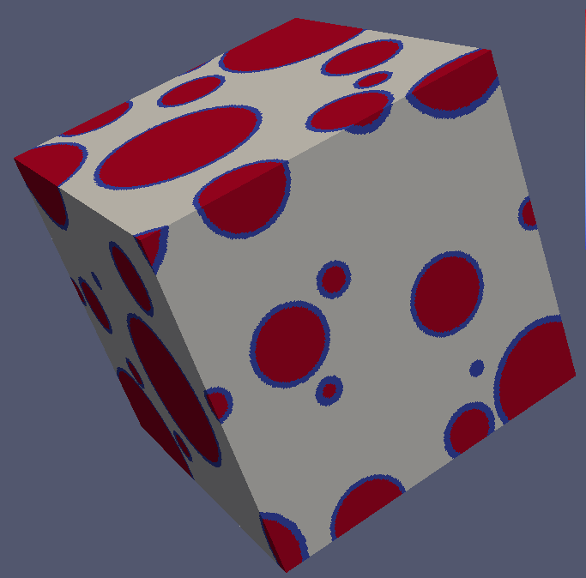
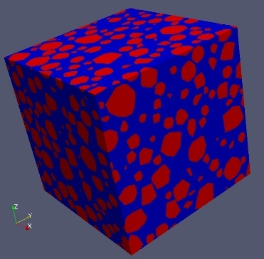
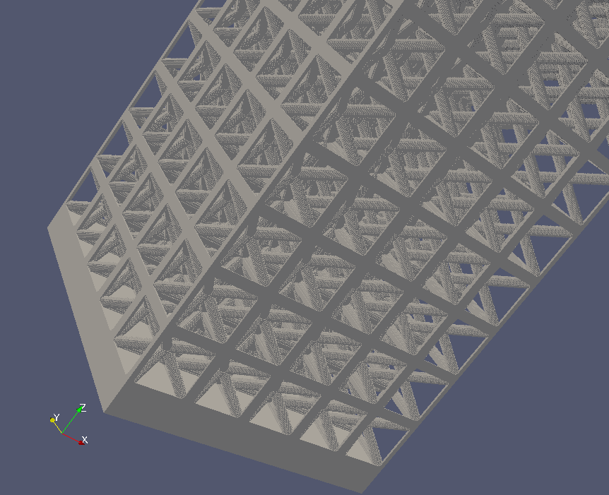
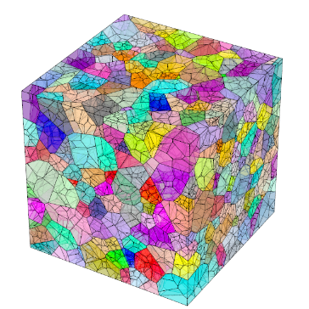
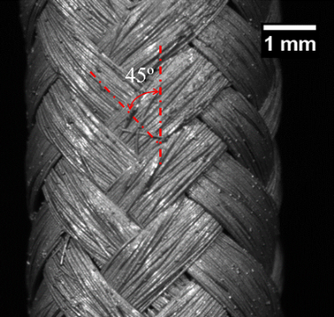
CONTEXT
1 – IMAGE-BASED NUMERICAL SIMULATION OF HETEROGENEOUS MATERIALS
Heterogeneous materials
Syntactic foam Concrete Architectured material Polycrystals (NEPER) SiC/SiC composites
Continuum Mechanics
Outputs
    Macroscopic behavior (average)
    Local quantities (Full fields)
SOLVER
Experiment
Notes:
The context of heterogeneous materials is very large as you can see on various examples
Howver, in all cases, we will consider the equations of continuum mechanics.
Then we use a numerical solver to obtain the macroscopic behavior as well as the local fields, to be compared to experiment
This is a standard approach followed in various labs at CEA-DES.

Slide 4
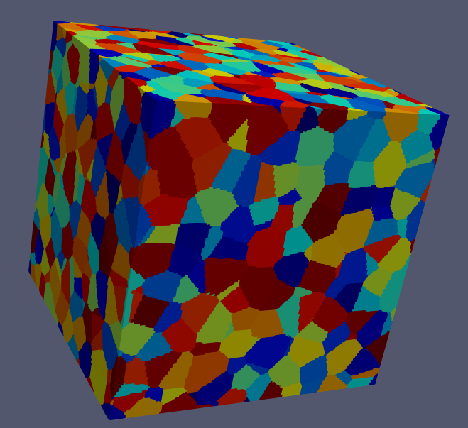
CONTEXT
3 - SOLVERS
Natural trends
Increase spatial resolution
Increase volume size
Complex behavior laws
Standard Finite Element (FE) codes
Computational LIMITS (time and memory)
FFT-based solvers (Moulinec-Suquet 1998)
Image-based simulation (no complex meshing procedure)
Efficiency > standard FE code
Well-suited for :
Parallel implementation -> push back computational LIMITS
Possible extensions (non-local mechanics, multi-physics…)
Notes:
The natural trends are …
When using standard FE codes, computational limits are rapidly reached.
On the other hand FFT-based solver are
More efficient than standard FE codes
Well-suited for parallel implementations
But also well-suited for diffrent extension

Slide 5



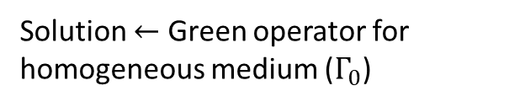




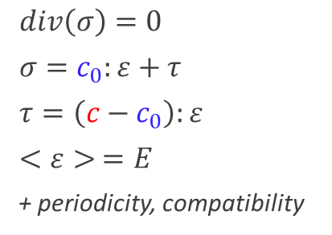

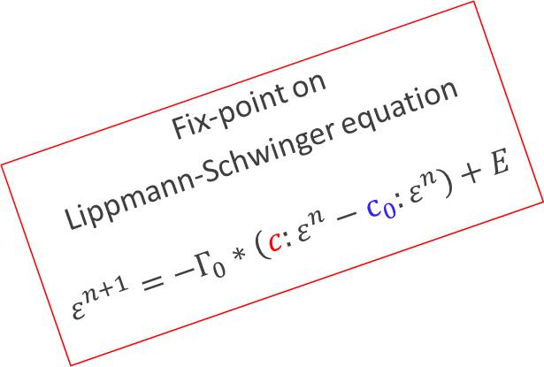
CONTEXT
4 - FFT SOLVER : the Basic Scheme (Moulinec-Suquet 1998)
Problem to solve on the unit-cell
Auxiliary problem
$div\left(σ\right)=0$
$σ=c_{0}:ε+τ$
$<ε> =E$
+ periodicity, compatibility
$div\left(σ\right)=0$
$σ=c:ε$
$<ε> =E$
+ periodicity, compatibility
Behavior splitting $σ=c_{0}:ε+\left(c−c_{0}\right):ε$
Solution $←$ Green operator for homogeneous medium ($Γ_{0}$)
$$τ$$
$ε=−Γ_{0}∗τ+E$
(in Real space)
Same problem (rewritten)
Fix-point on
Lippmann-Schwinger equation
$$ε^{n+1}=−Γ_{0}∗\left(c:ε^{n}−c_{0}:ε^{n}\right)+E$$
$div\left(σ\right)=0$
$σ=c_{0}:ε+τ$
$τ=\left(c−c_{0}\right):ε$
$<ε> =E$
+ periodicity, compatibility
$\hat{ε} =−{\hat{Γ}}_{0}:\hat{τ}$
$\hat{ε}(0) =E$
(in Fourier space)
$$τ=\left(c−c_{0}\right):ε$$
Notes:
One slide to explain the FFT-based solver.
The problem to solve is as follows :
The equilibrium equation
The behavior law
An average applied strain with periodicity condition
This problem is stricly equivalent to the Lippmann Scwinger equation, with Gamma0 the Green operator for an homogeneous material of arbitrary stiffness C0,
This equation is simply used to define a fix-point algorithm where the application of Gamma0 is evaluated in Fourier space
Using FFT, the discretization consists of a 3D regular grid or 3D image, with elements called vovels (the equivalent pixels for 2D images)
The drawbacks of the method are :
-
-
-

Slide 6
CONTEXT
Branch v8.17.X : AMITEX « Standard » (mechanics)
Stable version : bug corrections and minor modifications
Diffusion :
  https://amitexfftp.github.io/AMITEX/
  Research and Education Licence
Branch master : developments in progress
Major modifications or new functionalities for mechanics
Trunk for AMITEX « extensions » (coupling with other physics or codes)
Notes:
One slide to explain the FFT-based solver.
The problem to solve is as follows :
The equilibrium equation
The behavior law
An average applied strain with periodicity condition
This problem is stricly equivalent to the Lippmann Scwinger equation, with Gamma0 the Green operator for an homogeneous material of arbitrary stiffness C0,
This equation is simply used to define a fix-point algorithm where the application of Gamma0 is evaluated in Fourier space
Using FFT, the discretization consists of a 3D regular grid or 3D image, with elements called vovels (the equivalent pixels for 2D images)
The drawbacks of the method are :
-
-
-

Slide 7
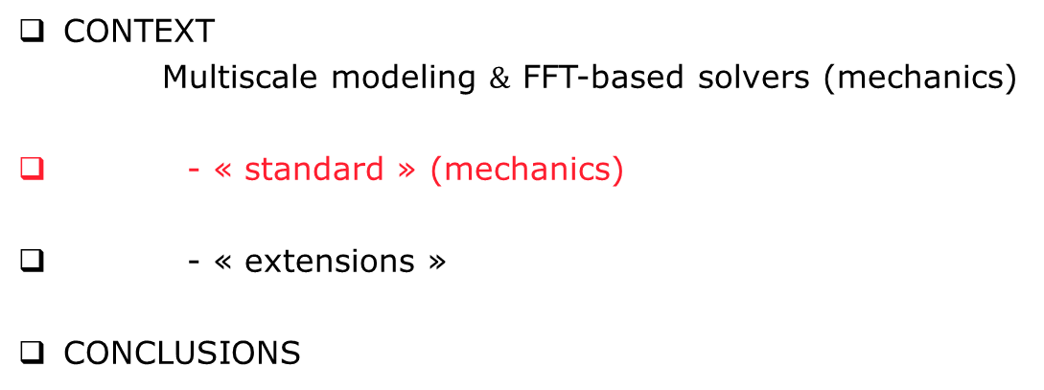

OUTLINE
CONTEXT
Multiscale modeling $\&$ FFT-based solvers (mechanics)
- « standard » (mechanics)
- « extensions »
CONCLUSIONS
User interface
UMAT ($→$ MFRONT) compatibility
HPP-Finite Strains
Discrete Green Operator
Convergence Acceleration
Composite voxels
Boundary conditions
HPC – scalability
Applications
Notes:
After the context, I will introfuce the contributions : first on the development of the method and then on its application
Then I will finsh with on-going works and conclusions

Slide 8
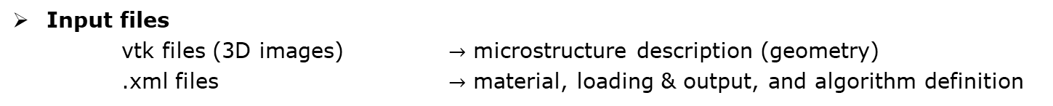
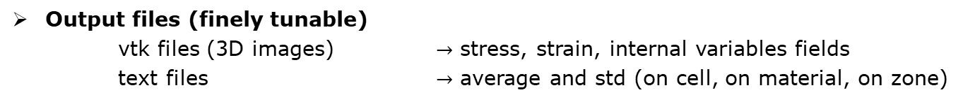
AMITEX « Standard »
« Versatile » user interface
mpirun (-np n) amitex_fftp -nm <num_mat.vtk> -nz <num_zone.vtk>
-a <algo.xml> -c <load.xml> -m <mat.xml>
-s <output>
Input files
vtk files (3D images) $→$ microstructure description (geometry)
.xml files $→$ material, loading & output, and algorithm definition
Output files (finely tunable)
vtk files (3D images) $→$ stress, strain, internal variables fields
text files $→$ average and std (on cell, on material, on zone)
How to learn ?
User’s guide : amitexfftp.github.io/AMITEX/user_guide/to_begin.html
Training session download : amitexfftp.github.io/AMITEX/general/download.html
Notes:
In this code, we have implemented a convergence acceleration inspired from the FE code

Slide 9
AMITEX « Standard »
« Versatile » user interface : behaviors
User defined behaviors
UMAT format compatibility with ABAQUS
Write your own behavior function following the UMAT format (i.e. my_own_umat.f90)
Compile and store the function in a dynamic library (i.e. libUmat.so)
Inform mate.xml file
<?xml version="1.0" encoding="UTF-8"?>
<Materials>
<!-- REFERENCE MATERIAL -->
<Reference_Material Lambda0=" 2.0431e+5" Mu0="0.8756e+5"/>
<!-- MATERIAL 1 -->
<Material numM="1" Lib="" Law="elasiso" >
<Coeff Index="1" Type="Constant" Value="100e3"/>
<Coeff Index="1" Type="Constant" Value="100e3"/>
</Material>
<!-- MATERIAL 2 -->
<Material numM="2" Lib="/home/gelebart/libUmat.so" Law="my_own_umat" >
<Coeff Index="1" Type="Constant" Value="200e3"/>
<Coeff Index="1" Type="Constant" Value="100e3"/>
<IntVar Index="1" Type="Constant" Value="0."/>
<IntVar Index="2" Type="Constant" Value="0."/>
</Material>
</Materials>
AMITEX native behavior
Lib=’’’’
Law=’’elasiso’’ (elastic isotropy)
User behavior
Lib="/home/gelebart/libUmat.so"
Law="my_own_umat"
Notes:
Here we have two material, the 1st one has a simple elastic beavior available in amitex
The 2nd is the user defined behavior
For the first one, we let Lib blank and set law= elasiso for isotropic elasticity
For the second, we inform Lib with path to the the path to the dynamic library and Law with the name of the user function

Slide 10


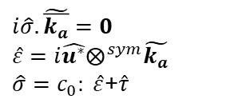



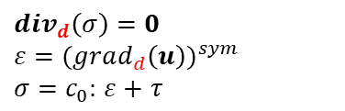
AMITEX « Standard »
Modified Discrete Green operator :
Implementation 2015, post-doc F. Ouaki
Simultaneously proposed in CR Mécanique, Willot 2015
$$ε^{n+1}=−Γ_{0}∗\left(c:ε^{n}−c_{0}:ε^{n}\right)+E$$
Finite Difference based DISCRETE GREEN OPERATOR $Γ_{0}$ (same as Willot 2015)
$$ε,σ$$
at grid centers
$$u,div(σ)$$
Linear FE with reduced integration
at grid corners
Discrete
Fourier Transform
Auxiliary problem
$$div_{d}\left(σ\right)=0$$
$ε={(grad_{d}\left(u\right))}^{sym}$
$σ=c_{0}:$ $ε+$ $τ$
$$i\hat{σ}. \tilde{\overline{k_{a}}}=0$$
$$\hat{ε}=i\hat{u^{∗}}⨂^{sym}\tilde{k_{a}}$$
$\hat{σ}=c_{0}: \hat{ε}$+$\hat{τ}$
$$\hat{ε}(k_{a})=−\hat{Γ_{0}}(\tilde{k_{a}}):\hat{τ }(k_{a})$$
$div_{d}$ & $grad_{d}$ : discrete derivatives
Notes:
In this code, we have implemented a convergence acceleration inspired from the FE code

Slide 11
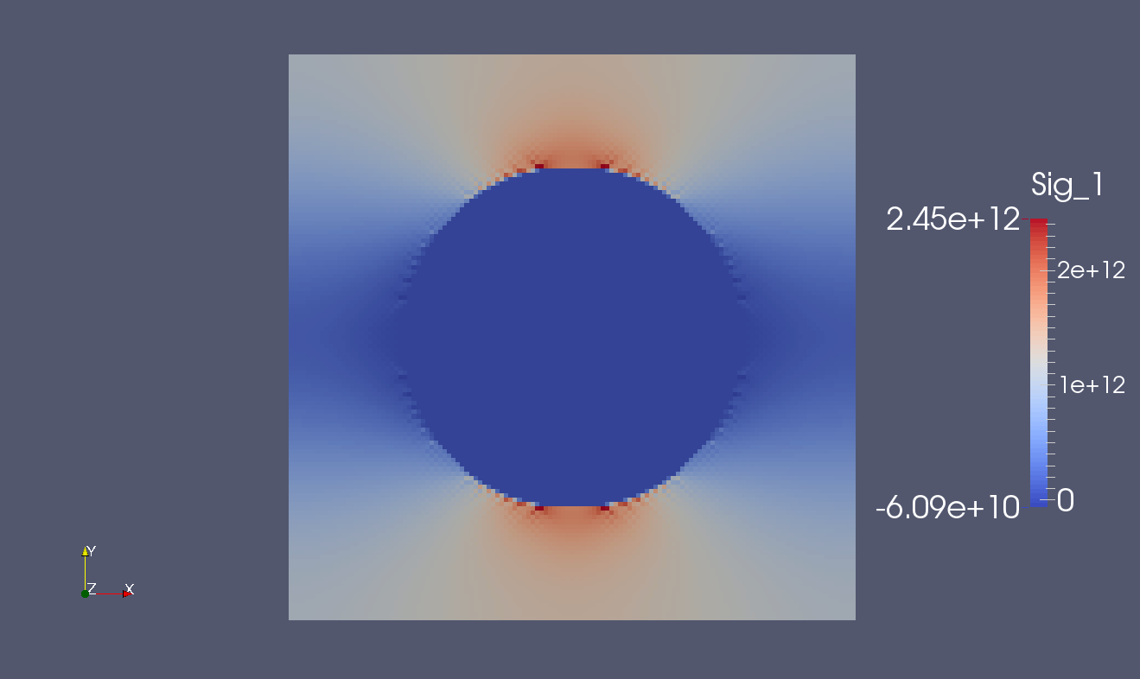
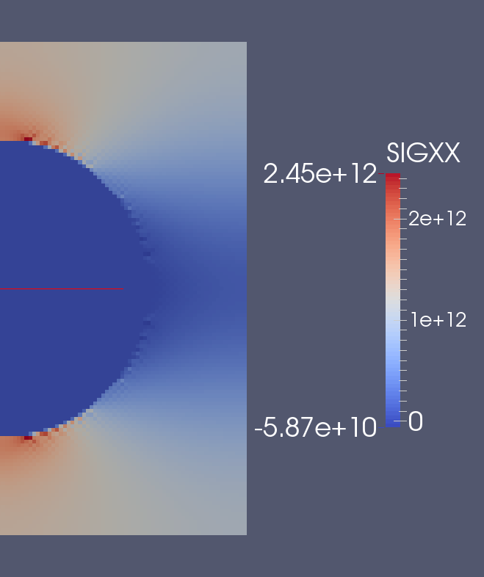


AMITEX « Standard »
Modified Discrete Green operator :
Cast3M
FFT
FEM
LINEAR Finite Element
with REDUCED INTEGRATION
AMITEX_FFTP
With modified DGO
Linear Elnt with Reduced Integr.
  AMITEX_FFTP : a FE method with an FFT-based solver
Notes:
In this code, we have implemented a convergence acceleration inspired from the FE code

Slide 12
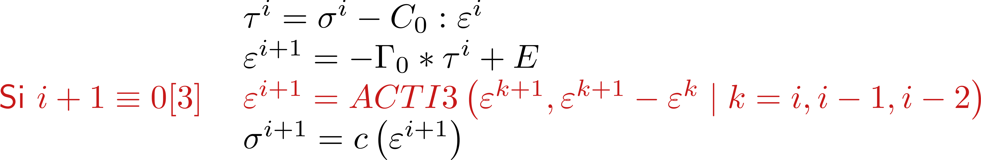
AMITEX « Standard »
ALGORITHM = Fix point + Convergence Acceleration (inspired from the FE code CAST3M ):
Implemented in 2014 (post-doc F. OUAKI)
Described in IJSS 2019, Chen, Gélébart & al.
$If i+1≡0\left[3\right] ε^{i+1}=ACV(ε^{k}$, $ε^{k+1}−ε^{k} | k=i,…,i−3)$
Memory : 4 couples (Residual/Solution) stored
Efficiency!
No need tangent behavior for non-linear problems!
Notes:
In this code, we have implemented a convergence acceleration inspired from the FE code

Slide 13
AMITEX « Standard »
Composite voxels
J. Comput. Physics, Gélébart, Ouaki, Filtering material properties to improve FFT-based methods for numerical homogenization
IJSS 2020a, Marano, Gélébart, Non-linear composite voxels for FFT-based explicit modeling of slip bands: Application to basal channeling in irradiated Zr alloys
Syntactic foam (PhD R. Charière, collab CEA-DRT)
IJSS 2020b, Charière, Marano, Gélébart
Evoid=0GPa
Eglass=69GPa
Epoly=1GPa
WITH COMPOSITE VOXELS
Notes:
We have also proposed and Implemented the concept of composite voxels, which are the voxels crossed by an interface,
The main adavantegves are :
A better description of the geometry for a given spatial resolution
A reduction of spurious oscillation as it is illustrated on the this figure
Considering the loading, we have introduce the possibility to apply strain gradient (not only the strain) but also any arbitrary Dirichlet BC,

Slide 14
AMITEX « Standard »
Boundary conditions : relaxing periodic BC
Uniform stress BC (Neumann) : straightforward in
Tensile test on tube (stress free BC)
IJSS2019, Chen & al
Internal pressure on tube
(uniform stress BC)
IJSS2019, Chen & al
    IJSS 2019, Chen, Gélébart & al. Analysis of the damage initiation in a SiC/SiC composite tube from a direct comparison between large-scale numerical simulation and synchrotron X-ray micro-computed tomography
Notes:
We have also proposed and Implemented the concept of composite voxels, which are the voxels crossed by an interface,
The main adavantegves are :
A better description of the geometry for a given spatial resolution
A reduction of spurious oscillation as it is illustrated on the this figure
Considering the loading, we have introduce the possibility to apply strain gradient (not only the strain) but also any arbitrary Dirichlet BC,

Slide 15
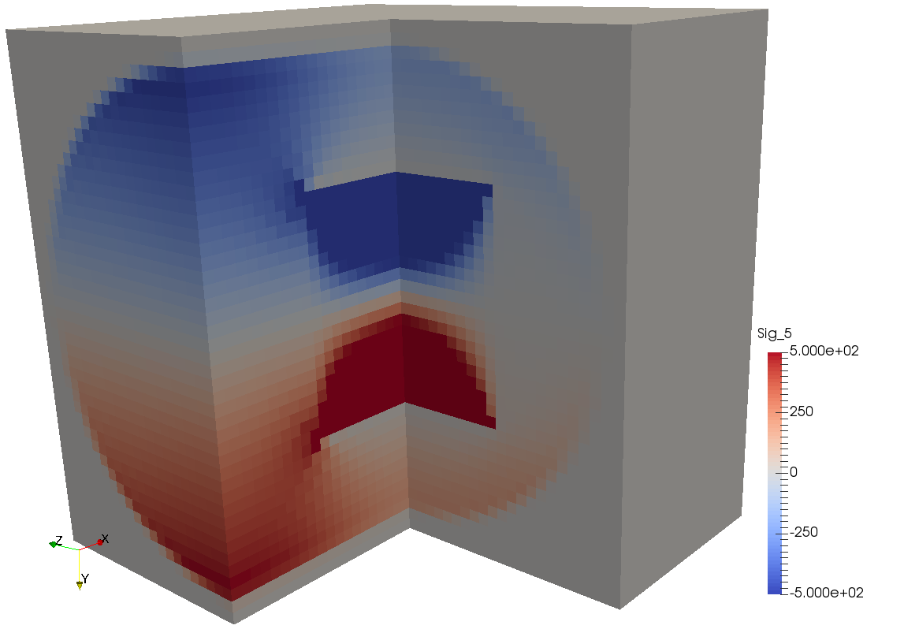
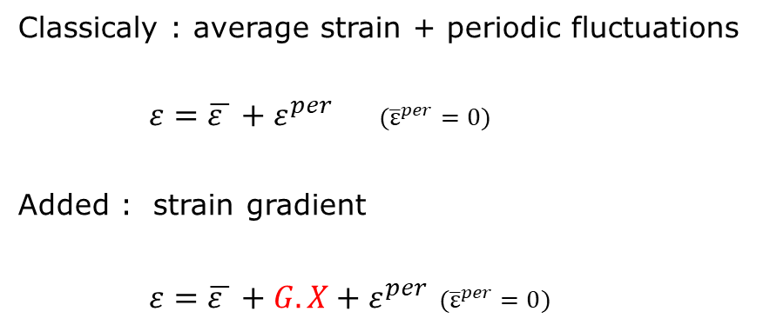
AMITEX « Standard »
Boundary conditions : Average Strain Gradient (beams and plates homogenization)
  JTCAM 2022, Gélébart, A simple extension of FFT-based methods to strain gradient loadings – Application to the homogenization of beams and plates with linear and non-linear behaviors
Classicaly : average strain + periodic fluctuations
$ε=\overline{ε }+ε^{per}$ $({\overline{ε}}^{per}=0)$
Added : strain gradient
$ε=\overline{ε }+G.X+ε^{per}$ $({\overline{ε}}^{per}=0)$
Beam bending (axial stress)
Linear & non-linear behaviors
Exemple of application :
homogenization of beams and plates
Notes:
We have also proposed and Implemented the concept of composite voxels, which are the voxels crossed by an interface,
The main adavantegves are :
A better description of the geometry for a given spatial resolution
A reduction of spurious oscillation as it is illustrated on the this figure
Considering the loading, we have introduce the possibility to apply strain gradient (not only the strain) but also any arbitrary Dirichlet BC,

Slide 16
AMITEX « Standard »
HPC ( scalability )
Distributed Memory
(MPI)
Behavior « local » in real space
Opérateur de Green « local » in Fourier space
FFT & iFFT « non-local »
Notes:
We have also proposed and Implemented the concept of composite voxels, which are the voxels crossed by an interface,
The main adavantegves are :
A better description of the geometry for a given spatial resolution
A reduction of spurious oscillation as it is illustrated on the this figure
Considering the loading, we have introduce the possibility to apply strain gradient (not only the strain) but also any arbitrary Dirichlet BC,

Slide 17
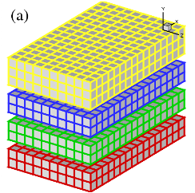
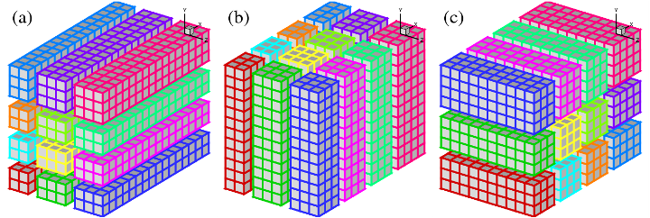
AMITEX « Standard »
HPC ( scalability )
Décomposition
1D decomposition (slabs)
2D decomposition (pencils)
http://www.2decomp.org/
Example :
Image 1000³
1000 process max
Example :
Image 1000³
1000x1000 process max!
FFT 3D = succession of 1D FFT
http://www.2decomp.org/
  Require to transpose datas
  Communications (MPI_ALLTOALL)!
    Librairie 2decomp
Notes:
We have also proposed and Implemented the concept of composite voxels, which are the voxels crossed by an interface,
The main adavantegves are :
A better description of the geometry for a given spatial resolution
A reduction of spurious oscillation as it is illustrated on the this figure
Considering the loading, we have introduce the possibility to apply strain gradient (not only the strain) but also any arbitrary Dirichlet BC,

Slide 18
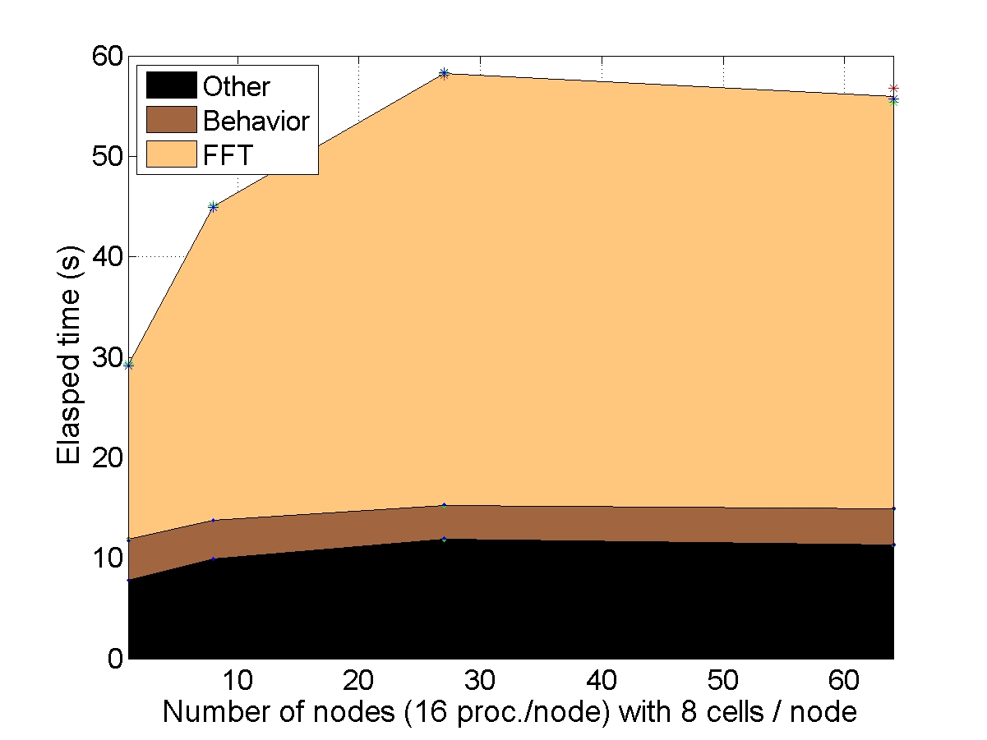
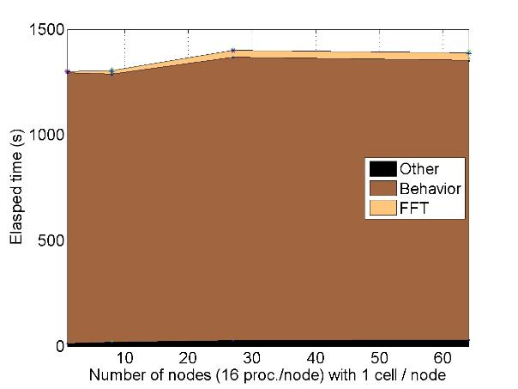
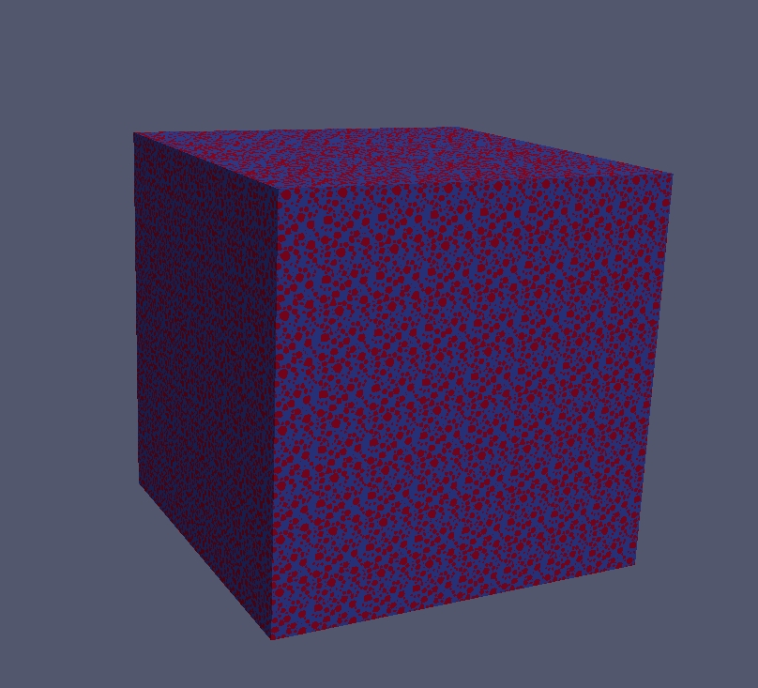
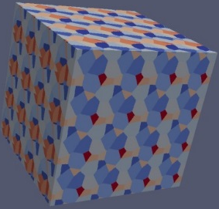
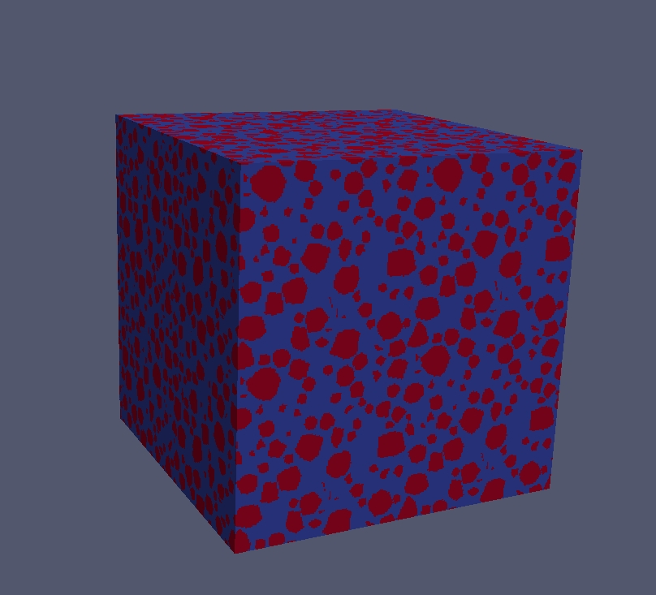


AMITEX « Standard »
HPC ( scalability )
  Scalability (weak)
Problem size = $αN_{nodes}$
Perfect scalability if “elapsed time” = cte
“light behavior”
Elasticity
“heavy behavior”
Crystal plasticity
1024³
512³
256³
128³
1 node
16 cores
64 nodes
1024 cores
1 node
16 cores
64 nodes
1024 cores
Notes:
We have also proposed and Implemented the concept of composite voxels, which are the voxels crossed by an interface,
The main adavantegves are :
A better description of the geometry for a given spatial resolution
A reduction of spurious oscillation as it is illustrated on the this figure
Considering the loading, we have introduce the possibility to apply strain gradient (not only the strain) but also any arbitrary Dirichlet BC,

Slide 19
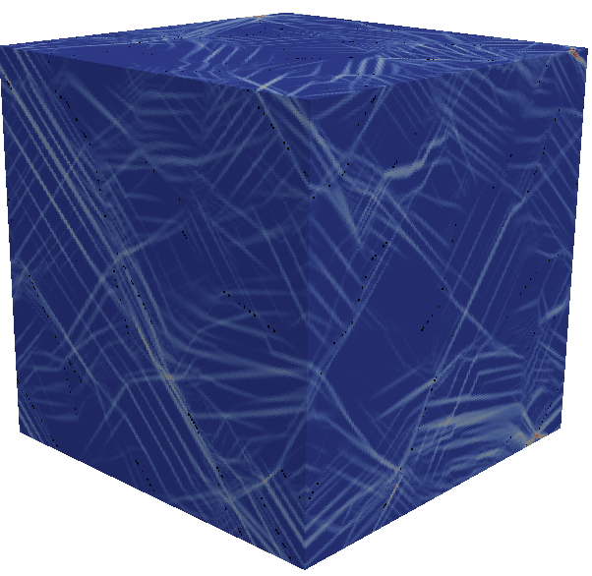
AMITEX « Standard »
Elastic behavior of syntactic foams (polypropylene matrix+ hollow glass microspheres) (light material for autmotive applications)
  PhD Romain Charière (coll. CEA-DES-LITEN Grenoble) – dec. 2019
    IJSS 2020, Charière, Marano, Gélébart, Use of composite voxels in FFT based elastic simulations of hollow glass microspheres/polypropylene composites
Damage mechanisms in SiC/SiC composites (genIV fuel cladding)
  PhD Yang Chen (coll. Ecole des Ponts, Navier) – Nov. 2017
    IJSS 2019, Chen, Gélébart & al. Analysis of the damage initiation in a SiC/SiC composite tube from a direct comparison between large-scale numerical simulation and synchrotron X-ray micro-computed tomography
    JECS 2020, Chen, Gélébart & al. Crack initiation and propagation in braided SiC/SiC composite tubes: Effect of braiding angle
7 billions voxels!
Simulation of intragranular plastic strain localization in polycrystals
  PhD Aldo Marano (coll. Ecole des Mines) – Nov. 2019
    Acta Materialia 2019, Marano, Gélébart, Forest, Intragranular localization induced by softening crystal plasticity: Analysis of slip and kink bands localization modes from high resolution FFT-simulations results
    IJSS 2020, Marano, Gélébart, Non-linear composite voxels for FFT-based explicit modeling of slip bands: Application to basal channeling in irradiated Zr alloys
    JMPS 2019, , Marano, Gélébart, Forest, FFT-based simulations of slip and kink bands formation in 3D polycrystals: Influence of strain gradient crystal plasticity
  CR Physique, 2021, Gélébart, Grain size effects and weakest link theory in 3D crystal plasticity simulations of polycrystals
Notes:
The code has been used by different PhD
Here to evaluate the elastic behaviors of syntactic foams for automotive applications
Here to analyse the damage mechanisms of SiC/SiC composites from a one-to-one comparison between Xray tomography and numerical simulation, here with 7billions of voxels (impossible with standard FE code)
The last point on strain localization will be detailled in the second focus.

Slide 20
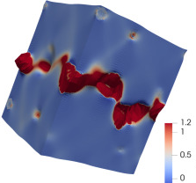
AMITEX « Standard »
Fracture in FCC materials
J. Hure & al. (Université Paris-Saclay, CEA)
Coalescence of Voids in single and polycrystals (infinite contrast + finite strain + crystal plasticity)
J. Appl. Mech. 2018, Barrioz, Hure, Tanguy, On void shape and distribution effects on void coalescence
MSE/A 2019, Barrioz, Hure, Tanguy, Effect of dislocation channeling on void growth to coalescence in FCC crystals
JMPS 2019, Hure, A coalescence criterion for porous single crystals
EJM 2021, Hure, Yield criterion and finite strain behavior of random porous isotropic materials
Stresses at grain boundaries to analyze intergranular cracking
Acta Materialia 2021, Liang, Hure & al., A micromechanical analysis of intergranular stress corrosion cracking of an irradiated austenitic stainless steel
Distribution of stresses at Grain Boundaries
3D EBSD
Stress field
Crystal Plasticity
Notes:
The code is also more and more used at CEA-DES
For example by J. Hure, and 3 of his PhD, supporting various publications.
We can mention
1/ the growth of void in crystals that gathers finite strain, crystal plasticity, and infinite contrats, which are not straightforward simulations…
2/ the evaluation of stresses at GB on an experimental microstructure with a high spatial resolution, possible with the efficient Parallel implementation of the code
The code is also used on oxyde uranium and zirconium alloys

Slide 21
AMITEX « Standard »
Application to the mechanical behavior of… Snow!
Input : 3D tomographic image of snow + segmentation
Behavior : crystal plasticity of ice (one orientation/grain)
Mechanical propertities vs snow density
Internship L. Vedrine @ Meteo France
Microstructure based modelling of snow visco plasticity
L. Védrine, A. Bernard, P. Hagenmuller, L. Gélébart, M, Montagnat, K. Fourteau
International Symposium on Snow 2022
P. Hagenmuller
M. Montagnat
| PAGE 20
Notes:
The code is also more and more used at CEA-DES
For example by J. Hure, and 3 of his PhD, supporting various publications.
We can mention
1/ the growth of void in crystals that gathers finite strain, crystal plasticity, and infinite contrats, which are not straightforward simulations…
2/ the evaluation of stresses at GB on an experimental microstructure with a high spatial resolution, possible with the efficient Parallel implementation of the code
The code is also used on oxyde uranium and zirconium alloys

Slide 22
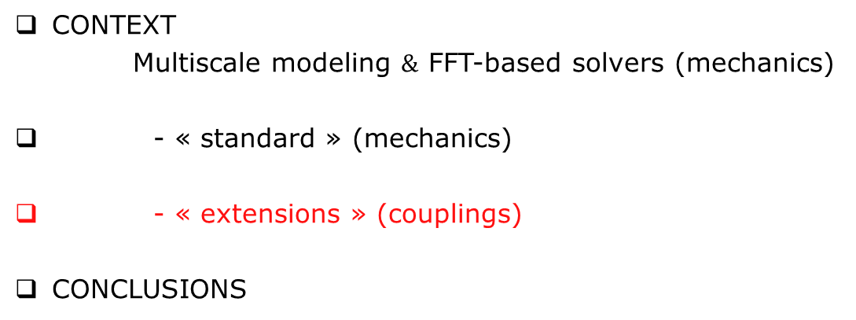
OUTLINE
CONTEXT
Multiscale modeling $\&$ FFT-based solvers (mechanics)
- « standard » (mechanics)
- « extensions » (couplings)
CONCLUSIONS
Notes:
After the context, I will introfuce the contributions : first on the development of the method and then on its application
Then I will finsh with on-going works and conclusions

Slide 23
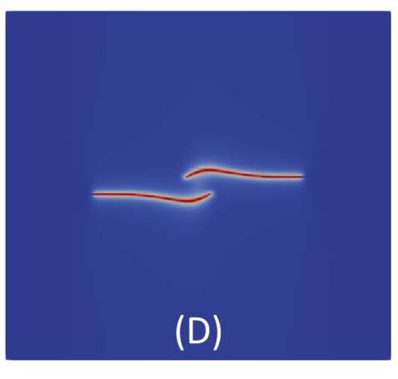
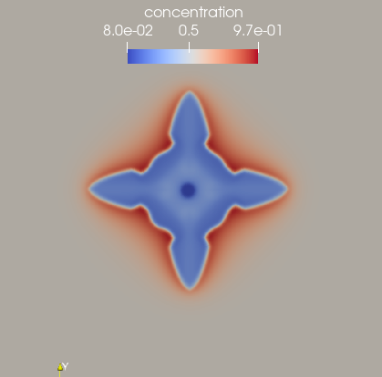
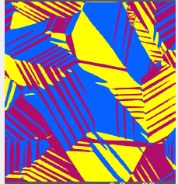
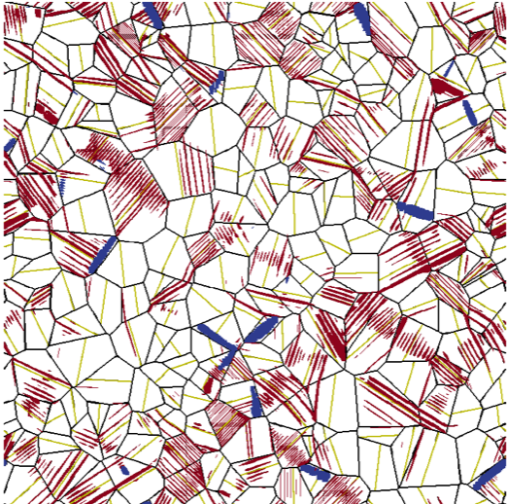
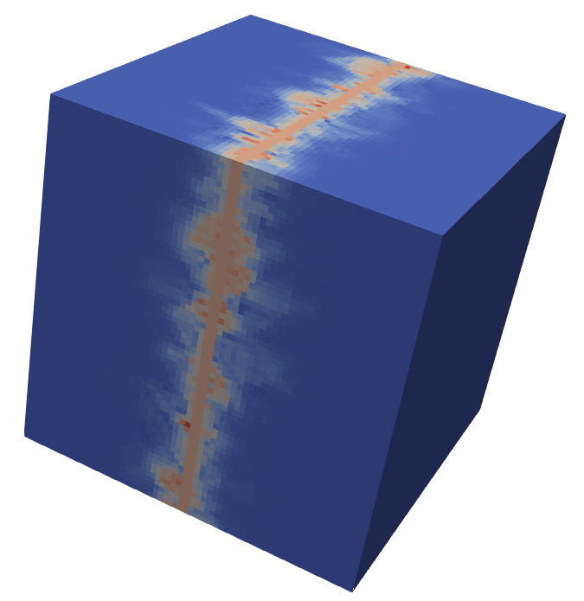
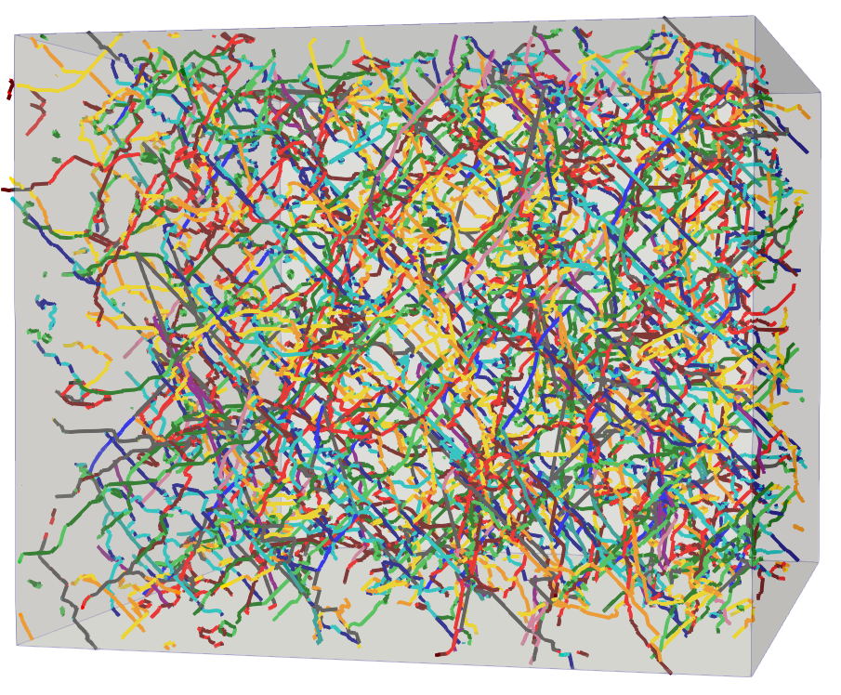

AMITEX « Extensions »
Various « Extensions » in progress…
Solid Phase Transformation such as $β→α$ in Ti, Zr…
Damage Phase Field
Amitex Multi-Scale
Solidification
Collab. Y. Chen
(now @Bath Univ.)
Collab, T. Pinomaa (VTT)
Collab J.Boisse
(LEMTA/ U. Lorraine)
Non-local Crystal plasticity
Flow in bi-porous media (Brinkman)
Transient Thermal
Simulations
DD coupling
Micromegas (ONERA)
Numodis (CEA – L. DUPUY)
Collab. U. Bath
(Y. Chen)
Notes:
The code is also more and more used at CEA-DES
For example by J. Hure, and 3 of his PhD, supporting various publications.
We can mention
1/ the growth of void in crystals that gathers finite strain, crystal plasticity, and infinite contrats, which are not straightforward simulations…
2/ the evaluation of stresses at GB on an experimental microstructure with a high spatial resolution, possible with the efficient Parallel implementation of the code
The code is also used on oxyde uranium and zirconium alloys

Slide 24
CONCLUSION
FFT-based solvers are of growing interest and use in the community
good position among available codes (versatile user interface, parallel implementation)
allows for original applications with High Resolution simulations
well-suited for various original extensions (non-local, coupling with phase-field, DD…)
Support of various collaborations :
Mines CDM-Evry (S. Forest, then H. Proudhon & D. Ryckelynck)
Ecole des Ponts – Navier (M. Bornert, C. Chateau)
Bath University (Y. Chen)
Université de Lorraine – LEMTA (J. Boisse)
VTT (Finland) (T. Pinomaa)
National and International diffusion :
ENSMA, ENSTA, Mines Saint-Etienne, IMT Lille, EDF (France)
    VTT (Finland), Illinois Univ (US), Bath Univ., Brystol Univ. (UK), Max Planck Garching (Germany), NCBJ (Poland), Harbin Inst. Tech., Shangai Jin Tong Univ. (China)
    And others…
Notes:
In terms of code that can be used for various applications, AMITEX_FFTP is probably one of the more interesting
Versatile user interface
Parallel implementations
Lots of recents improvements

Slide 25
  lionel.gelebart@cea.fr
  https://amitexfftp.github.io/AMITEX/
Notes:
The code is also more and more used at CEA-DES
For example by J. Hure, and 3 of his PhD, supporting various publications.
We can mention
1/ the growth of void in crystals that gathers finite strain, crystal plasticity, and infinite contrats, which are not straightforward simulations…
2/ the evaluation of stresses at GB on an experimental microstructure with a high spatial resolution, possible with the efficient Parallel implementation of the code
The code is also used on oxyde uranium and zirconium alloys

Slide 26
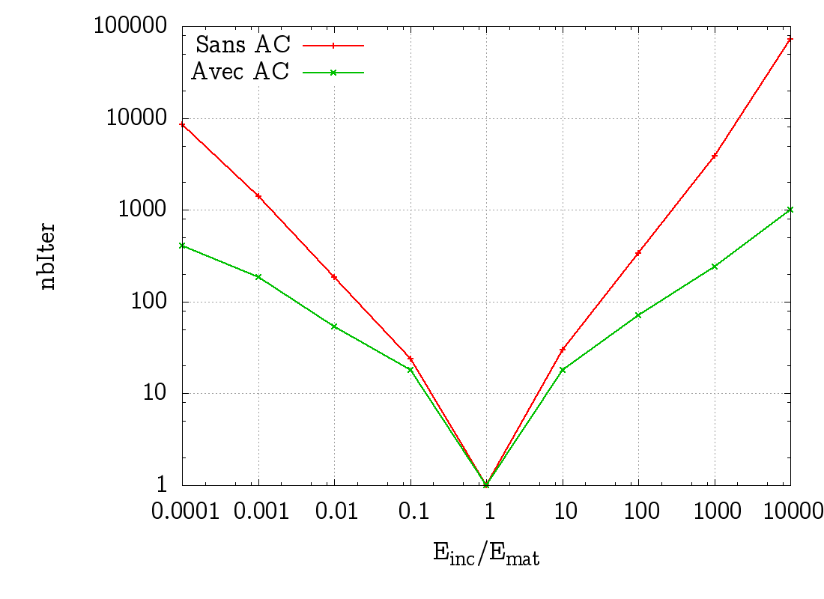
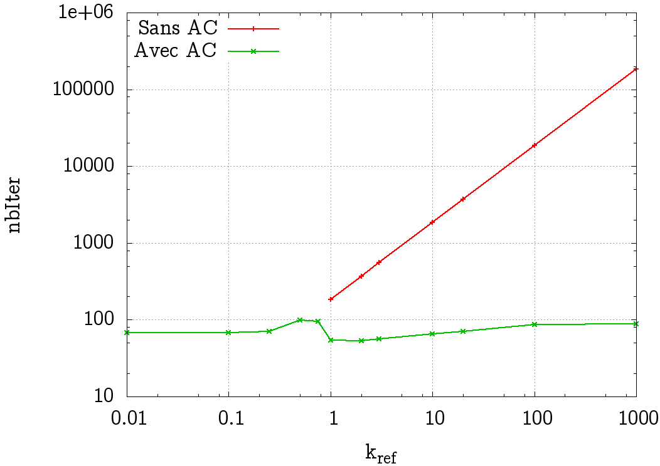
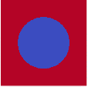

AMITEX « Standard »
ALGORITHM = Fix point + Convergence Acceleration (inspired from the FE code CAST3M ):
Implemented in 2014 (post-doc F. OUAKI)
Described in IJSS 2019, Chen, Gélébart & al.
$If i+1≡0\left[3\right] ε^{i+1}=ACV(ε^{k}$, $ε^{k+1}−ε^{k} | k=i,…,i−3)$
Memory : 4 couples (Residual/Solution) stored
Efficiency!
No need tangent behavior for non-linear problems!
Sensitivity to mechanical contrast
Sensitivity to Reference material
Notes:
In this code, we have implemented a convergence acceleration inspired from the FE code

Slide 27
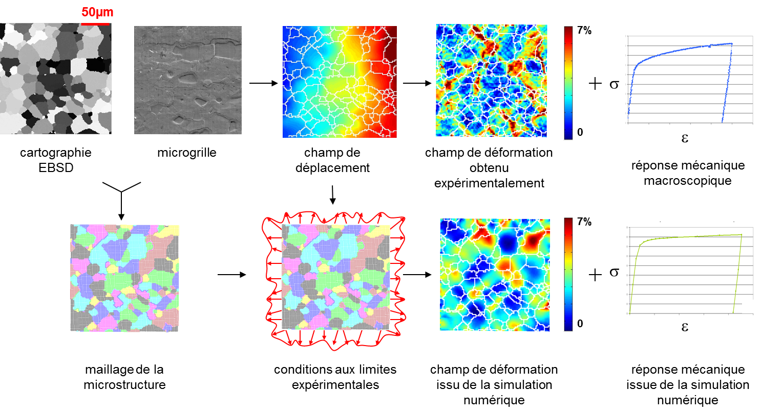
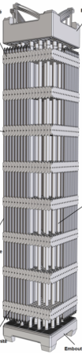
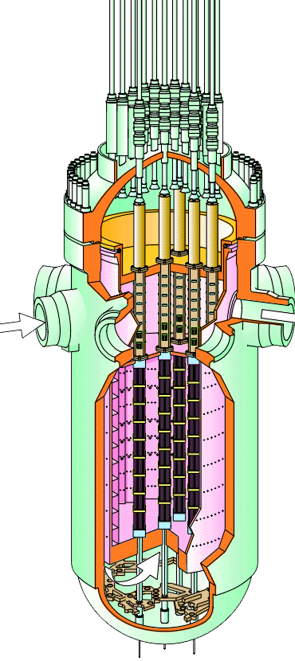
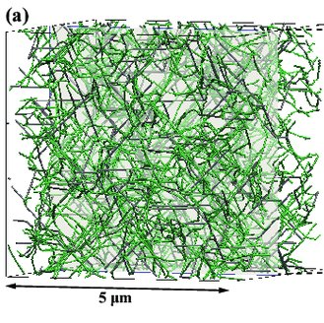
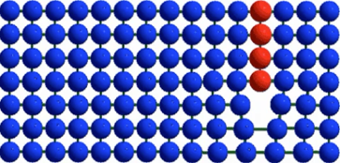

CONTEXT
2 – POSITION IN THE MULTI-SCALE APPROACH OF POLYCRYSTALS (for nuclear application)
Polycrystal (EBSD map)
Local strain field
Macroscopic Stress-strain curve
Tensile test
(~m)
(~mm)
(~µm)
(~nm)
$$σ=c:(ε−ε^{P})$$
Atomic
Disloc. Dyn.
Crystal Plasticity Law
Polycrystal
Structures
AMITEX
Notes:
In the case of polycrystal, the local strain fields and macroscopic behavior results from grain to grain interaction and the purpose of numerical simulation is to reproduce these interactions.
It takes as input the CP law, informed from DD, itself informed from atomic scale simulations.
On the other side, the output of the simulation will be used at the scale of the structure,

Slide 28
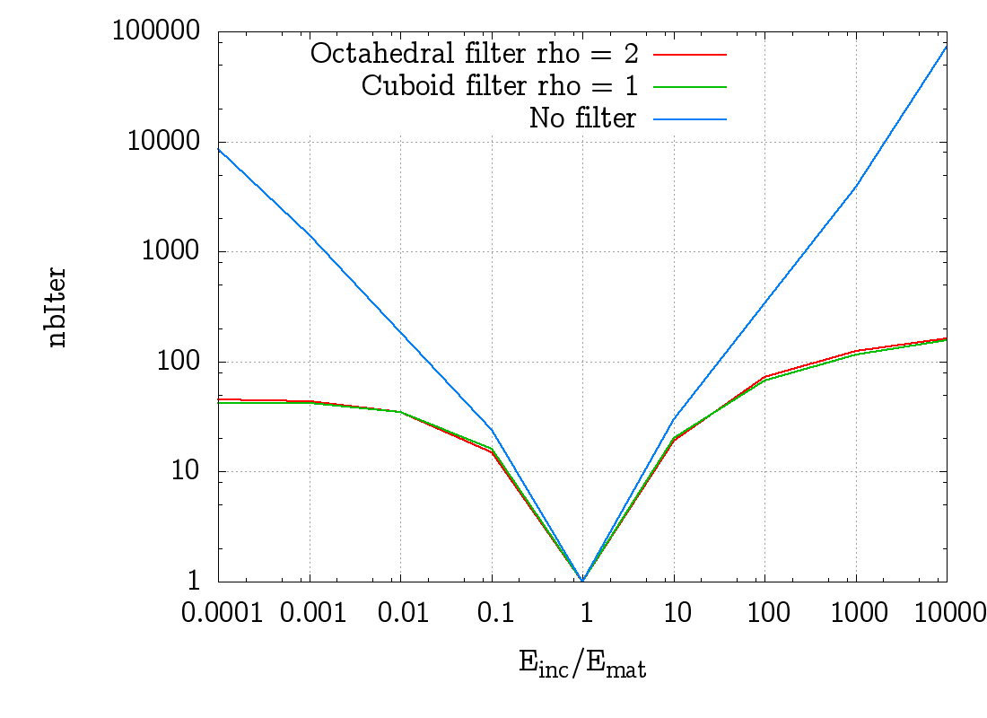




AMITEX « Standard »
Modified Discrete Green operator :
Convergence wrt
Elastic contrats
Classical DGO
Uniaxial Strain
Modified DGO
Classical DGO
Modified DGO
Notes:
In this code, we have implemented a convergence acceleration inspired from the FE code

Slide 29
AMITEX « Extensions »
FRAMEWORK FOR EXTENSION : in progress, only available for collaboration
once stabilized $→$ available for all
TRUNK
EXTENSION (PLUGIN)
Source code
amitex_fftp
(Branch master)
+
plugin_name
Compile
Executable
amitex_fftp
amitex_fftp_plugin
Writing a new plugin (i.e. extension) :
  Do not modify the TRUNK amitex_fftp
  Uses TRUNK for : Data input / output
Mechanical evolution
Generic functions
  Focuses on the new physics and/or coupling
| PAGE 28
Notes:
The code is also more and more used at CEA-DES
For example by J. Hure, and 3 of his PhD, supporting various publications.
We can mention
1/ the growth of void in crystals that gathers finite strain, crystal plasticity, and infinite contrats, which are not straightforward simulations…
2/ the evaluation of stresses at GB on an experimental microstructure with a high spatial resolution, possible with the efficient Parallel implementation of the code
The code is also used on oxyde uranium and zirconium alloys

Slide 30
AMITEX « Standard »
HPP and Finite Strains
HPP
Finite Strains
Initial configuration
IDENTICAL algorithms : UNIQUE implementation
Notes:
In this code, we have implemented a convergence acceleration inspired from the FE code

Slide 31
AMITEX « Extensions »
Standard algorithm (mechanics)
STANDARD ALGORITHM
Initializations
Loop over load increment
unpas (EPS0,SIG0, VARINT0 => EPS,SIG, VARINT)
update : EPS0=EPS, SIG0=SIG, VARINT0=VARINT
| PAGE 30
Notes:
The code is also more and more used at CEA-DES
For example by J. Hure, and 3 of his PhD, supporting various publications.
We can mention
1/ the growth of void in crystals that gathers finite strain, crystal plasticity, and infinite contrats, which are not straightforward simulations…
2/ the evaluation of stresses at GB on an experimental microstructure with a high spatial resolution, possible with the efficient Parallel implementation of the code
The code is also used on oxyde uranium and zirconium alloys

Slide 32
AMITEX « Extensions »
Standard algorithm (mechanics) + « user » functions
STANDARD ALGORITHM
Initializations + init_user_variables
Loop over load increment
before_unpas_user
unpas (EPS0,SIG0, VARINT0 => EPS,SIG, VARINT)
after_unpas_user
update : EPS0=EPS, SIG0=SIG, VARINT0=VARINT
New coupling = 4 fonctions
init_user_variables
before_unpas_user
after_unpas_user
umat (behavior)
| PAGE 31
Notes:
The code is also more and more used at CEA-DES
For example by J. Hure, and 3 of his PhD, supporting various publications.
We can mention
1/ the growth of void in crystals that gathers finite strain, crystal plasticity, and infinite contrats, which are not straightforward simulations…
2/ the evaluation of stresses at GB on an experimental microstructure with a high spatial resolution, possible with the efficient Parallel implementation of the code
The code is also used on oxyde uranium and zirconium alloys

